Slide 1


HSC Minimum Standard – Writing Test
What does a Level 3 response look like?
Notes:
This presentation will explain the alignment process associated with the HSC Minimum Standard Writing Test.

Slide 2

Contents
Contents
1. The Achievement Level Descriptions
2. What does the test involve?
3. Reviewing a sample response
Notes:
We will look at the Achievement Level Descriptions for writing, explore the test requirements and review a sample response.

Slide 3

Acknowledgement of Country
We acknowledge the Traditional Custodians of the various lands on which we work today and the Aboriginal and Torres Strait Islander people participating in this meeting.
We pay our respects to Elders past, present and emerging, and recognise and celebrate the diversity of Aboriginal peoples and their ongoing cultures and connections to the lands and waters of NSW.
Artwork by Danielle Mate, First Nations Artist and proud Murrawari & Euahlayi woman

Slide 4
The Achievement Level Descriptions
Writing
Reading
Learning
Oral communication
Numeracy
Audience, purpose and meaning making
The mechanics of writing
Notes:
The Achievement Level Descriptors for writing have been generated based on the Australian Core Skills Framework.
The ACSF identifies two main indicators of writing quality.

Slide 5
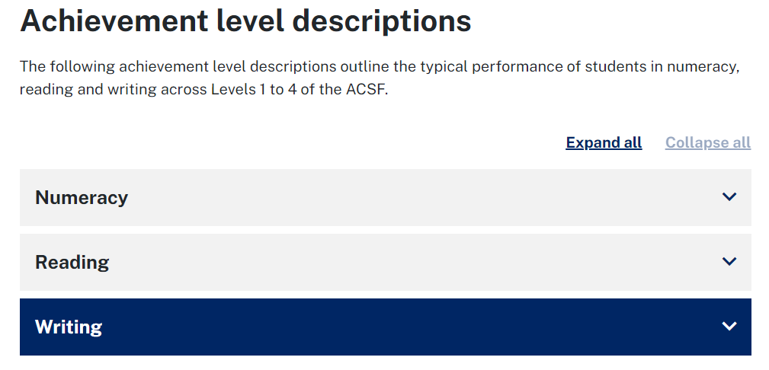
The Achievement Level Descriptions
To help teachers understand the skill level required for students to meet the HSC minimum standard, NESA has developed achievement level descriptions to describe what a typical student at level 3 can do in reading, writing and numeracy.
Notes:
The Achievement Level Descriptions are located on the NESA website.

Slide 6
The Achievement Level Descriptions: Level 3
Individuals performing at this level typically produce a range of familiar texts with appropriate grammatical structures and writing conventions.
They sequence writing to produce cohesive texts and vary language to suit the audience and purpose. They use a range of formal and informal language, and appropriate vocabulary with increasing precision for the audience and context.
They use tense appropriately, as well as simple, compound and some complex sentences. They use punctuation to aid understanding.
They spell frequently used words with reasonable accuracy, and use strategies to spell unfamiliar words
Notes:
The Achievement Level Descriptions are used holistically when assessing responses. Minimum standard is set at Level 3

Slide 7



The rubric
Answers are assessed on:
  relevance of writing to the topic
  structure and sequence of ideas
  control of language
Notes:
Students need to write a response which is relevant to the topic, yet they are not required to demonstrate subject specific knowledge.
Students typically use paragraphing to structure their response but other sequencing methods to show the development of ideas are valid.
Overall, students need to show that they can manipulate language to convey meaning and demonstrate a functional degree of literacy.

Slide 8

What does the test involve?
  The suggested word count is 500 words
500 words
✓
Under 500 words
Notes:
In many cases, students are able to demonstrate minimum standard in under 500 words.

Slide 9

What does the test involve?
  Students are issued with two prompts, one of which has a visual element, from which they must choose one to write.
Compose a piece of writing about your dream job, explaining why this job would suit you.
OR
Compose a piece of writing about your favourite time of the day.
Notes:
Students are directed to compose a piece of writing on ONE of two options: a written prompt or a visual prompt.

Slide 10
Aligning responses to the Achievement Level Descriptions
  The following sample will be aligned to the Achievement Level Descriptions.
  Prompt:
  Compose a piece of writing about your dream job, explaining why this job would suit you.
Notes:
A student sample will now be aligned and reasons for the decision will be explained. Please read the sample which continues over the next 3 slides.

Slide 11
Sample answer: Carpenter (Page 1 of 3)
My dream job would be to own a carpentry buisness, this would be a very good thing thing to happen in my life because there will allways be houses, structures and buildings to build. This job would suit me bacause I allways loved building things such as cubbyhouses and sheds. Ever sience I did my first week of work experience as a carpenter I knew this job was for me.
Firstly, as a owner of a buisness my boss would be my self which means i will have no one in charge of me and I can do what i think is neccaserry for my buisness. Being my own boss means that everyone working for me has to listen to me which gives me the free will to tell people what they need to do so they can get the job done. I would also be a fair boss and not over work my workers, while giving them a good waige. As well as working in office i would try to get my hands dirty on site and give out helping hand to who ever needs it.
Notes:
Insert audio: Please read this response.

Slide 12
Sample answer: Carpenter (Page 2 of 3)
Secondly, in this prefesion there are never is a lack of jobs, there is allways something that needs to be renovated or rebuilt. Capentry is a job that will allways be needed and will allways have new employees ready to work. As a plus side it is good to see people learning the skills they need to get through life such as the value of money, and the value of hard work.
Thirdly, In my buisness i would have it on the residential side of building because you wouldn't have to deal with largers companys and big coperrations who think there better than you. Sticking to residential would mean i would have to only deal with one person ussally the one who owns the house and that means i just have to listen to what he or she wants.

Slide 13
Sample answer: Carpenter (Page 3 of 3)
Finally, although having a buisnses would be great now i'm much to young to own and I would need to finish my appreticeship as a carpeter to get the life lessons I need to do such a thing. I would also like to compete a buisness course at uni or tafe before i think about owning my own. With a buisnes i might loose money, friendships and mental health, but i think that one day it would all be worth it in the end.
The reason why i came to these conclusions is because of the people I know. My father use to own a electrical buisness which he had to sell due to stress, but he still learned life lessons which improved him as a better person and father. That is why my dream job would be to own a carpentry buisnes.

Slide 14
What level is this response?
Answer: Level 3
It is a cohesive, persuasive piece of writing which is relevant to the topic.
The response is well sequenced, but the structure and paragraphing are somewhat formulaic
Complex sentences are attempted with some success
Language is manipulated to support the communication of ideas.
Notes:
This annotation explains why a Level 3 is applied to the sample response.

Slide 15
Sample: Carpenter
Sample: Carpenter
My dream job would be to own a carpentry buisness, this would be a very good thing thing to happen in my life because there will allways be houses, structures and buildings to build. This job would suit me bacause ....
Firstly, as a owner of a buisness my boss would be my self which means i will have no one in charge of me and I can do what i think is neccaserry for my buisness. Being my own boss means that everyone working for me has to listen to me which gives me the free will to tell people what they need to do so they can get the job done. I would also be a fair boss and not over work my workers, while giving them a good waige. As well as working in office i …
Legend
Writing prompt addressed
Complex sentences
Grammatical inconsistencies
Incorrect spelling of familiar words
Inconsistent use of punctuation
Notes:
Complex sentences are attempted
There is a sense of audience awareness and an attempt to communicate purposefully.
The grammar is mostly correct with some minor errors in subject-verb agreement
Notes:
Let’s look more closely at the response to understand why it meets the characteristics of Level 3.
The writing prompt is addressed immediately as highlighted in green, and ideas of relevance are used throughout the response.
In the yellow, the capacity to form complex sentences is displayed, yet sentence control is hampered by some run on sentences - exemplified here.
Also, in blue, some grammar inconsistencies are highlighted and
in violet, there is the incorrect spelling of a familiar word.
In pink, the correct use of commas is inconsistent as is the application of capitalisation rules.

Slide 16

Sample: Carpenter
Sample: Carpenter
Secondly, in this prefesion there are never is a lack of jobs, there is allways something that needs to be renovated or rebuilt. Capentry is a job that will allways be needed and will allways have new employees ready to work. As a plus side it is good to see people learning the skills they need to get through life such as the value of money, and the value of hard work.
Thirdly, In my buisness i would have it on the residential side of building because you wouldn't have to deal with largers companys and big coperrations who think there better than you. Sticking to residential would mean i would have to only deal with one person ussally the one who owns the house and that means i just have to…
Legend
Writing prompt addressed
Complex sentences
Grammatical inconsistencies
Incorrect spelling of familiar words
Inconsistent use of punctuation
Notes:
There is a sense of audience awareness and a strong attempt to communicate purposefully.
The grammar is mostly correct with some minor errors in subject-verb agreement and in the use of prepositions and articles.
Notes:
In green, a technique to sequence the text is used despite it being formulaic
In purple, vocab precision is displayed
In the blue, we can see irregularities in the tense used and with the use of grammatically appropriate word forms.
In yellow, different sentence types are used, however, control of sentence formation is problematic in some places as illustrated here in pink.

Slide 17
Sample: Carpenter
Sample: Carpenter
Finally, although having a buisnses would be great now i'm much to young to own and I would need to finish my appreticeship as a carpeter to get the life lessons… With a buisnes i might loose money, friendships and mental health, but i think that one day it would all be worth it in the end.
The reason why i came to these conclusions is because of the people I know. My father use to own a electrical buisness which he had to sell due to stress, but he still learned life lessons which improved him as a better person and father.
That is why my dream job…
Legend
Writing prompt addressed
Complex sentences
Grammatical inconsistencies
Incorrect spelling of familiar words
Inconsistent use of punctuation

Notes:
Tense changes are mostly appropriate.
Vocabulary is appropriate and includes some precise words relating to the topic.
There is some understanding of punctuation but commas are inconsistently used and, at times, punctuation is not used to effectively aid understanding.
Notes:
In blue, grammatical errors can be seen.
In some places, punctuation is missing. Some are highlighted in pink.
Attention to structure and idea sequencing is shown in green.
In violet, we can see some control of language in the vocab helps to communicate the ideas. And in yellow, we can see that the writer is able to form complex sentences with some success.
While there are faults illustrated in this sample, when the achievement level descriptors are applied holistically, performance is typical of Level 3.

Slide 18
For more information
Visit the HSC Minimum Standard section of the NESA website. or
Email: lnsupport@nesa.nsw.edu.au
Phone: 1800 200 955
Notes:
Please visit the NESA website for more information.

