Slide 1
Grants Administration Guide
Notes:
This training is intended to provide an overview of the Grants Administration Guide. It is is important that you familiarise yourself with the detailed information and requirements set out in the Guide.
The slides are broken up into sections – so you can minimise sections that you may already be familiar with or do not want to focus on.

Slide 2
Contents
Overview | 4. Key principles of grants administration
What does the Guide cover? | Seven key principles
Compliance with the Guide | Grants must always serve a public purpose
2. Responsibilities | 5. Process of grants administration
Ministers | Planning and promoting grant opportunities
Officials | Assessing applications and providing grants
Ministerial staff | Publishing information, monitoring and evaluation
3. What is a grant? | 6. Contacts and additional resources

Slide 3
Overview
1

Slide 4
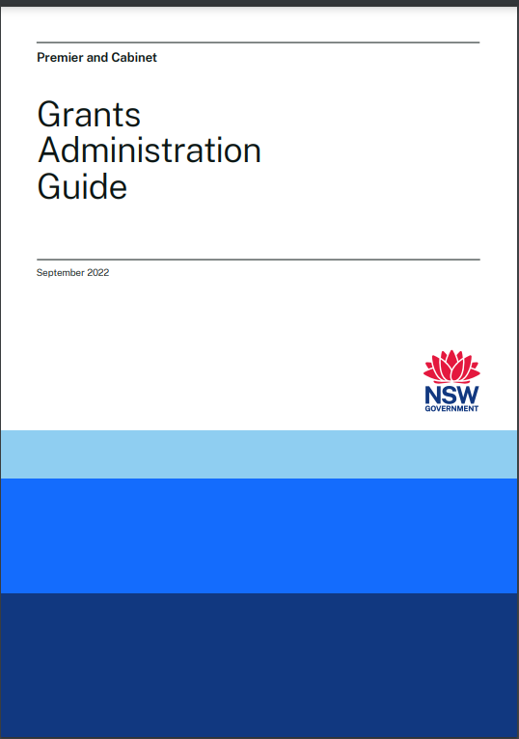
Overview
The Grants Administration Guide was developed as part of the Review of Grants Administration in NSW, led by DPC in partnership with the NSW Productivity Commissioner, Mr Peter Achterstraat AM.
The Guide came into effect when it was issued under a Premier’s Memorandum and gazetted on 19 September 2022.
The Guide provides:
an overview of the grants administration process
overarching principles that apply to all NSW Government grants
mandatory requirements for administering grants.
Notes:
The Guide and a range of supplementary resources is available on the following webpage –
https://www.nsw.gov.au/grants-and-funding/grants-administration-guide

Slide 5
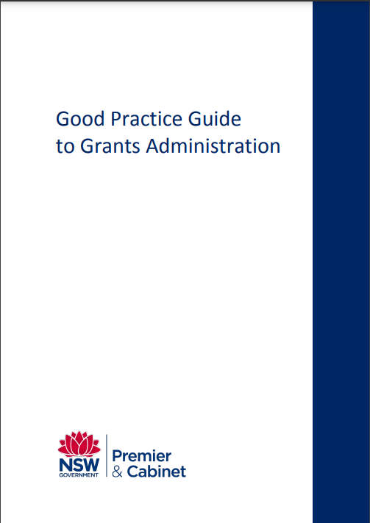
How does the Grants Administration Guide compare to the Good Practice Guide?
The Grants Administration Guide replaced the Good Practice Guide.
The two guides are substantially different – the Grants Administration Guide is not merely an updated version of the Good Practice Guide.
While the Grants Administration Guide draws on elements of the Good Practice Guide, it is more closely aligned with the Commonwealth Grants Rules and Guidelines 2017 (the Commonwealth’s grants policy framework).
Notes:
The Grants Administration Guide is not a minor update or refresh of the Good Practice Guide – it replaces the Good Practice Guide with a new Guide that draws on but is not based on the previous Guide. The Grants Administration Guide is more closely aligned with the Commonwealth Grants Rules and Guidelines 2017 than the Good Practice Guide.

Slide 6
Key changes from the Good Practice Guide
Grants Administration Guide | Good Practice Guide
Applies to officials, Ministers and ministerial staff | Applies only to officials
Principles-based approach | Focus on ensuring good process
Mandatory requirements | Good practice, tools and resources for grant program managers
Compliance is a legislative requirement | Enforceable as issued under a circular (which applies to agencies and their staff)
Notes:
Some key differences between the Grants Administration Guide and the Good Practice Guide are:
The application of the Guide is extended. While the Good Practice Guide only applied to officials, the Grants Administration Guide applies to officials, Ministers and ministerial staff.
The Grants Administration Guide also takes a principles-based approach to grants administration – key principles (such as accountability and transparency) that apply to all elements of grants administration are outlined in Section 5 of the Guide. In contrast, the Good Practice Guide focused on good process in each stage of the grant process.
The Grants Administration Guide also includes mandatory requirements. In contrast, the Good Practice Guide provided information on good practice, tools and resources for each stage of the grants cycle for grant program managers to consider.
Compliance with the Grants Administration Guide is a legislative requirement under section 31 of Schedule 1 to the Government Sector Finance Act 2018 (NSW) (GSF Act). The Good Practice Guide was enforceable as it was issued under a DPC Circular, but that Circular only applied to agencies and agency staff.

Slide 7
Structure of the Guide
Sections 1 and 2 – overview and key definitions.
Section 3 – overview of responsibilities of Ministers, Ministerial staff and officials (these are detailed further in Sections 5 and 6)
Section 4 – defines what a grant is
Section 5 – key principles
Section 6 – process for administering grants and specific requirements for Ministers, Ministerial staff and officials

Slide 8
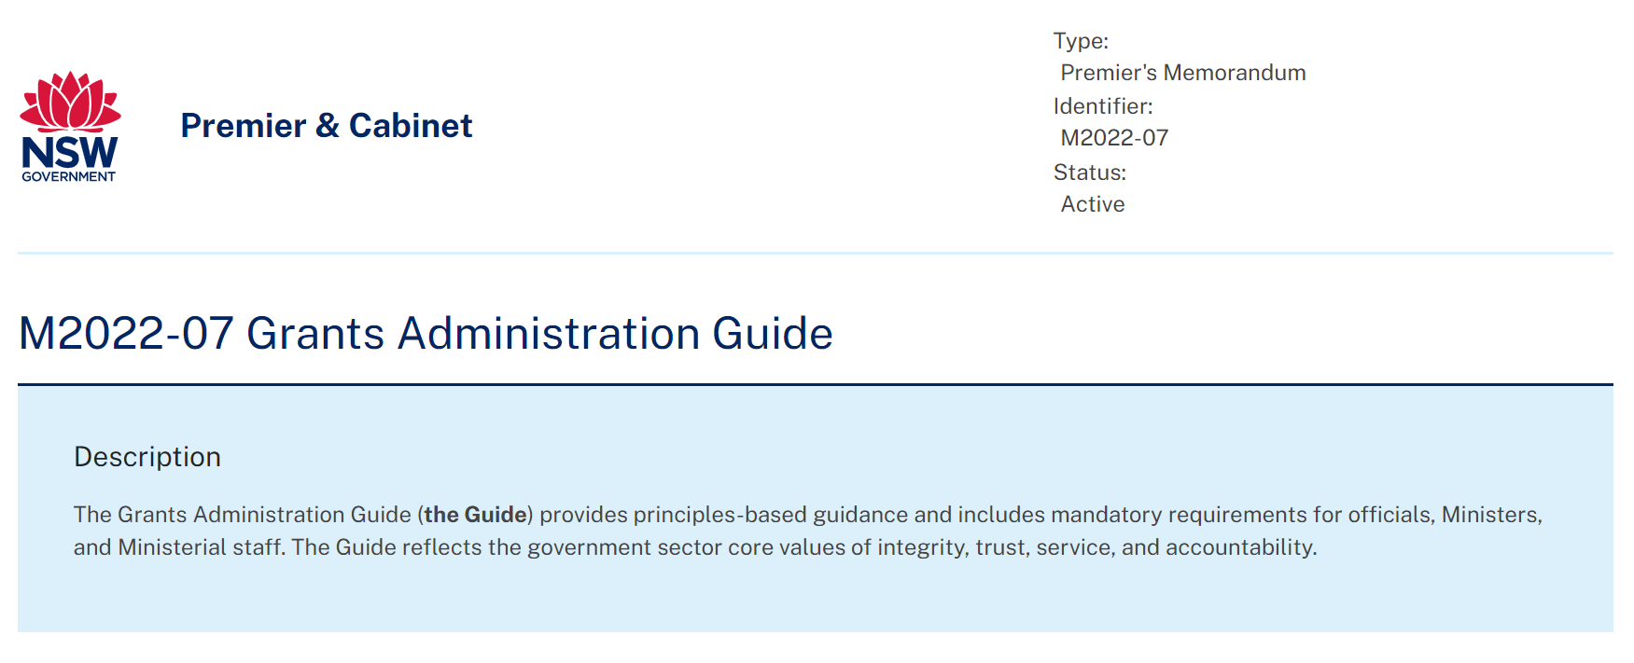
Compliance with the Guide
The Guide is published under Premier’s Memorandum M2022-07 and applies to:
Ministers, officials (government sector employees) and Ministerial staff
all grants administered by the government sector (not local government or State Owned Corporations).
Compliance with the Guide is a legislative requirement under the Government Sector Finance Act 2018 (NSW).
If local government or another third party administers grants on behalf of NSW Government, officials must be satisfied that the administration of grants is consistent with the key principles and requirements of the Guide.
The Guide sits alongside other requirements that apply to the expenditure of public money in NSW, as well as laws and policies that govern ethical behaviour.
Notes:
The Guide applies to Ministers, officials (government sector employees – as defined in the GSE Act, excluding employees of State Owned Corporations) and Ministerial staff.
The Guide applies to all grants administered by the NSW government.
Compliance with the Guide is a legislative requirement under section 31 of Schedule 1 to the Government Sector Finance Act 2018 (NSW) (GSF Act).
The Guide does not apply to local government or State Owned Corporations. However, where local government or other third parties administer grants on behalf of the NSW Government, officials must satisfy themselves that there are practices and procedures in place for the administration of the grants consistent with the key principles and requirements of the Guide, with appropriate adaptations as necessary.
Boards and other committees established under NSW legislation may be involved in grants administration, including by providing advice to Ministers or officials who exercise the expenditure functions of government. The Guide applies to Ministers and officials carrying out those functions. All parties involved in grants administration for or on behalf of the NSW Government are encouraged to adhere to the Guide.
The Guide sits alongside other requirements that apply to the expenditure of public money in NSW, as well as laws and policies that govern ethical behaviour. The Guide does not affect the requirements of those laws and policies, and officials, Ministers and Ministerial staff must ensure that they comply with all relevant laws and policies when administering grants. The key requirements of that legislative and policy framework are set out at 1.4 of the Guide – e.g. the GSF Act requires that the expenditure of money must be ‘authorised’, the Government Sector Employment Act 2013 (NSW) establishes the Ethical Framework for the government sector, and the State Records Act 1998 (NSW) requires public offices (including agencies and Ministerial offices) to keep full and accurate records of the activities of the office.

Slide 9
Responsibilities
2
Notes:
This section outlines the responsibilities of Ministers, officials and Ministerial staff. These responsibilities are primarily located in Sections 5 and 6 of the Grants Administration Guide and are summarised in Section 3 of the Guide.

Slide 10
Ministers
Compliance with the Guide (including to promote compliance to Ministerial staff and officials)
Mandatory requirements:
Administer the grant in accordance with grant guidelines
Cannot approve or decline a grant without first receiving written advice from officials on the merits of the proposed grant or group of grants
Record the decision (to approve or decline a grant) in writing, including the reasons for the decision (and any departure from the recommendation of officials)
May approve the awarding of a grant, or opening of a grant opportunity, using a method other than a competitive, merit-based assessment process but must have regard to the advice of officials and document the reasons for selecting the alternative process.
Notes:
Compliance – Ministers must comply with the Guide and promote compliance with the Guide to Ministerial staff and officials
Ministers must comply with the following mandatory requirements:
Administer the grant in accordance with grant guidelines
Cannot approve or decline a grant without first receiving written advice from officials on the merits of the proposed grant or group of grants
Record the decision (to approve or decline a grant) in writing, including the reasons for the decision (and any departure from the recommendation of officials), having regard to the grant guidelines and the key principle of achieving value for money, and manage these records in accordance with the requirements of the SR Act (see exceptions at 6.3 Receiving and assessing grant applications for non-competitive grants)
A Minister (or delegate) may approve the awarding of a grant, or opening of a grant opportunity, using a method other than a competitive, merit-based assessment process. The decision-maker must have regard to the advice of officials and must document the reasons for selecting the alternative process

Slide 11
Officials
Compliance with the principles and processes in the Guide
Full and frank advice to Ministers
Comply with mandatory requirements in relation to:
Planning and designing grant opportunities
Assessment and decision-making
Providing grants and publishing grant information
Notes:
Compliance – officials must comply with the Guide as well as other applicable laws and policies
Provide full and frank advice to Ministers about grants, grants processes and decision-making
Comply with the mandatory requirements set out in the Guide in relation to:
Planning and designing grant opportunities
Assessment and decision-making
Providing grants and publishing grant information
A checklist for officials on the requirements of briefing the decision maker is available to download from on the Grants Administration Guide webpage.

Slide 12
Ministerial staff
Compliance with the Guide
Mandatory requirements:
Put practices and procedures in place to ensure Ministerial involvement in grants administration is consistent with the key principles and requirements in the Guide
Where a Minister is the decision-maker, ensure that the decision is recorded in writing and records are managed in accordance with the State Records Act 1998 (NSW).
Notes:
Compliance – officials must comply with the Guide as well as other applicable laws and policies
Comply with the following mandatory requirements:
Ministerial staff must put in place practices and procedures to ensure that Ministerial involvement in grants administration is conducted in a manner that is consistent with the key principles and requirements in the Guide
Where a Minister is the decision-maker, Ministerial staff must ensure that the decision is recorded in writing and the records are managed in accordance with the requirements of the State Records Act 1998 (NSW)
A Protocol for Grants Administration in NSW Ministerial Offices has been developed and is available on the Grants Administration Guide webpage, as is a grants decision making register.

Slide 13
What is a grant?
3
Notes:
This section focuses on definition of Grant. This information is detailed in Section 4 of the Grants Administration Guide.

Slide 14
Definition
A grant is an arrangement for the provision of financial assistance by the NSW Government (or on behalf of the NSW Government) whereby money:
is paid to a grantee other than the NSW Government
is intended to help address one or more of the NSW Government’s policy outcomes
is intended to assist the grantee to achieve its objectives
does not result in the return of goods or services by the grantee of an equivalent value to the NSW Government (i.e. it is a non-reciprocal exchange).
Notes:
The Guide provides a broad definition but excludes certain types of financial arrangements.
In order to determine if what you are dealing with is a grant for the purposes of the Grants Administration Guide, consider:
Does it meet the four criteria set out on this slide?
If so, does it fall within one of the exclusions from the definition (set out on the next slide)?

Slide 15
A grant does not include
the purchase of goods and services for the direct use or benefit of the NSW Government (i.e. procurement or tender)
engaging another party to carry out work on behalf of the NSW Government (i.e. commissioning)
a gift of public property
ex gratia and act of grace payments made to persons who have suffered a financial or other detriment as a result of the workings of government
a payment to a person of a benefit or an entitlement established by legislation
an arrangement that is explicitly for the purpose of the transfer of funds and/or assets between NSW Government entities or SOCs
a tax concession or offset
a loan provided on commercial
a payment of remuneration, compensation or damages
a payment from the Commonwealth where the NSW Government is used as an intermediary to distribute funds to other parts of government or to non-government entities
a scholarship
a sponsorship arrangement in which the NSW Government provides money to an organisation or individuals to carry out a particular event or activity in return for sponsorship rights.
Notes:
A ‘What is a grant?’ fact sheet will shortly be available to download from the Grants Administration Guide webpage.

Slide 16
Key principles of grant administration
4
Notes:
This section focuses on the 7 key principles that should underpin all aspects of grant administration. These key principles are detailed in Section 5 of the Grants Administration Guide.

Slide 17
Key principles
Collaboration and partnership
Value for money
Robust planning and design
Outcomes orientation
Probity and transparency
Proportionality
Governance and accountability
Notes:
The Guide adopts the 7 key principles to be applied in administering grants as set out in the Commonwealth Grants Rules and Guidelines 2017. These principles reflect government sector core values. Officials must put in place practices and procedures to ensure grants are administrated consistent with the key principles:
Robust planning and design
Collaboration and partnership
Proportionality
An outcomes orientation
Achieving value with relevant money
Governance and accountability
Probity and transparency

Slide 18
1. Robust planning and design
Grants should meet identified needs.
In your planning, consider:
is a grant the best vehicle to achieve policy objectives?
the rationale for the grant
co-design opportunities with grantees and stakeholders
costs and benefits
taxation/accounting treatments
commercial considerations
management issues (e.g. risk management).
Notes:
Robust planning and design is important to facilitate fair, effective and transparent grants administration.
Ensure grants meet identified needs and deliver value for money.
Ensuring grants are strategic – including considering if a grant is the best vehicle to achieve policy objectives.
In considering options for the design of the grant, consider:
Rationale for the grant and how it will meet objectives
Potential for co-design with prospective grantees and stakeholders
Expected costs and benefits
Taxation or accounting treatments
Commercial considerations (e.g. funding strategy and grant agreement)
Management issues (i.e. engaging with stakeholders; risk management; accountability; application and selection processes; the role of decision-makers; performance measures; monitoring and evaluation; documentation; applicable legal, policy and governance requirements).

Slide 19
2. Collaboration and partnership
Plan early to ensure that grants are fit for purpose and address identified stakeholder needs.
Consider the interaction of grants with other funded opportunities.
Collaborate with other agencies and levels of government to ensure clear lines of responsibility.
Consult to identify and address risks – this will improve the design and delivery of grants.
Notes:
Collaboration with stakeholders is important and their needs should be considered in the development of grant opportunities. It should not be assumed that the same approach will suit all grant opportunities.
Consider how the grant will – or could – interact with other funded activities – particularly where there are similar policy outcomes.
Collaboration and partnership is particularly critical when grants administration is shared between different agencies or levels of government, or when a third party is responsible for grants administration.
Early consultation can:
Improve the design and delivery of grants
Reduce duplication
Improve the responsiveness, flexibility and relevance of grants
Reduce administration costs
Support the appropriate responsibility for costs and risks among stakeholders
Support the development of appropriate outputs, accountability requirements, governance structures and documentation for the grant
Assist potential grantees to understand the grants administration process
Co-design of grants with stakeholders (allowing stakeholders to have input on the design of the grant opportunity) may be appropriate in some cases to ensure grants meet identified needs.

Slide 20
3. Proportionality
Customise the administration of grants with regard to their scale and complexity.
Grant guidelines, application processes, grant agreements and reporting and acquittal requirements should be tailored to the particular grant.
For example, the volume, detail and frequency of grant reporting requirements, and rigour of acquittal procedures should be proportional to the risks involved and the intended policy outcomes.
There may be opportunities to reduce the burden of reporting requirements, while managing risks.
Any consideration of proportionality in the planning and design of grant opportunities should be documented.
Notes:
Grants may vary in scale and complexity.
Grants should be customised according to their value, complexity and the associated risks. Tailoring grant guidelines, application and assessment processes, grant agreements and reporting/acquittal requirements will ensure effective grants administration.
Important factors to consider include:
the capability and experience of applicants and grantees
the intended policy outcomes
the purpose, value and duration of a grant
the nature and type of deliverables
governance and accountability requirements
the nature and level of the risks involved
the effect of any application or process requirements for grantees on the accessibility of the grant.
The volume, detail and frequency of reporting requirements should be proportional to the risks involved and the intended policy outcomes. Consider opportunities to reduce the burden of reporting requirements while managing risk, including by having regard to information that is otherwise available (for example, information that is otherwise collected by government and available to the relevant officials or publicly available) and by aligning grant reporting requirements with a grantee’s internal reporting requirements (such as the annual reporting cycle), where appropriate.
Any considerations of proportionality made by officials in the planning and design of grant opportunities should be documented, particularly to explain the approach taken towards identified risks. Officials should review these decisions prior to opening further grant rounds.

Slide 21
4. An outcomes orientation
Grants administration should be focused on achieving government objectives.
Grant opportunities must comply with TPP18-06 NSW Government Business Case Guidelines:
develop objectives that are outcomes and benefits-focused
document how the grant’s inputs and activities will lead to desired outcomes
plan for monitoring and evaluation (including performance measures)
specific requirements exist for grants over a certain value.
Notes:
Grant administration should be focused on achieving outcomes and benefits that align with NSW Government objectives.
Grant opportunities must comply with TPP18-06 NSW Government Business Case Guidelines.TPP18-06 includes specific requirements for grants over a certain value, as well as helpful guidance for grants administration:
develop objectives that are outcomes and benefits-focused and are:
linked to NSW Government, cluster and agency priorities or State Outcomes
measurable with clear expectations
clearly communicated
reviewed regularly
document how the grant’s inputs and activities are expected to lead to desired outcomes and benefits
plan for monitoring and evaluation – this includes appropriate performance measures to assess if intended outcomes and benefits are realised. These measures should be specified in grant guidelines and agreements.
specific requirements exist for grants over a certain value.
Following the implementation of a grant opportunity, you should conduct an outcomes evaluation to assess how and if it led to intended changes and objectives. This may also inform an economic evaluation (which assesses value for money).

Slide 22
5. Achieving value for money
Value for money should be a key consideration across the grant life cycle – from initial design through to implementation and evaluation.
This requires an assessment of lifetime benefits of a grant opportunity against lifetime costs
For a grant opportunity to proceed, officials must demonstrate how it will deliver value for money.
Additional documentation may be required for grant programs or opportunities over a certain value:
Business case (TPP18-06).
Cost-benefit analysis (TPP17-03):
Benefit-cost ratio
Net present value
Notes:
Value for money should be a key consideration across the grant life cycle – from initial design through to implementation and evaluation.
Achieving value for money is important to ensure maximum benefits of grants for the people of NSW.
There are many ways to deliver value for money and costs and benefits will vary from grant to grant depending on a multitude of factors. Some important factors include:
Early planning and design of grant
Consultation with stakeholders
Risk management
Monitoring the use of funds
For a grant opportunity to proceed, officials must demonstrate how it will deliver value for money during the planning and design phase.
Additional documentation may be required for grant programs or opportunities over a certain value:
TPP18-06 NSW Government Business Case Guidelines requires a business case for grants over a certain value
TPP17-03 NSW Government Guide to Cost Benefit Analysis requires a cost-benefit analysis for new grant programs or individual grants over a certain value. Key metrics from a cost benefit analysis (the benefit-cost ratio and the net present value) should be provided to decision-makers.
Value for money should be considered at the individual grant level, as well as in the planning and design of a grant opportunity. The approach to assess value for money should be proportionate to the risk and value of the grant, as well as the individual circumstances (e.g. a cost-benefit analysis may not be practicable for emergency relief).
A value for money fact sheet is available to download from the Grants Administration webpage.

Slide 23
6. Governance and accountability
Solid governance and accountability structures are the foundation of good grants administration.
This should be facilitated by:
grant guidelines
documented roles and responsibilities
record-keeping
grant agreements that are fit for purpose and easy to understand
Notes:
The foundation of good grants administration is solid governance structures and clear accountabilities.
All parties (including Ministers, officials, agencies and grantees) should be accountable for their roles in grants administration.
You must develop policies, procedures and documentation to ensure strong accountability and governance.
This should include grant guidelines and operational guidance, which details clear responsibilities for different parts of the grants administration process.
You must also ensure full and accurate records are kept of the grants administration process. Good record keeping also supports better decision-making. You must also ensure you compliant with the State Records Act 1998.
Grant agreements should be well drafted, fit for purpose and easy to understand. You should also ensure that grant agreements are supported by ongoing communication, active grants management and performance monitoring requirements.
NSW Government Funding Agreement templates are available to download from the Grants Administration Guide webpage.

Slide 24
7. Probity and transparency
Grants should be administered honestly, impartially and with integrity and accountability
Grants administration should:
be open to scrutiny
be well-documented and supported by good record-keeping
have internal controls in place to prevent fraud and corruption – officials must develop fraud controls for grants administration
ensure transparent and systematic application and selection processes
manage private interests – officials must develop a plan for managing conflicts
Notes:
Grants should be administered honestly, impartially and with integrity and accountability.
This involves:
being open to scrutiny – this may include providing reasons for decisions or providing information to other agencies, the Parliament, grantees or the community
being able to demonstrate and justify the use of public resources – record keeping is an important part of this process
establishing internal controls to safeguard against fraud, unlawful activities and other inappropriate conduct – this process should include providing a risk appetite statement for all medium to high-risk grants.
establishing and adhering to transparent and systematic application and selection processes – these should be competitive, merit-based (where appropriate) and used to allocate grants based on clearly defined criteria
managing private interests to avoid conflicts of interests between a Minister or official’s private interests and public duties. Officials involved in grants administration should not have a direct or indirect interest that may influence the administration of a grant. Officials must develop a plan for managing conflicts of interest when designing the grant assessment process. Ministers and officials must adhere to the Ministerial Code of Conduct and the Code of Ethics and Conduct for NSW Government Sector Employees, respectively.
Grants should always be administered with the public interest taking precedence over the private interests of any individuals.
All interests should be declared in accordance with your agency private interest declaration processes.

Slide 25
The public interest
The allocation of grants may at times have a political benefit – but they should always serve a public purpose.
The allocation of grants which benefit private interests over the public interest may result in a breach of public trust or amount to unlawful or improper conduct.
Notes:
Government funds – including grants – may at times give rise to a political benefit (also known as pork barreling) but they must always serve a public purpose.
Conduct arising from pork barreling may be deemed unlawful – such as when there is corruption, bribery, maladministration or records mismanagement/destruction.
The allocation of grants may result in a breach of public trust or unlawful or improper conduct if it benefits private interests at the expense of – or without due consideration of – the public interest.
The principles and processes in the Grants Administration Guide will help officials, Ministers and ministerial staff to ensure that the public interest remains paramount in the administration of NSW Government grants.
A Public Interest and Grants Administration fact sheet is available to download from the Grants Administration Guide webpage.

Slide 26
Reducing the risk of unlawful or improper conduct in the context of grants administration
Practical measures:
record-keeping requirements – recording recommendations and grant decisions in writing
mandatory requirement to manage conflicts of interest when designing the assessment process for grants
fraud controls
publishing grant information and decisions online.
Probity and transparency should be prioritised in all aspects of grants administration.
Notes:
The principles and processes in the Guide are directed to preventing unlawful or improper conduct in the context of grants administration by promoting transparency and accountability
Practical measures in the guide include:
recording recommendations to decision-makers and grant decisions – including decisions which deviate from advice – in writing
establishing procedures to ensure decision-makers do not have a direct or indirect interest which may influence grants activities
ensuring that controls are in place to manage fraud and corruption
mandatory requirement to publish grant information and decisions online on the NSW Government Grants and Funding Finder website. Decisions on grants awarded must be published no later than 45 calendar days after the grant agreement, or if no grant agreement 45 calendar days from the first payment made to the grantee

Slide 27
Legislative and policy framework
Key Government Sector Legislation
Government Sector Finance Act 2018 (NSW) (GSF Act) – principles for the expenditure of money and financial management
Government Sector Employment Act 2013 (NSW) – establishes the Ethical Framework for the NSW Government Sector
Government Information (Public Access) Act 2009 (NSW) – encourages proactive release of government information
Integrity framework
Independent Commission Against Corruption Act 1998 (NSW); Ministerial Code of Conduct; NSW Office Holder’s Staff Code of Conduct
Independent Commission Against Corruption, NSW Ombudsman and the Audit Office of NSW – investigate complaints of maladministration and serious and substantial waste of public money.
Financial management and investment policies
Internal Audit and Risk Management Policy for the General Government Sector (TPP 20-08) – assists agencies in fulfilling legislative obligations under the GSF Act.
NSW Government Business Case Guidelines (TPP 18-06) – assists agencies to prepare business cases.
Compliance with the Guide is a legislative requirement under the GSF Act.
Notes:
Criminal and legally enforceable sanctions exist for unlawful or improper conduct in grants administration.
The legislative and policy framework that applies in respect of the expenditure of public money in NSW is set out at section 1.4 of the Guide. Key components of that framework include:
Government Sector Finance Act 2018 (NSW) (GSF Act) sets out principles for the expenditure of money and financial management
The Government Sector Employment Act 2013 (NSW) establishes the Ethical Framework for the NSW Government Sector
The Government Information (Public Access) Act 2009 (NSW) encourages proactive release of government information
The integrity framework in NSW enables various integrity bodies to investigate and make findings and recommendations in relations to the workings of government and the conduct of Ministers and officials:
ICAC Act 1998 (NSW), the Ministerial Code of Conduct and the NSW Office Holder’s Staff Code of Conduct all provide guidance
Integrity agencies – such as the Independent Commission Against Corruption, NSW Ombudsman and the Audit Office of NSW – investigate complaints of maladministration and serious and substantial waste of public money.
Financial management policies – including TPP 20-08 and TPP 18-06 regulate financial and risk management, as well as investment prioritisation.
It should also be noted that compliance with the Guide is a legislative requirement under the GSF Act – a person must not knowingly breach a mandatory requirement of the Guide. The Guide is also issued under a Premier’s Memorandum (which is binding on Ministers, ministerial staff and officials).

Slide 28
Process of grant administration
5
Notes:
This section outlines an overview of the process of grant administration – including specific requirements that have to be adhered to. This section is based on Section 6 of the Grants Administration Guide.

Slide 29
Planning and designing the grant opportunity
Mandatory requirements and general guidance:
TPP 18-06 NSW Government Business Case Guidelines
TPP 17-03 NSW Government Guide to Cost-Benefit Analysis
Assess and manage risk – program risk, grantee risk and governance risks.
NSW Treasury Risk Management Toolkit
TPP 20-08 Internal Audit and Risk Management Policy for the General Government Sector
Supplier due diligence: a guide for NSW public sector agencies
Develop the key elements of a grant opportunity:
Method in which grants are offered (competitive, non-competitive, ad hoc)
Determine the selection criteria:
All grants should have clear eligibility criteria
Competitive grants (and some non-competitive grants) should also have assessment criteria
Select an appropriate assessment process:
The type of assessment process will depend on the grant.
If a method other than a competitive, merit-based selection process is used, officials must document the justification and outline the risk mitigation strategies. This must be approved by the relevant Minister (or head of agency or delegate).
Consider and develop a plan to manage conflicts of interest.
Identify the designated decision-maker:
This may be a Minister, an official, or a board or Committee.
This will be influenced by the administrative burden of the grant assessment process as well as the potential for conflicts of interest to arise.
Develop grant guidelines and associated materials:
The Guide specifies minimum requirements for grants guidelines.
Guidelines are required for all grants, including ad hoc or one off grants (minimum information required differs).
Notes:
As outlined in the key principles, careful planning is required to ensure that grants achieve government objectives and are administered effectively.
TPP18-06 and TPP 17-03 are NSW policy guidelines that set out mandatory requirements for business case and cost-benefit analysis (as outlined earlier) as well as general guidance for officials designing grants.
Assessing and managing risk is a key element of the planning and process. You need to assess program risk (related to the implementation of the grant – this will be affected by the scale and complexity of the grant); grantee risk (related to the grant recipient – such as the grantee’s experience and capacity to deliver the grant activities) and governance risks (e.g. the relationship between the grantor and the grantee).
Officials should consider how grants will be offered and assessed. There are a number of ways a grant can be administered – competitive (open or targeted), non competitive (closed, open, or demand-driven) or one off/ad hoc grants. The type of grant process will affect the way that grant applications are assessed.
The aim of selection criteria is to help potential applicants consider whether they are eligible before they apply for a grant. All grants should have clear eligibility criteria – the minimum requirements an applicant must meet to be eligible for funding. Where relevant – such as in the case of competitive grants – applications may also be assessed against assessment criteria in comparison with other applicants. Assessment criteria should allow for an objective assessment of relevant factors (such as capability and experience – or deliverability of the project).
The assessment process should be chosen at the beginning of a grants administration process and information should be included in the grant guidelines.
Competitive grants should have a two stage assessment process – including an assessment stage (against the selection criteria) and a decision-making stage (where the assessment team makes a recommendation in writing to the designated decision-maker).
The assessment process will be determined by the individual grant – depending on its value, risk profile, timeline, nature of grant activity and the likely number and type of applications.
One off or ad hoc grants do not usually have planned selection criteria and assessment processes (as they are designed to meet a specific need)
Non-competitive grants may involve applicants being assessed individually against criteria – rather than by comparison with other applicants. A two stage process may not be needed.
Officials must consider and develop a plan to manage conflicts of interest when developing an assessment process.
Practical considerations will influence the determination of the designated decision maker – e.g. the extent of the administrative work and potential conflicts of interest. If there is a large number of applicants, it may not be practical for Ministers or a head of an agency to complete the necessary conflict of interest checks for each applicant.
There is no legal or policy requirement that grant payments must be approved by Cabinet or a Committee of Cabinet.
Cabinet may still play a role in approving the funding allocation for grant opportunities, approving grant guidelines or receiving reports on the outcomes of a grant program.
Officials must prepare clear and consistent grant guidelines.
At a minimum, grant guidelines must contain the purpose and objectives; selection criteria; grant value; opening, closing and application outcome dates; source agency/ies and the decision-maker.
Guidelines are required for all grants, including ad hoc or one off grants – at a minimum guidelines for one off or ad hoc grants should include the purpose and objectives of the grant, any eligibility and evidence requirements, grant value, source agency/ies and the decision-maker
Once a grant opportunity has been opened, changes to the grant guidelines should be minimal – however, if significant changes have been made, officials must revise and republish the grant guidelines (it may also be appropriate to advise applicants who have already made an application)
Application forms should be easy to understand and assist potential grantees to provide the information required for assessment against the selection criteria.

Slide 30
Promoting the grant opportunity
Promote grant opportunities in a way that supports open, transparent and equitable access to grants.
Greater awareness of grant opportunities may lead to higher calibre of grant applicants.
Open grant opportunities must be published on the NSW Government Grants and Funding Finder.
Guidelines for one off and ad hoc grants must be prepared but do not have to be published (other information does need to be published).
Notes:
Promotion of the grant opportunity should be done in a way that supports open, transparent and equitable access to grants
Increasing awareness of grant opportunities can lead to an improvement in the quantity and quality of applicants. Promotion may include through media, editorials, direct mail or public announcements.
It may also be worth considering opportunities for targeted promotion to key groups aligned with the grant opportunity.
Officials must ensure:
key information about open grant opportunities is published on the NSW Government Grants and Funding Finder
Information is published within the requirements as set out in Section 6.5 of the Guide

Slide 31
Receiving and assessing grant applications
Eligibility cull
Assessment against criteria
Recommendation
Decision-making
Announcement
Grants must be administered in accordance with the grant guidelines.
General process of receiving and assessing applications.
All decisions in the selection process must be documented
Notes:
The general process of receiving and assessing applications will follow:
Eligibility check – culling applications
Assessment criteria – the assessment team will assess applications and document reasons for their decisions.
Recommendation – the assessment team makes a recommendation in writing to the designated decision-maker.
Decision-making – the decision-maker will consider the recommendations and record their decision in writing (including documenting, justifying and publishing any departure form the assessment team’s recommendation)
Announcement – a public announcement of the decision may be made and information about the grants must be published. Announcements should not be made before the grantee has been informed. Written advice to unsuccessful applicants should be provided on or before the announcement.
All decisions in the selection process must be documented.

Slide 32
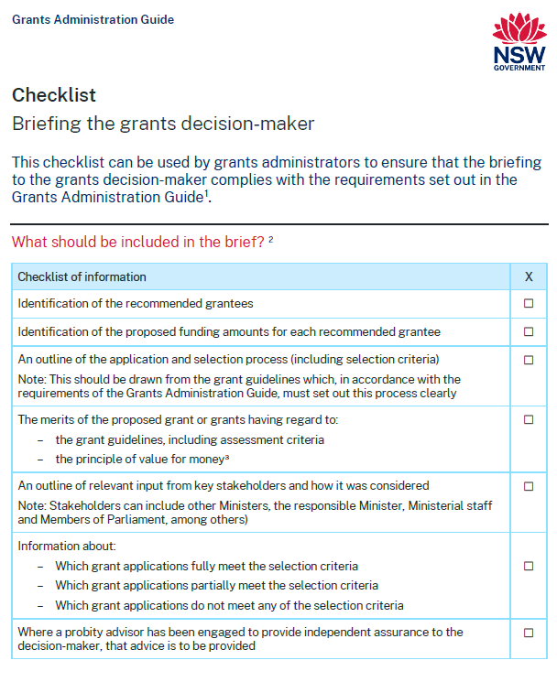
Briefing the decision-maker
Where the decision-maker is a Minister
At a minimum, officials must provide the following written advice:
Application and selection process
Eligibility and assessment criteria
Merits of the proposed grant having regard to value for money
Recommended grantees and proposed funding amounts for each
Consideration of input provided from key stakeholders (e.g. MPs, responsible Minister, Ministerial staff and other Ministers)
Meeting the assessment criteria
Officials should at a minimum indicate which grant applications:
Fully meet assessment criteria
Partially meet assessment criteria
Do not meet any of the assessment criteria
Probity Advice
Assessment team recommendations
Notes:
For on-off and ad-hoc grants, the Minister is generally the decision maker and the principles in the Guide relevant to decision-makers do apply. Ministers’ responsibilities are set out in Section 2 of this slide deck.
There is a ‘Briefing the grants decision-maker’ checklist available to download on the Grants Administration Guide webpage

Slide 33
Requirements for decision-makers
A Minister must not approve or decline a grant without first receiving written advice from officials on the merits of the proposed grant
A Minister or an official who approves or declines a grant must record the decision in writing, including the reasons for the decision (and any departure from the recommendation of officials), having regard to the grant guidelines and the key principle of achieving value for money
Records must be managed in accordance with the State Records Act 1998
Should not approve a grant that has been assessed as ineligible, except if eligibility criteria waived in limited circumstances
Notes:
The Guide requires that Ministers receive written advice on the merits of a proposed grant, and imposes obligations in terms of recording decisions and keeping records of those decisions, in accordance with the requirements of the State Records Act 1998.
The Guide recognises that decision-makers may approve or decline grants in variance from the recommendation of officials, but this departure from a recommendation must be recorded and published.
Generally, an application assessed as ineligible should not be approved. In limited circumstances, a decision may be made to waive eligibility criteria, for example, where not doing so would: lead to perverse or unfair outcomes, be contrary to the policy intent, or damage the reputation and integrity of the grant program. If such circumstances apply and it is considered that eligibility criteria should be waived, the reasons for waiving the eligibility criteria must be documented and the waiver must be approved by the decision-maker (whether as part of the final approval or otherwise).

Slide 34
Assessment of non-competitive grants
Agencies need to identify
the designated decision-maker who must be satisfied that funds are being assessed and administered appropriately
the assessor(s) responsible for ensuring grants are administered in accordance with approved criteria
Automated systems
Records should be retained
Notes:
There are exceptions for non-competitive grants – such as high-volume grants, as the assessment process will differ and may not involve a two-stage assessment and decision making process.
Agencies need to identify
the decision maker who must satisfy themselves that funds are being assessed and administered in accordance with approved criteria and policy intent. This may entail approving grant program policies and processes in risk management, assessment, quality assurance and auditing, and escalation of compliance issues.
the assessor(s) responsible for administration of grants against approved criteria
Records from automated systems (such as used for high volume grants) should be retained as part of the documentation of the grants administration process (and be made available for internal auditing/fraud control purposes).
These exceptions do not apply to one-off, ad hoc grants as the Minister is generally the decision-maker.

Slide 35
Providing grants
A grant agreement should formalise terms and conditions.
Grantees must be subject to clear and specific terms and conditions.
Agreements must be legally enforceable and include appropriate accountability for grant money (including monitoring and acquittal requirements).
If it is not practical to provide each individual with a grant agreement (e.g. emergency relief and high-volume grants), grantees must still be bound by specific terms and conditions.
All offer letters must require a grantee to acknowledge the financial support provided by the NSW Government.
Notes:
Once applicants have been advised of the assessment outcome, the terms and conditions of the grant should be formalised in writing.
Officials must ensure grantees are subject to clear and specific terms and conditions for a grant.
There is no required format for grant agreements, however officials should ensure that grant agreements are fit for purpose with regard to the nature of the grant and grantee, the risks of the grant and the principle of proportionality.
Agreements must be legally enforceable and include appropriate accountability for grant money (including monitoring and acquittal requirements)
If it is not practical to provide each individual with a grant agreement (e.g. emergency relief and high-volume grants), grantees must still be bound by specific terms and conditions.
All offer letters must require a grantee to acknowledge the financial support provided by the NSW Government.
Template funding agreements are available on https://www.nsw.gov.au/grants-and-funding/grants-administration-guide.

Slide 36
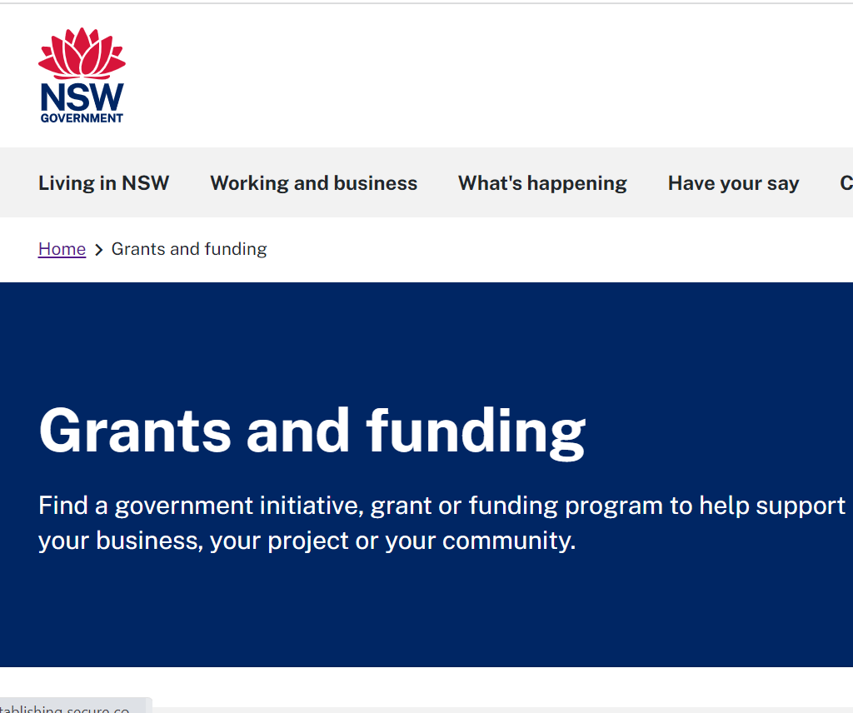
Publishing grant information
The following information about grants must be published:
upcoming grant opportunities
open grant opportunity guidelines
all grants awarded
the exercise of Ministerial discretion
program evaluations.
Specific publishing requirements are set out at Appendix A to the Guide.
Information about grants awarded must be published within 45 days.
Some legal and policy exceptions to publication may apply.
Notes:
Effective disclosure and publishing of grants information are essential for transparency and public accountability.
Officials must publish the following information about grants to best-practice customer experience standards on the NSW Government Grants and Funding Finder
upcoming grant opportunities
open grant opportunity guidelines
all grants awarded
the exercise of Ministerial discretion in making grant decisions that vary from the recommendation of officials, including the reasons for any such decision
program evaluations.
Official must publish this information in accordance with the requirements of Appendix A to the Guide.
Decisions relating to grants must be published within 45 days of the agreement – or 45 days from when the first payment is made to the grantee if there is no grant agreement.
The Guide sets out certain legal and policy exceptions to publication.

Slide 37
Monitoring and acquitting grants
Officials should monitor both individual grants and the overall grant opportunity:
track the progress of grant activities
establish if funds were dispersed correctly and used as intended
assess outcomes, benefits and value for money.
An acquittals process is also a key element of continuous financial monitoring. Officials should conduct an acquittal for individual grants to account for how funds have been spent and compliance with the grant terms and conditions.
Notes:
Grant agreements should be supported by ongoing communication, active grants management and performance monitoring, which are proportional to the risks involved.
It is important that officials support grantees with appropriate guidance, templates and a contact to obtain additional advice if they need it.
Officials should also ensure that reliable and timely evidence demonstrates that the grant is used according to its terms and conditions.
Monitoring
Monitoring payments made and the progress towards intended outcomes is integral to good governance and risk management.
Agencies need to ensure they are resourced to for ongoing grants monitoring and management following the signing of a grants agreement.
Officials should monitor both individual grants and the overall grant opportunity:
track the progress of grant activities
establish if funds were dispersed correctly and used as intended
assess outcomes, benefits and value for money.
Acquittal
An acquittals process is a key part of continuous financial monitoring that accounts for how funds have been spent.
An acquittal should be conducted for individual grants – assessing grantees’ compliance with the terms and conditions set out in the funding agreement.
Funding agreements should include adequate safeguards to prevent misuse of grant funds and stipulate what should happen to funds that are not fully expended.
Where conducting an acquittal for each grant is not practicable, such as in high-volume grant opportunities for emergency relief, agencies should apply appropriate alternative methods for verifying how grant money has been spent.

Slide 38
Grants evaluation
Grants evaluation is important to determine whether a grant has met its intended outcomes and to help inform the design of future grant opportunities.
There are three main types of evaluation:
Process evaluation
Outcome evaluation
Economic evaluation
The NSW Government publication ‘Treasury Policy and Guidelines: Evaluation’ sets out mandatory requirements, recommendations and guidance for agencies to conduct evaluation.
Notes:
Evaluating grants is important to:
determine whether a grant is on track to meet objectives and government priorities, and any performance improvement needed
identify outcomes and benefits, including assessing how the grant has improved the welfare of the NSW community
contribute to a broader knowledge base to help inform the design and appraisal of future grant opportunities.
There are 3 main types of evaluation:
process evaluation – consider how an initiative was delivered, including whether it was implemented as intended, and any issues that arose
outcome evaluation – examine if and how an initiative has lead to intended changes
economic evaluation – identify and measure the impacts of an initiative relative to its costs (an assessment of value for money or net social benefit).
The NSW Government publication Treasury Policy and Guidelines: Evaluation sets out mandatory requirements, recommendations and guidance for agencies to plan for and conduct evaluation.

Slide 39
Contacts and additional resources
6

Slide 40
Resources
Premier’s Memorandum M2022-07 Grants Administration Guide
Grants Administration Guide, including fact sheets and templates: https://www.nsw.gov.au/grants-and-funding/grants-administration-guide
NSW Government Grants and Funding Finder: https://www.nsw.gov.au/grants-and-funding
TPP 17-03: NSW Government Guide to Cost-Benefit Analysis
TPP 18-06: NSW Government Business Case Guidelines
TPP 20-08: Internal Audit and Risk Management Policy for the General Government Sector
Treasury Policy and Guidelines: Evaluation

