Slide 1
<title>
Safe, respectful, responsible use of technology

Slide 2
Activities
Activity 1: A strong password
Activity 2: Don’t fall for fake
Activity 3: Safe, Respectful and Responsible

Slide 3
Activity 1
A strong password

Slide 4
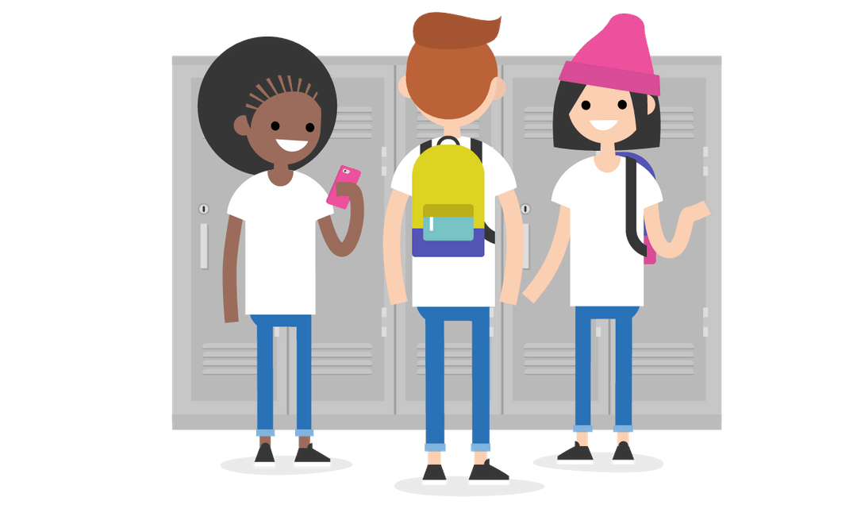
Password
Do’s and Don’ts
Part of making sure you are safe online is about knowing how to create a strong password and keep it secure.
Let’s learn about some principles about passwords before we create our own secure password.
Notes:
Presenter notes:
As a group, complete the Do and Don’ts on the next slide.

Slide 5
Password
Do’s and Don’ts
DO
make passwords eight or more characters long
DON’T
use dictionary words as your password
DO
include numbers letters, and symbols in your password
DO
change your password every six months
DON’T
use private identity information in your password
DON’T
use your phone number as your password
DON’T
use your nickname as your password
DON’T
share you password with your friends
DO
create a password that you can remember
Notes:
Presenter notes:
Review the do’s and don’ts. Elaborate if necessary on each on. A reason is provided below. You may wish to ask the group ‘Why’ or the reason for each do and don’t.
The general rule is: the longer the password, the harder it is for a computer to crack.
Complete single words like: Piano, password, happy etc are very easy for computers to crack.
Adding complexity to your password by using symbols makes it much stronger
You should change your password regularly.
Never put privte indentity information in your password. Sometimes this information is used to verify accounts.
Never use your phone number. Increasingly phone numbers are used as a recovery option.
Etc
Sharing your password is a big security problem.
Its important to be able to remember your password. If your keep forgetting it because you have something really hard to remember, you are more likely to create a weaker password at have your security compromised.

Slide 6
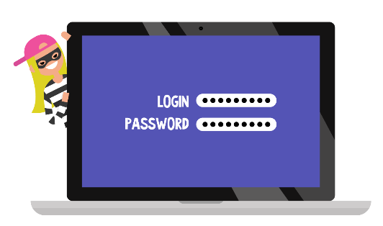
Password detective
In this activity you need to identify the hardest password to crack. There are four options and each corner of the room represents one of the options.
A clue will be provided to help you decide on the hardest password for a computer to crack.
Notes:
Presenter notes:
You will need a colour square of paper for each corner of the room. Set this up before the session.

Slide 7
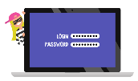
Password detective
Which is the hardest to crack?
tr0uBl3&me!
P@ssword!
qwerty9876
Ilikepizza@7PM
Notes:
Presenter notes:
Ask the group to move to the password that they believe is the hardest to crack.
This activity is known as North, South, East, West.
Hint:
The password that is hardest for a computer to crack:
Uses a combination of capitals, lowercase, numbers and special characters.
tr0uBl3&me!

Slide 8
Password detective
Which is the hardest to crack?
tr0uBl3&me!
P@ssword!
qwerty9876
Ilikepizza@7PM
Notes:
Presenter notes:
Reasons:
Ask the group what the problem with the eliminated password is.
Hints:
The password that is hardest for a computer to crack:
Is not a common password with substituted letters.

Slide 9
Password detective
Which is the hardest to crack?
tr0uBl3&me!
P@ssword!
qwerty9876
Ilikepizza@7PM
Notes:
Presenter notes:
Reasons:
Ask the group what the problem with the eliminated password is.
Next hint:
Before giving the hints 3 & 4, ask students to move to what they now think is the answer.
Once students have moved or remained, read the hints in order from 1-4 and ask if anyone would like to move based on the hint
Hints:
The password that is hardest for a computer to crack:
Uses a combination of capitals, lowercase, numbers and special characters.
Is not a common password with substituted letters.
is easy for a person to remember, but hard for a computer to crack.
Is more than 8 characters long

Slide 10
Password detective
Which is the hardest to crack?
tr0uBl3&me!
P@ssword!
qwerty9876
Ilikepizza@7PM
Notes:
Presenter notes:
Reasons:
Ask the group what the problem with the eliminated password is.
Hints:
The password that is hardest for a computer to crack:
Uses a combination of capitals, lowercase, numbers and special characters.
Is not a common password with substituted letters.
is easy for a person to remember, but hard for a computer to crack.
Discussion:
tr0uBl3&me! – this is a strong password, not as strong as the passphrase. The problem with this password is it is hard for you to remember, and that means you are more likely to forget, and then reset it to something simple. [Also, is it a zero or a capital O]
Ilikepizza@7PM – this is a strong passphrase because of the length of the passphrase. It is 14 characters long, contains upper-case and lowercase letters, numbers and symbols. It is also much easier for you to remember.

Slide 11
Takeaway messages
Common passwords are easy to crack, so don’t use things like password, qwerty.
Passphrases are generally more difficult for a computer to crack, but easy for you to remember. Much easier than tr0uBl3&me! and more secure! Double win!

Slide 12
How long
In small groups, you will decide how long each password would take a computer to crack.
1 day 1 week 1 month 1 year | 10 years 100 years 1000 years 10,000+ years

Slide 13
How long for a computer to crack?
1 day 1 week 1 month 1 year | 10 years 400 years 1000 years 10,000+ years
qwerty9876
P@ssword!
tr0uBl3&me!!
Ilikepizza@7PM

Slide 14
How long for a computer to crack?
1 day 1 week 1 month 1 year | 10 years 400 years 1000 years 10,000+ years
Answers
https://howsecureismypassword.net/
qwerty9876
P@ssword!
tr0uBl3&me!!
Ilikepizza@7PM
1
Day
1
Week
400
years
200
million years
Notes:
1 Week

Slide 15
Austrlalian Cyber Security and Signals Directorate
Resource: Comparison sheet ACSC of password v passphrase
[Necessary? What activity? Or optional resource extra?]

Slide 16
Create a strong password/phrase
In this activity you will create a new, secure password.

Slide 17
Create a strong password/phrase
Write down an answer for each of the following categories, one per blank strip of paper.
Arrange the four strips in various combinations to create a new password, keeping in mind the DOs and DON’Ts tips discussed earlier.
CATEGORIES
Favourite number
Pet’s name, or favourite character’s name
A symbol (#, $, %, *, or &)
Favourite food
Notes:
Presenter notes:
Distribute 4 slips of paper. Students write a response for each category, one per blank strip of paper.
When they’ve finished, have them share their new password with a partner, and then have them vote on which password they consider the strongest. For an added challenge, students can tear words apart to create more options for combinations.
Invite students to share their winning passwords with the class, and discuss what makes them so strong.
Extension:
Use the website below test the generated password for strength
https://howsecureismypassword.net/

Slide 18
Activity 2
Don’t fall for fake
Notes:
Presenter notes:
This activity is from the BIA resource

Slide 19
Don’t Fall for Fake.
g.co/BeInternetAwesome

Slide 20
Phishing is when someone tries to steal information like your login or account details by pretending to be someone you trust in an email, text, or other online communication.

Slide 21
Some phishing attacks are obviously fake. Others can be sneaky and really convincing.

Slide 22
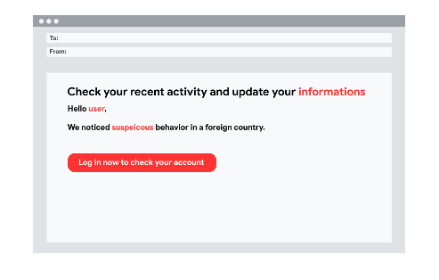
1. Does the email look professional?
Is the company’s usual logo there? Are there spelling errors?

Slide 23
2. Is the siteʼs URL correctly listed in the email? Does the URL start with “https://” with a little green padlock to the left of it?

Slide 24
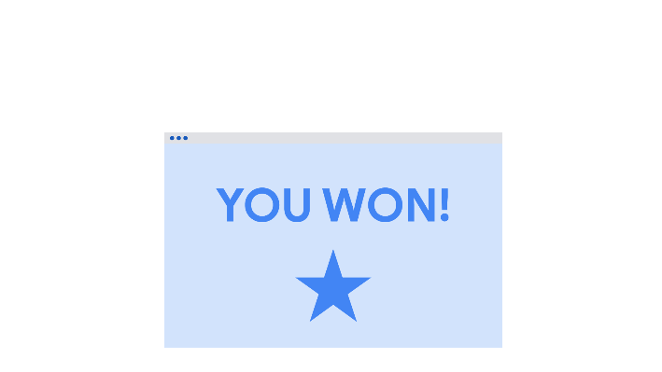
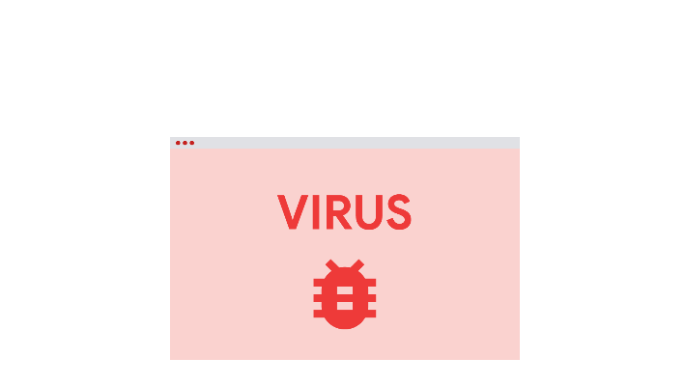
3. Are there any spammy pop-ups?

Slide 25
4. Whatʼs in the fine print?

Slide 26
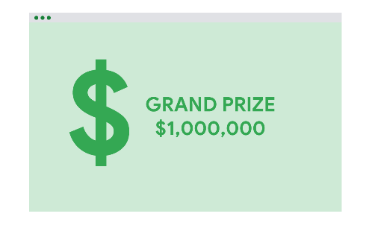
5. Is the email offering something that sounds too good to be true, like a chance to make a lot of money?

Slide 27
Let’s try to spot phishing emails together!
Notes:
Instructions: Pass out shape Real vs. Fake signs if you haven’t already. Students should cut out signs (if they haven’t already) to prep for upcoming activities. Optional: Glue popsicle sticks to printable signs for students to easily showcase them in the following game.

Slide 28
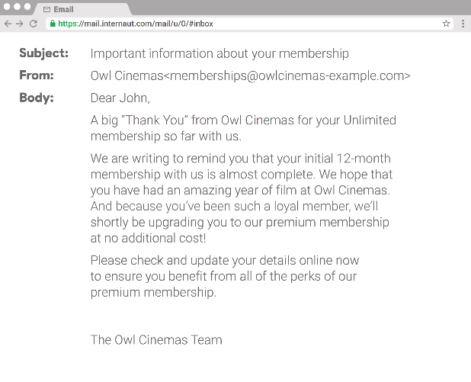
Is this email real or fake?
Notes:
Instructions: Review the following email with the class. Have them put up a sign “Real” vs “Fake” based on if they should trust this is a true email.

Slide 29
Notes:
Instructions: This email is real! (details on next slide)

Slide 30
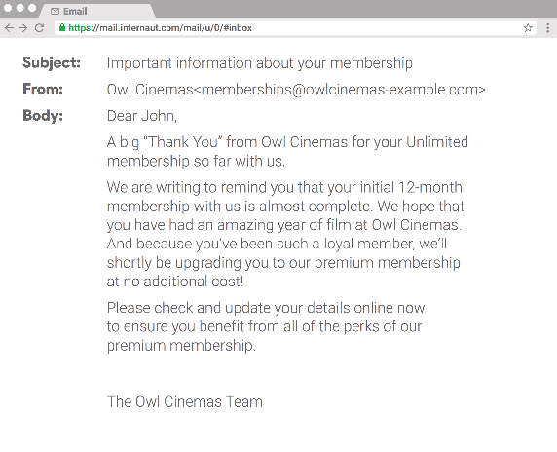
In this case the email seems real, the offer is reasonable, and the email is not asking for any personal information.
Notes:
Instructions: Review why this email is real as showcased on the slide.

Slide 31
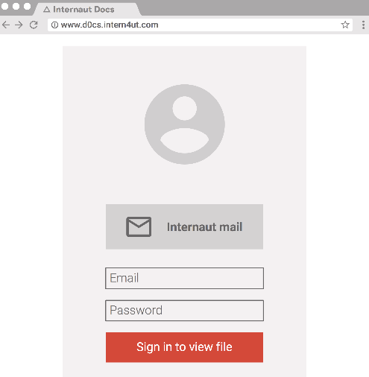
Is this email real or fake?
Notes:
Instructions: Review the following email with the class. Have them put up a sign “Real” vs “Fake” based on if they should trust this is a true email.

Slide 32
Notes:
Instructions: This email is fake! (details on next slide)

Slide 33
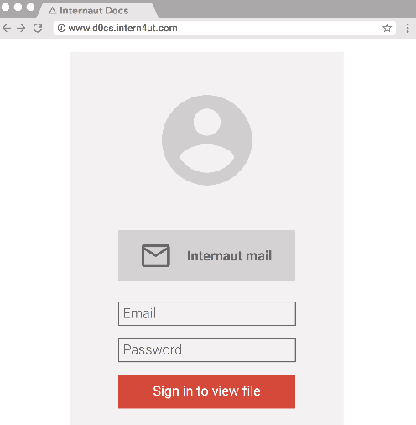
Remember to always look at the URL. The URL should start with “https://” and have no misspellings.
Notes:
Instructions: Review why this email is fake as showcased on the slide.

Slide 34
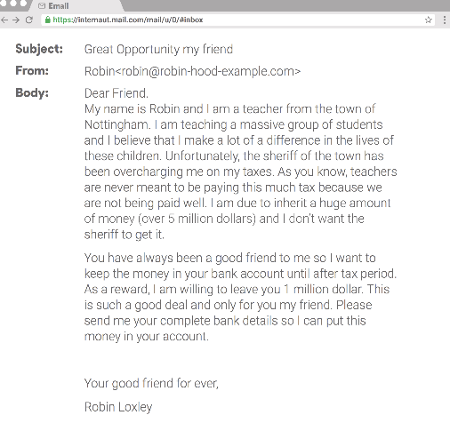
Is this email real or fake?
Notes:
Instructions: Review the following email with the class. Have them put up a sign “Real” vs “Fake” based on if they should trust this is a true email.

Slide 35
Notes:
Instructions: This email is fake! (details on next slide)

Slide 36
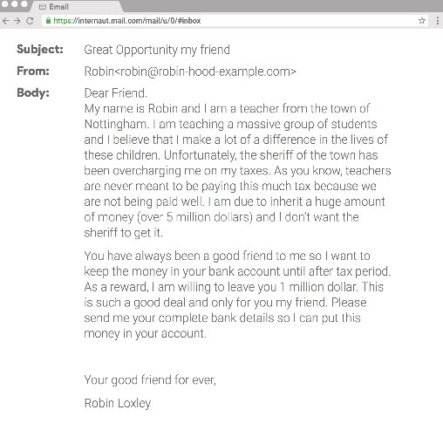
There are misspellings in the email, the last name doesn’t match the email, and they’re asking for personal information.
Notes:
Instructions: Review why this email is fake as showcased on the slide.

Slide 37
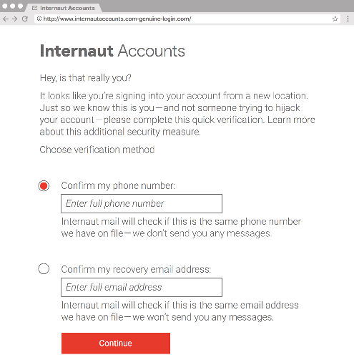
Is this email real or fake?
Notes:
Instructions: Review the following email with the class. Have them put up a sign “Real” vs “Fake” based on if they should trust this is a true email.

Slide 38
Notes:
Instructions: This email is fake! (details on next slide)

Slide 39
The “s” in “https://” in the URL is important in helping determine that the website is safe.
Notes:
Instructions: Review why this email is fake as showcased on the slide.

Slide 40
Is this URL real or fake?
Notes:
Instructions: Review the following URL with the class. Have them put up a sign “Real” vs “Fake” based on if they should trust this is a true site.

Slide 41
Notes:
Instructions: This email is fake! (details on next slide)

Slide 42
Make sure you check URL's for misspellings to determine whether they are credible or not. A number 1 is used instead of and ‘i’
Notes:
Instructions: Review why this site is fake as showcased on the slide.
Correct URL:
Masthead: Notice how a 1 is used instread of an ‘i’.

Slide 43
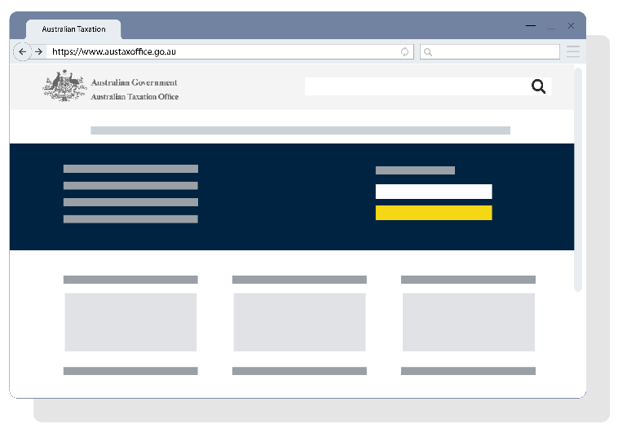
Is this website real or fake?
Notes:
Instructions: Review the following URL with the class. Have them put up a sign “Real” vs “Fake” based on if they should trust this is a true site.

Slide 44
Notes:
Instructions: This website is fake! (details on next slide)

Slide 45
Make sure you check URLs for misspellings, the secuirty padlock and whether the URL is the offical page.
Notes:
Instructions: Review why this site is fake as showcased on the slide. Sometimes fake sites look almost exactly like the real thing! The URL looks credible, but it is not the real one (ATO.gov.au)
Real URL: https://www.ato.gov.au/
URL errors: .go, austaxoffice
The fake one is also missing the security padlock which identifies a secure connection.

Slide 46
Congratulations!
You are now officially Internet Alert!

Slide 47
Activity 3
Safe, respectful and responsible use

Slide 48
Safe, Responsible, Respectful
Using a digital device can lead to some exciting experience, but also some dangerous and harmful experiences. In this activity you need to make a choice about each scenario
Notes:
This activity is to draw out the knowledge your students already have and reinforce positive behaviours. Pick some or use all 14 scenarios to discuss safe, responsible and respectful use of digital devices at all times.

Slide 49
Scenarios
Start in the middle of the room for each scenario.
Move to the side of the room that indicates your choice. Be prepared to explain why.
You’re caught texting during class, so your teacher takes your phone. You were supposed to call home to let your parents know whether or not you have practice after school.
Respectful and Responsible
Not Respectful and Responsible

Slide 50
Scenarios
Answer:
You need to follow your school rules regarding mobile phones. Texting during class is not a respectful or responsible behaviour choice
You’re caught texting during class, so your teacher takes your phone. You were supposed to call home to let your parents know whether or not you have practice after school.
Not Respectful and Responsible

Slide 51
Scenarios
Start in the middle of the room for each scenario.
Move to the side of the room that indicates your choice. Be prepared to explain why.
Your friend shows you these awful text messages he’s just received from someone in your class.
School will take action when it is reported to them
Private issue so it isn’t a school matter

Slide 52
Scenarios
Answer:
Where there is a connection to the school, action will be taken regardless of the time or place it occurred
Your friend shows you these awful text messages he’s receiving from someone in your class.
School will take action when it is reported to them
Private issue so it isn’t a school matter

Slide 53
Scenarios
Start in the middle of the room for each scenario.
Move to the side of the room that indicates your choice. Be prepared to explain why.
Some one makes rude comments to you, so you block and report them to an adult
Respectful and Responsible
Not Respectful and Responsible

Slide 54
Scenarios
Answer:
Always block and report, you may wish to take a screen shot first. Don’t respond with rude comments
Some one makes rude comments to you, so you block and report them to an adult
Respectful and Responsible
Not Respectful and Responsible

Slide 55
Scenarios
Start in the middle of the room for each scenario.
Move to the side of the room that indicates your choice. Be prepared to explain why.
A friend takes a video of a classmate without him knowing. You see him start texting the video to a bunch of people.
Respectful and Responsible
Not Respectful and Responsible

Slide 56
Scenarios
Answer:
You must have someone’s permission to record someone. When posting online, you should seek permission from the individual too.
A friend takes a video of a classmate without him knowing. You see him start texting the video to a bunch of people.
Respectful and Responsible
Not Respectful and Responsible

Slide 57
Scenarios
Start in the middle of the room for each scenario.
Move to the side of the room that indicates your choice. Be prepared to explain why.
On Google Classroom you and your friends are continually posting comments unrelated to classwork
Respectful and Responsible
Not Respectful and Responsible

Slide 58
Scenarios
Start in the middle of the room for each scenario.
Move to the side of the room that indicates your choice. Be prepared to explain why.
On Google Classroom you and your friends are continually posting comments unrelated to classwork
Respectful and Responsible
Not Respectful and Responsible

Slide 59
Scenarios
Start in the middle of the room for each scenario.
Move to the side of the room that indicates your choice. Be prepared to explain why.
At home, you click share to an abusive post about someone at school
School will take action when it is reported to them
Outside of school so it isn’t a school matter

Slide 60
Scenarios
Answer:
Where there is a connection to the school, action will be taken. Sharing this content is not respectful or responsible behaviour
At home, you click share to an abusive post about someone at school
School will take action when it is reported to them
Outside of school so it isn’t a school matter

Slide 61
Scenarios
Start in the middle of the room for each scenario.
Move to the side of the room that indicates your choice. Be prepared to explain why.
You receive a friend request from someone you have never met and do not know
Safe to accept friend request
Not safe to accept friend request

Slide 62
Scenarios
Answer:
Never accept requests from people you do not know or have not met.
You receive a friend request from someone you have never met and do not know
Safe to accept friend request
Not safe to accept friend request

Slide 63
Scenarios
Start in the middle of the room for each scenario.
Move to the side of the room that indicates your choice. Be prepared to explain why.
Your friend keeps forwarding mass emails to you that say you’ll have bad luck if you don’t forward them to 10 more people.
Safe and responsible to forward the message
Not safe or responsible to forward the message

Slide 64
Scenarios
Answer:
These emails are best deleted and not forwarded. They are scams or hoaxes. You can look up Scam Watch and find details
Your friend keeps forwarding mass emails to you that say you’ll have bad luck if you don’t forward them to 10 more people.
Safe and responsible to forward the message
Not safe or responsible to forward the message

Slide 65
Scenarios
Start in the middle of the room for each scenario.
Move to the side of the room that indicates your choice. Be prepared to explain why.
Your school policy is to restrict devices except when directed during class.
You decide to listen to music at lunch time.
Respectful and Responsible
Not Respectful and Responsible

Slide 66
Scenarios
Answer:
You need to follow the school rules and procedures
unless granted an exemption or given permission
Your school policy is to restrict devices except when directed during class.
You decide to listen to music at lunch time.
Respectful and Responsible
Not Respectful and Responsible

Slide 67
Scenarios
Start in the middle of the room for each scenario.
Move to the side of the room that indicates your choice. Be prepared to explain why.
Someone starts a fake twitter account in your teacher’s name. The posts are really funny but your friend thinks you should let your teacher know about the account.
Let the school know
Don’t let the school know

Slide 68
Scenarios
Answer:
The respectful and responsible choice is to inform the school.
Someone starts a fake twitter account in your teacher’s name. The posts are really funny but your friend thinks you should let your teacher know about the account.
Let the school know
Don’t let the school know

