Slide 1
Grants Administration Guide
Notes:
This training is intended to provide an overview of the Grants Administration Guide. It is is important that you familiarise yourself with the detailed information and requirements set out in the Guide.
The slides are broken up into sections – so you can minimise sections that you may already be familiar with or do not want to focus on.

Slide 2
Contents
1. Overview
Structure of the Guide
Who must comply with the Guide
Legislative requirements under the Government Sector Finance Act 2018 (NSW)
Legislative and policy framework
2. Responsibilities under the Guide
Ministers
Officials
Ministerial Staff
3. What is a grant?
4. Key principles of grants administration
The 7 key principles of grants administration
The public interest
Reducing the risk of unlawful or improper conduct
5. Process of grants administration
Planning and designing the grant opportunity
Promoting the grant opportunity
Receiving and assessing grant applications
Providing grants
Publishing grants information
Monitoring and acquitting grants
Grants evaluation
6. Contacts and additional resources

Slide 3
Overview
1

Slide 4
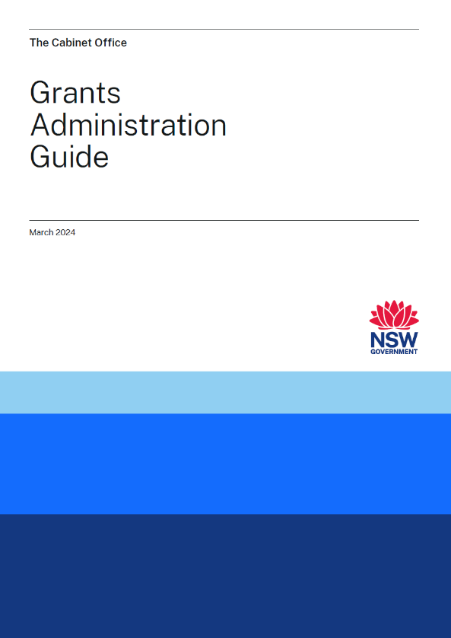
Overview
The Grants Administration Guide was developed as part of the Review of Grants Administration in NSW, led by the former Department of Premier and Cabinet in partnership with the NSW Productivity Commissioner, Mr Peter Achterstraat AM.
The Guide first came into effect when it was issued under a Premier’s Memorandum and gazetted on 19 September 2022.
It has since been updated and was reissued on 18 March 2024.
The Guide provides:
an overview of the grants administration process
overarching principles that apply to all NSW Government grants
mandatory requirements for administering grants.
Notes:
The Guide and a range of supplementary resources is available on the following webpage –
https://www.nsw.gov.au/grants-and-funding/grants-administration-guide

Slide 5
Structure of the Guide
Sections 1 and 2 – overview and key definitions.
Section 3 – overview of responsibilities of Ministers, Ministerial staff and officials (these are detailed further in Sections 5 and 6)
Section 4 – defines what a grant is
Section 5 – key principles
Section 6 – process for administering grants and specific requirements for Ministers, Ministerial staff and officials

Slide 6
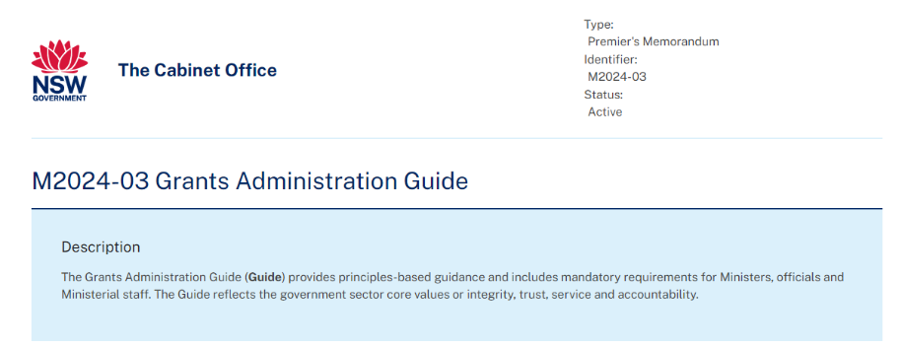
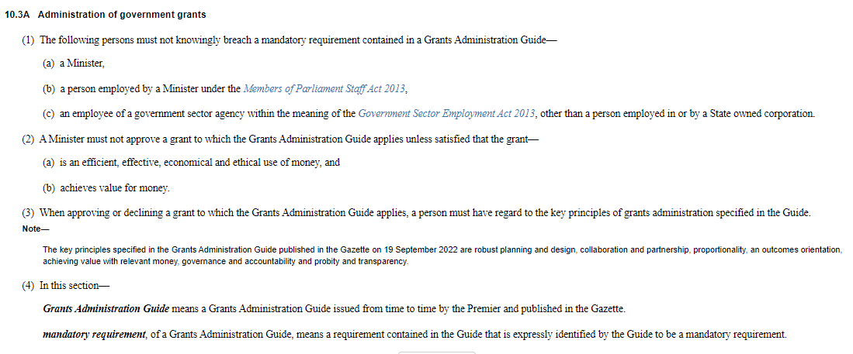
Who must comply with the Guide?
The Guide is published under Premier’s Memorandum M2024-03 and applies to:
Ministers, officials (government sector employees) and Ministerial staff
all grants administered by the government sector (not local government or State Owned Corporations).
If local government or another third party administers grants on behalf of NSW Government, officials must be satisfied that the administration of grants is consistent with the key principles and requirements of the Guide.
The Guide sits alongside other requirements that apply to the expenditure of public money in NSW, as well as laws and policies that govern ethical behaviour.
Notes:
The Guide applies to Ministers, officials (government sector employees – as defined in the GSE Act, excluding employees of State Owned Corporations) and Ministerial staff.
The Guide applies to all grants administered by the NSW government.
The Guide does not apply to local government or SOCs. However, where local government or other third parties administer grants on behalf of the NSW Government, officials must satisfy themselves that there are practices and procedures in place for the administration of the grants consistent with the key principles and requirements of the Guide, with appropriate adaptations as necessary. This may be achieved, for example, through the terms of the engagement of local government or a third party for this purpose. Where multiple agencies are involved in a grant that is to be administered by a third party, consultation may be required between agencies to ensure officials are satisfied.
The Guide sits alongside other requirements that apply to the expenditure of public money in NSW, as well as laws and policies that govern ethical behaviour. The Guide does not affect the requirements of those laws and policies, and officials, Ministers and Ministerial staff must ensure that they comply with all relevant laws and policies when administering grants. The key requirements of that legislative and policy framework are set out at 1.4 of the Guide – e.g. the GSF Act requires that the expenditure of money must be ‘authorised’, the Government Sector Employment Act 2013 (NSW) establishes the Ethical Framework for the government sector, the State Records Act 1998 (NSW) requires public offices (including agencies and Ministerial offices) to keep full and accurate records of the activities of the office, and the Government Information (Public Access) Act 2009 (NSW) provides for the proactive release of government information by agencies and gives members of the public an enforceable right to access government information held by an agency.

Slide 7
Legislative Requirements under the Government Sector Finance Act 2018 (NSW) (GSF Act)
Compliance with the Grants Administration Guide is a legal requirement under section 10.3A the GSF Act.
Section 10.3A(1) specifies that Ministers, their staff and employees of government sector agencies must not knowingly breach a mandatory requirement contained in the Guide.
Section 103A also imposes other requirements on grants decision-makers that apply in addition to the requirements set out in the Guide.
Section 10.3A(2) requires that Ministers must not approve a grant to which the Guide applies unless satisfied that the grant:
—is an efficient, effective, economical and ethical use of money, and
—achieves value for money
Section 10.3A(3) requires that when approving or declining a grant to which the Guide applies, a person must have regard to the key principles of grants administration specified in the Guide.
Notes:
Compliance with the Grants Administration Guide is a legal requirement under section 10.3A the Government Sector Finance Act 2018 (NSW).
Section 10.3A of the GSF Act also imposes other requirements on grants decision-makers that apply in addition to the requirements set out in the Guide.

Slide 8
Legislative and policy framework
Key Government Sector Legislation
Government Sector Finance Act 2018 (NSW) (GSF Act) – principles for the expenditure of money and financial management
Government Sector Employment Act 2013 (NSW) – establishes the Ethical Framework for the NSW Government Sector
Government Information (Public Access) Act 2009 (NSW) – encourages proactive release of government information
Integrity framework
Independent Commission Against Corruption Act 1998 (NSW); Ministerial Code of Conduct; NSW Office Holder’s Staff Code of Conduct
Independent Commission Against Corruption, NSW Ombudsman and the Audit Office of NSW – investigate complaints of maladministration and serious and substantial waste of public money.
Financial management and investment policies
Internal Audit and Risk Management Policy for the General Government Sector (TPP 20-08) – assists agencies in fulfilling legislative obligations under the GSF Act.
NSW Government Business Case Guidelines (TPP 18-06) – assists agencies to prepare business cases.
Compliance with the Guide is a legislative requirement under section 10.3A of the GSF Act.
Notes:
Criminal and legally enforceable sanctions exist for unlawful or improper conduct in grants administration.
The legislative and policy framework that applies in respect of the expenditure of public money in NSW is set out at section 1.4 of the Guide. Key components of that framework include:
Government Sector Finance Act 2018 (NSW) (GSF Act) sets out principles for the expenditure of money and financial management. Note also section 10.3A which relates to the administration of government grants, requires compliance with the mandatory requirements of the Guide and imposes certain obligations on grants decision-makers.
The Government Sector Employment Act 2013 (NSW) establishes the Ethical Framework for the NSW Government Sector
The Government Information (Public Access) Act 2009 (NSW) encourages proactive release of government information
The integrity framework in NSW enables various integrity bodies to investigate and make findings and recommendations in relations to the workings of government and the conduct of Ministers and officials:
ICAC Act 1998 (NSW), the Ministerial Code of Conduct and the NSW Office Holder’s Staff Code of Conduct all provide guidance
Integrity agencies – such as the Independent Commission Against Corruption, NSW Ombudsman and the Audit Office of NSW – investigate complaints of maladministration and serious and substantial waste of public money.
Financial management policies – including TPP 20-08 and TPP 18-06 regulate financial and risk management, as well as investment prioritisation.

Slide 9
Responsibilities under the Guide
2
Notes:
This section outlines the responsibilities of Ministers, officials and Ministerial staff. These responsibilities are primarily located in Sections 5 and 6 of the Grants Administration Guide and are summarised in Section 3 of the Guide.

Slide 10
Ministers
Be familiar and comply with the principles and grants administration processes, as well as applicable laws and policies that guide ethical behaviour
Promote compliance with the Guide by officials and Ministerial Staff
Mandatory requirements:
Comply with all relevant laws when administering grants and recording keeping obligations
Must not approve a grant that has been assessed as ineligible, unless they decide to waive the eligibility criteria
Administer grants in accordance with the grant guidelines
Must not approve or decline a grant without first receiving written advice from officials on the merits of the proposed grant or group of grants
Record the decision (to approve or decline a grant) in writing, including the reasons for the decision (and any departure from the recommendation of officials)
Notes:
1. Compliance – Ministers must comply with the Guide and promote compliance with the Guide to Ministerial staff and officials
2. Ministers must comply with the following mandatory requirements:
Comply with all relevant laws when administering grants
Comply with their record keeping obligations under the State Records Act 1998 (NSW) (SR Act)
Must not approve a grant that has been assessed as ineligible, unless they decide to waive the eligibility criteria
Administer grants in accordance with the grant guidelines
Must not approve or decline a grant without first receiving written advice from officials on the merits of the proposed grant or group of grants (see exceptions at 6.3 Receiving and assessing grant applications for non-competitive grants)
Record the decision (to approve or decline a grant) in writing, including the reasons for the decision (and any departure from the recommendation of officials), having regard to the grant guidelines and the key principle of achieving value for money, and manage these records in accordance with the requirements of the SR Act (see exceptions at 6.3 Receiving and assessing grant applications for non-competitive grants)
Note: these obligations sit alongside the obligations under other laws and policies, including the requirements of section 10.3A of the GSF Act, which is outlined on a previous slide.

Slide 11
Officials
Be familiar and comply with the principles and grants administration processes, as well as applicable laws and policies that guide ethical behaviour
Full and frank advice to Ministers
Comply with mandatory requirements in relation to:
Planning and designing grant opportunities
Assessment and decision-making
Providing grants and publishing grant information
Notes:
Compliance – officials must comply with the Guide as well as other applicable laws and policies
Provide full and frank advice to Ministers about grants, grants processes and decision-making
Comply with the mandatory requirements set out in the Guide in relation to:
Planning and designing grant opportunities
Assessment and decision-making
Providing grants and publishing grant information
A checklist for officials on the requirements of briefing the decision maker is available to download from the Grants Administration Guide webpage.
Note: these obligations sit alongside the obligations under other laws and policies, including the requirements of section 10.3A of the GSF Act, which is outlined on a previous slide.

Slide 12
Ministerial staff
Be familiar and comply with the principles and grants administration processes, as well as applicable laws and policies that guide ethical behaviour
Mandatory requirements:
Comply with all relevant laws when administering grants
Put practices and procedures in place to ensure Ministerial involvement in grants administration is consistent with the key principles and requirements in the Guide
Where a Minister is the decision-maker, ensure that the decision is recorded in writing and records are managed in accordance with the State Records Act 1998 (NSW).
Notes:
Compliance – officials must comply with the Guide as well as other applicable laws when administering grants
Comply with the following mandatory requirements:
Comply with all relevant laws when administering grants
Comply with their record keeping obligations under the State Records Act 1998 (NSW) (SR Act)
Ministerial staff must put in place practices and procedures to ensure that Ministerial involvement in grants administration is conducted in a manner that is consistent with the key principles and requirements in the Guide
Where a Minister is the decision-maker, Ministerial staff must ensure that the decision is recorded in writing and the records are managed in accordance with the requirements of the State Records Act 1998 (NSW)
A Protocol for Grants Administration in NSW Ministerial Offices has been developed and is available on the Grants Administration Guide webpage, as is a grants decision making register.

Slide 13
What is a grant?
3
Notes:
This section focuses on definition of Grant. This information is detailed in Section 4 of the Grants Administration Guide.

Slide 14
Definition
A grant is an arrangement for the provision of financial assistance by the NSW Government (or on behalf of the NSW Government) whereby money:
is paid to a grantee other than the NSW Government¹
is intended to help address one or more of the NSW Government’s policy outcomes
is intended to assist the grantee to achieve its objectives
does not result in the return of goods or services by the grantee of an equivalent value to the NSW Government (i.e. it is a non-reciprocal exchange).
If the above characteristics are established, consider whether the arrangement falls within one of the exclusions identified at section 4.2 of the Guide.
1. This does not mean that a grants program with both government and non-government applicants is not a grant for the purposes of the Guide. In these circumstances, the grant should be treated as a grant under the Guide, and be administered accordingly, notwithstanding that some of the grants recipients may be government agencies.
Notes:
The Guide provides a broad definition but excludes certain types of financial arrangements.
In assessing whether or not the relevant financial arrangement is a grant, you should first consider the four key characteristics identified.
If one of these characteristics does not apply, then the arrangement in question is likely not a grant.
If all four key characteristics are established, you should then consider the exclusions identified in section 4.2 of the Guide to see if any apply.
The Guide applies to all payments that meet the above definition, including payments made:
as a result of a selection process, regardless of whether that process is open, closed, targeted, competitive or non-competitive
where particular criteria are satisfied
on a one-off or ad hoc basis.
If in doubt as to how to characterise a particular arrangement, seek advice from your agency’s legal or governance area.

Slide 15
Key principles of grants administration
4
Notes:
This section focuses on the 7 key principles that should underpin all aspects of grant administration. These key principles are detailed in Section 5 of the Grants Administration Guide.

Slide 16
Key principles
Collaboration and partnership
Achieving value with relevant money
Robust planning and design
An outcomes orientation
Probity and transparency
Proportionality
Governance and accountability
Notes:
The Guide specifies 7 key principles to be applied in administering grants. Officials must put in place practices and procedures to ensure grants are administrated consistent with the key principles:
Robust planning and design
Collaboration and partnership
Proportionality
An outcomes orientation
Achieving value with relevant money
Governance and accountability
Probity and transparency

Slide 17
1. Robust planning and design
Grants should meet identified needs.
In your planning, consider:
is a grant the best vehicle to achieve policy objectives?
the rationale for the grant
the location or area in NSW that the grant initiative is targeting
co-design opportunities with grantees and stakeholders
costs and benefits
taxation/accounting treatments
commercial considerations
management issues (e.g. risk management).
Notes:
Robust planning and design is important to facilitate fair, effective and transparent grants administration.
Ensure grants meet identified needs and deliver value for money.
Ensuring grants are strategic – including considering if a grant is the best vehicle to achieve policy objectives.
In considering options for the design of the grant, consider:
Rationale for the grant and how it will meet objectives
the location or area in NSW that the grant initiative is targeting
Potential for co-design with prospective grantees and stakeholders
Expected costs and benefits
Taxation or accounting treatments
Commercial considerations (e.g. funding strategy and grant agreement)
Management issues (i.e. engaging with stakeholders; risk management; accountability; application and selection processes; the role of decision-makers; performance measures; monitoring and evaluation; documentation; applicable legal, policy and governance requirements).

Slide 18
2. Collaboration and partnership
Plan early to ensure that grants are fit for purpose and address identified stakeholder needs.
Consider the interaction of grants with other funded opportunities.
Collaborate with other agencies and levels of government to ensure clear lines of responsibility.
Consult to identify and address risks – this will improve the design and delivery of grants.
Notes:
Collaboration with stakeholders is important and their needs should be considered in the development of grant opportunities. It should not be assumed that the same approach will suit all grant opportunities.
Consider how the grant will – or could – interact with other funded activities – particularly where there are similar policy outcomes.
Collaboration and partnership is particularly critical when grants administration is shared between different agencies or levels of government, or when a third party is responsible for grants administration.
Early consultation can:
Improve the design and delivery of grants
Reduce duplication
Improve the responsiveness, flexibility and relevance of grants
Reduce administration costs
Support the appropriate responsibility for costs and risks among stakeholders
Support the development of appropriate outputs, accountability requirements, governance structures and documentation for the grant
Assist potential grantees to understand the grants administration process
Co-design of grants with stakeholders (allowing stakeholders to have input on the design of the grant opportunity) may be appropriate in some cases to ensure grants meet identified needs.

Slide 19
3. Proportionality
Customise the administration of grants with regard to their scale and complexity.
Grant guidelines, application processes, grant agreements and reporting and acquittal requirements should be tailored to the particular grant.
For example, the volume, detail and frequency of grant reporting requirements, and rigour of acquittal procedures should be proportional to the risks involved and the intended policy outcomes.
There may be opportunities to reduce the burden of reporting requirements, while managing risks.
Any consideration of proportionality in the planning and design of grant opportunities should be documented.
Notes:
Grants may vary in scale and complexity.
Grants should be customised according to their value, complexity and the associated risks. Tailoring grant guidelines, application and assessment processes, grant agreements and reporting/acquittal requirements will ensure effective grants administration.
Important factors to consider include:
the capability and experience of applicants and grantees
the intended policy outcomes
the purpose, value and duration of a grant
the nature and type of deliverables
governance and accountability requirements
the nature and level of the risks involved
the effect of any application or process requirements for grantees on the accessibility of the grant.
The volume, detail and frequency of reporting requirements should be proportional to the risks involved and the intended policy outcomes. Consider opportunities to reduce the burden of reporting requirements while managing risk, including by having regard to information that is otherwise available (for example, information that is otherwise collected by government and available to the relevant officials or publicly available) and by aligning grant reporting requirements with a grantee’s internal reporting requirements (such as the annual reporting cycle), where appropriate.
Any considerations of proportionality made by officials in the planning and design of grant opportunities should be documented, particularly to explain the approach taken towards identified risks. Officials should review these decisions prior to opening further grant rounds.

Slide 20
4. An outcomes orientation
Grants administration should be focused on achieving government objectives.
Grant opportunities must comply with TPP18-06 NSW Government Business Case Guidelines:
develop objectives that are outcomes and benefits-focused
document how the grant’s inputs and activities will lead to desired outcomes
plan for monitoring and evaluation (including performance measures)
specific requirements exist for grants over a certain value.
Notes:
Grant administration should be focused on achieving outcomes and benefits that align with NSW Government objectives.
Grant opportunities must comply with TPP18-06 NSW Government Business Case Guidelines.TPP18-06 includes specific requirements for grants over a certain value, as well as helpful guidance for grants administration:
develop objectives that are outcomes and benefits-focused and are:
linked to NSW Government, cluster and agency priorities or State Outcomes
measurable with clear expectations
clearly communicated
reviewed regularly
document how the grant’s inputs and activities are expected to lead to desired outcomes and benefits
plan for monitoring and evaluation – this includes appropriate performance measures to assess if intended outcomes and benefits are realised. These measures should be specified in grant guidelines and agreements.
specific requirements exist for grants over a certain value.
Following the implementation of a grant opportunity, you should conduct an outcomes evaluation to assess how and if it led to intended changes and objectives. This may also inform an economic evaluation (which assesses value for money).

Slide 21
5. Achieving value for money
Value for money should be a key consideration across the grant life cycle – from initial design through to implementation and evaluation.
This requires an assessment of lifetime benefits of a grant opportunity against lifetime costs
For a grant opportunity to proceed, officials must demonstrate how it will deliver value for money.
Additional documentation may be required for grant programs or opportunities over a certain value:
Business case (TPG22-04).
Cost-benefit analysis (TPG23-08):
Benefit-cost ratio
Net present value
Notes:
Value for money should be a key consideration across the grant life cycle – from initial design through to implementation and evaluation.
Achieving value for money is important to ensure maximum benefits of grants for the people of NSW.
There are many ways to deliver value for money and costs and benefits will vary from grant to grant depending on a multitude of factors. Some important factors include:
Early planning and design of grant
Consultation with stakeholders
Risk management
Monitoring the use of funds
For a grant opportunity to proceed, officials must demonstrate how it will deliver value for money during the planning and design phase.
Additional documentation may be required for grant programs or opportunities over a certain value:
TPG22-04 Submission of a Business Case requires business cases for NSW Government investments over a certain value
TPG23-08 NSW Government Guide to Cost-Benefit Analysis, which requires a CBA to be undertaken for larger grants over a certain value (A CBA is a mandatory part of a business case, which is required for capital, recurrent and ICT proposals with an estimated total cost of $10 million or higher.)
Value for money should be considered at the individual grant level, as well as in the planning and design of a grant opportunity. The approach to assess value for money should be proportionate to the risk and value of the grant, as well as the individual circumstances (e.g. a cost-benefit analysis may not be practicable for emergency relief).
A value for money fact sheet is available to download from the Grants Administration webpage.

Slide 22
6. Governance and accountability
Solid governance and accountability structures are the foundation of good grants administration.
This should be facilitated by:
grant guidelines
documented roles and responsibilities
record-keeping
grant agreements that are fit for purpose and easy to understand
ensuring the decision-maker (or delegate) has the appropriate financial delegation to sign agreements
Notes:
The foundation of good grants administration is solid governance structures and clear accountabilities.
All parties (including Ministers, officials, agencies and grantees) should be accountable for their roles in grants administration.
You must develop policies, procedures and documentation to ensure strong accountability and governance.
This should include grant guidelines and operational guidance, which details clear responsibilities for different parts of the grants administration process.
You must also ensure full and accurate records are kept of the grants administration process. Good record keeping also supports better decision-making. You must also ensure you compliant with the State Records Act 1998.
Grant agreements should be well drafted, fit for purpose and easy to understand. You should also ensure that grant agreements are supported by ongoing communication, active grants management and performance monitoring requirements.
The grant agreement should be signed by the decision-maker unless they have approved the agreement being signed by another official with the necessary financial delegation. For example, the Minister may be the decision-maker, but may authorise the Secretary to execute the grant agreements.
NSW Government Funding Agreement templates are available to download from the Grants Administration Guide webpage.

Slide 23
7. Probity and transparency
Grants should be administered honestly, impartially and with integrity and accountability
Grants administration should:
be open to scrutiny
be well-documented and supported by good record-keeping
have internal controls in place to prevent fraud and corruption – officials must develop fraud controls for grants administration
ensure transparent and systematic application and selection processes
manage private interests – officials must develop a plan for managing conflicts
Notes:
Grants should be administered honestly, impartially and with integrity and accountability.
This involves:
being open to scrutiny – this may include providing reasons for decisions or providing information to other agencies, the Parliament, grantees or the community
being able to demonstrate and justify the use of public resources – record keeping is an important part of this process
establishing internal controls to safeguard against fraud, unlawful activities and other inappropriate conduct – this process should include providing a risk appetite statement for all medium to high-risk grants.
establishing and adhering to transparent and systematic application and selection processes – these should be competitive, merit-based (where appropriate) and used to allocate grants based on clearly defined criteria
managing private interests to avoid conflicts of interests between a Minister or official’s private interests and public duties. Officials involved in grants administration should not have a direct or indirect interest that may influence the administration of a grant. Officials must develop a plan for managing conflicts of interest when designing the grant assessment process. Ministers and officials must adhere to the Ministerial Code of Conduct and the Code of Ethics and Conduct for NSW Government Sector Employees, respectively.
Grants should always be administered with the public interest taking precedence over the private interests of any individuals.
All interests should be declared in accordance with your agency private interest declaration processes.

Slide 24
The public interest
The allocation of grants may at times have a political benefit – but it should always serve a public purpose.
The allocation of grants which benefit private interests over the public interest may result in a breach of public trust or amount to unlawful or improper conduct.
The public interest and grants administration Fact Sheet is available to download: https://www.nsw.gov.au/grants-and-funding/grants-administration-guide/public-interest-and-grants-administration
Notes:
Government funds – including grants – may at times give rise to a political benefit (also known as pork barreling) but they must always serve a public purpose.
Conduct arising from pork barreling may be deemed unlawful – such as when there is corruption, bribery, maladministration or records mismanagement/destruction.
The allocation of grants may result in a breach of public trust or unlawful or improper conduct if it benefits private interests at the expense of – or without due consideration of – the public interest.
The principles and processes in the Grants Administration Guide will help officials, Ministers and ministerial staff to ensure that the public interest remains paramount in the administration of NSW Government grants.
A Public Interest and Grants Administration fact sheet is available to download from the Grants Administration Guide webpage.

Slide 25
Reducing the risk of unlawful or improper conduct in the context of grants administration
Practical measures:
record-keeping requirements – recording recommendations and grant decisions in writing
mandatory requirement to manage conflicts of interest when designing the assessment process for grants
fraud controls
publishing grant information and decisions online.
Probity and transparency should be prioritised in all aspects of grants administration.
Notes:
The principles and processes in the Guide are directed to preventing unlawful or improper conduct in the context of grants administration by promoting transparency and accountability
Practical measures in the guide include:
recording recommendations to decision-makers and grant decisions – including decisions which deviate from advice – in writing
establishing procedures to ensure decision-makers do not have a direct or indirect interest which may influence grants activities
ensuring that controls are in place to manage fraud and corruption
mandatory requirement to publish grant information and decisions online on the NSW Government Grants and Funding Finder website. Decisions on grants awarded must be published no later than 45 calendar days after the grant agreement, or if no grant agreement 45 calendar days from the first payment made to the grantee

Slide 26
Process of grants administration
5
Notes:
This section outlines an overview of the process of grant administration – including specific requirements that have to be adhered to. This section is based on Section 6 of the Grants Administration Guide.

Slide 27
Planning and designing the grant opportunity
Considering objectives and initial planning
Assess and manage risk - program risk, grantee risk, governance risk
Develop the key elements of a grant opportunity:
Select an appropriate assessment process:
Consider any mandatory requirements and general NSW Government policy Guidance:
TPP 18-06 NSW Government Business Case Guidelines
TPG 23-08 NSW Government Guide to Cost-Benefit Analysis
TPG23-18 The Disaster Cost-Benefit Framework
Consider how the grant is to be delivered where multiple agencies are involved and the responsibilities of each agency
Risk management should be proportionate to the program risk level
Probity advice must be sought for high-risk or high value grants
Conduct checks of the applicant must be done for complex, high-risk or high value grants
Resources and further guidance:
NSW Treasury Risk Management Toolkit
TPP 20-08 Internal Audit and Risk Management Policy for the General Government Sector
Supplier due diligence: a guide for NSW public sector agencies
Method in which grants are offered (competitive, non-competitive, ad hoc)
The type of assessment process will depend on the grant.
If a method other than a competitive, merit-based selection process is used, officials must document the justification and outline the risk mitigation strategies. This must be approved by the relevant Minister (or head of agency or delegate).
Consider and develop a plan to manage conflicts of interest.
Determine the selection criteria:
All grants should have clear eligibility criteria
Competitive grants (and some non-competitive grants) should also have assessment criteria
The Guide specifies mandatory selection criteria for one-off or ad hoc grants.
Notes:
As outlined in the key principles, careful planning is required to ensure that grants achieve government objectives and are administered effectively.
TPP18-06 and TPG23-08 are NSW policy guidelines that set out mandatory requirements for business case and cost-benefit analysis (as outlined earlier) as well as general guidance for officials designing grants. TPG23-18 The Disaster Cost-Benefit Framework includes a rapid assessment framework that can be applied when providing immediate relief in response to a disaster These guidelines should be consulted for current value thresholds that trigger a requirement to comply. However, these guidelines provide useful guidance for officials planning grants of any value.
Where multiple agencies are involved, agencies should agree between themselves the roles they perform through the grant life cycle and which agency takes responsibility for the applicable mandatory requirements at any given time. This arrangement should be outlined in the grant guidelines and agencies may seek to capture it in a Memorandum of Understanding.
Assessing and managing risk is a key element of the planning and process. You need to assess program risk (related to the implementation of the grant – this will be affected by the scale and complexity of the grant); grantee risk (related to the grant recipient – such as the grantee’s experience and capacity to deliver the grant activities) and governance risks (e.g. the relationship between the grantor and the grantee).
Grants that can typically carry higher risks are grants that have a high dollar value, are complex or are awarded via a non-competitive process. For these types of grants, probity advice must be sought to support the design, application, assessment and decision-making phases.
Conduct checks of the applicant (potential grant recipient) must also be conducted on complex, high-risk or high value grant opportunities proportionate to the value and risk of the grant. Checks may include criminal checks, internal conflict checks or ASIC searches, among others. The information obtained from these checks may be used to determine if the applicant meets specific eligibility criteria, or to inform the merits brief provided to the Minister.
Officials should consider how grants will be offered and assessed. There are a number of ways a grant can be administered – competitive (open or targeted), non-competitive (closed, open, or demand-driven) or one-off/ad hoc grants. The type of grant process will affect the way that grant applications are assessed.
The aim of selection criteria is to help potential applicants consider whether they are eligible before they apply for a grant. All grants should have clear eligibility criteria – the minimum requirements an applicant must meet to be eligible for funding. Where relevant – such as in the case of competitive grants – applications may also be assessed against assessment criteria in comparison with other applicants. Assessment criteria should allow for an objective assessment of relevant factors (such as capability and experience – or deliverability of the project).
The Guide specifies mandatory selection criteria for one-off or ad hoc grants (section 6.1.4) (additional assessment criteria may be added at the discretion of the agency):
the project for which funding is proposed to be provided is deliverable within the proposed timeframe and scope:
the proposed grant recipients have sufficient capacity and expertise to deliver the project
the grant will provide community benefit
the grant will achieve value for money
alignment with NSW Government policy objectives
The assessment process should be chosen at the beginning of a grants administration process and information should be included in the grant guidelines.
Competitive grants should have a two-stage assessment process – including an assessment stage (against the selection criteria) and a decision-making stage (where the assessment team makes a recommendation in writing to the designated decision-maker).
The assessment process will be determined by the individual grant – depending on its value, risk profile, timeline, nature of grant activity and the likely number and type of applications.
One off or ad hoc grants do not usually have planned selection criteria and assessment processes (as they are designed to meet a specific need), but mandatory selection criteria apply, as outlined above.
Non-competitive grants may involve applicants being assessed individually against criteria – rather than by comparison with other applicants. A two stage process may not be needed.
Officials must consider and develop a plan to manage conflicts of interest when developing an assessment process.

Slide 28
Planning and designing the grant opportunity
Identify the designated decision-maker:
Develop grant guidelines and associated materials:
Providing support to applicants
This may be a Minister or an official.
This will be influenced by the administrative burden of the grant assessment process as well as the potential for conflicts of interest to arise
Ensure the decision-maker has the appropriate financial delegation to expend funds for each grant
The Guide specifies minimum requirements for grants guidelines.
Guidelines are not required for one-off or ad hoc grants, however, mandatory selection criteria specified in the Guide apply.
Changes to the grant guidelines should be minimised once a grant opportunity has opened
Consideration should be given as to what support, if any may be provided to applicants during the grant application
The support available to applicants must be documented
Any support given to applicants and the reasons for giving the support must be documented.
Notes:
Practical considerations will influence the determination of the designated decision maker – e.g. the extent of the administrative work and potential conflicts of interest. If there is a large number of applicants, it may not be practical for Ministers or a head of an agency to complete the necessary conflict of interest checks for each applicant.
There is no legal or policy requirement that grant payments must be approved by Cabinet or a Committee of Cabinet. Cabinet may still play a role in approving the funding allocation for grant opportunities, approving grant guidelines or receiving reports on the outcomes of a grant program.
Officials must prepare clear and consistent grant guidelines (except in the case of one-off or ad hoc grants)
At a minimum, grant guidelines must contain the purpose and objectives; selection criteria; grant value; opening, closing and application outcome date; any support available to grant applicants; source agency/ies and the decision-maker.
Once a grant opportunity has been opened, changes to the grant guidelines should be minimal – however, if significant changes have been made, officials must revise and republish the grant guidelines (it may also be appropriate to advise applicants who have already made an application)
Application forms should be easy to understand and assist potential grantees to provide the information required for assessment against the selection criteria.
Although not required, officials may choose to develop grant guidelines for one-off or ad hoc grants. If such guidelines are developed, they must include the mandatory assessment criteria for one-off or ad hoc grants set out in the Guide. Even if grant guidelines are not developed for one-off or ad hoc grants, officials must ensure that relevant information about the grant is documented, including the decision-maker for the grant.
In considering what kinds of support should be made available to applicants for a particular grant opportunity, officials should consider:
Equity - support given must not unfairly advantage or disadvantage certain applicants
The characteristics of the applicant cohort - for certain grant opportunities, the applicant cohort, or some of the applicants, may have particular needs that mean it is appropriate to provide additional support
Whether the proposed support is economical and represents value for money – officials should consider the cost of support to be provided, whether that cost is justifiable, especially as against the grant funding available, and whether the ‘investment’ of providing support achieves value for money
Transparency – it is critical that any support provided is appropriately documented and made public. Officials must capture in the grant guidelines (or, where guidelines are not required and not prepared, otherwise document) what support is made available to applicants and relevant details of that support. Officials must also document what support has been given to a grant applicant and the reasons for giving that support.
Separation of roles – in designing the grant program, officials should consider allocating roles and responsibilities so that, where possible, those involved in providing support to applicants do not also play a role in making recommendations or decisions about a grant application. This will help ensure impartiality in decision-making and avoid the risk of undue influence.

Slide 29
Promoting the grant opportunity
Promote grant opportunities in a way that supports open, transparent and equitable access to grants.
Greater awareness of grant opportunities may lead to higher caliber of grant applicants.
Open grant opportunities must be published on the NSW Government Grants and Funding Finder.
Notifications or announcements of anticipated grant outcomes should not generally be made before the assessment process for that grant opportunity has concluded. The only circumstances in which this might occur are:
in the case of an election commitment
where the timing of the project or matter for which funding is sought is such that the prospective grant recipient requires an indication of whether funding might be available before it is possible to complete the grant assessment.
Notes:
Promotion of the grant opportunity should be done in a way that supports open, transparent and equitable access to grants
Increasing awareness of grant opportunities can lead to an improvement in the quantity and quality of applicants. Promotion may include through media, editorials, direct mail or public announcements.
It may also be worth considering opportunities for targeted promotion to key groups aligned with the grant opportunity.
Officials must ensure:
key information about open grant opportunities is published on the NSW Government Grants and Funding Finder
Information is published within the requirements as set out in Section 6.5 of the Guide
Notifications or announcements of anticipated grant outcomes should not generally be made before the assessment process for that grant opportunity has concluded.

Slide 30
Receiving and assessing grant applications
Eligibility cull
Assessment against criteria
Recommendation
Decision-making
Announcement
Grants must be administered in accordance with the grant guidelines.
General process of receiving and assessing applications.
All decisions in the selection process must be documented
Notes:
The general process of receiving and assessing applications will follow:
Eligibility check – culling applications
Assessment criteria – the assessment team will assess applications and document reasons for their decisions.
Recommendation – the assessment team makes a recommendation in writing to the designated decision-maker.
Decision-making – the decision-maker will consider the recommendations and record their decision in writing (including documenting, justifying and publishing any departure form the assessment team’s recommendation)
Announcement – a public announcement of the decision may be made and information about the grants must be published. Announcements should not be made before the grantee has been informed. Written advice to unsuccessful applicants should be provided on or before the announcement.
All decisions in the selection process must be documented.

Slide 31
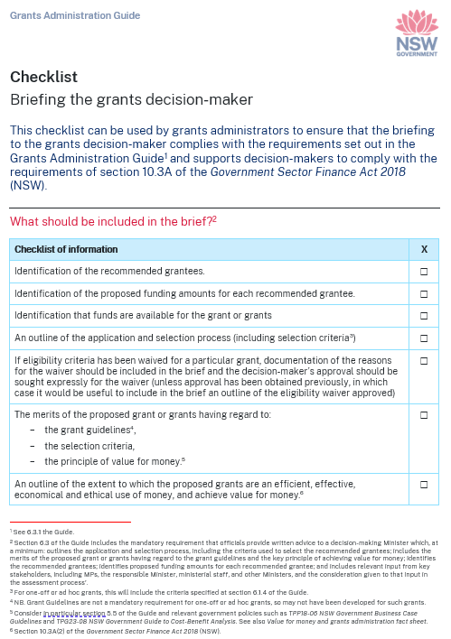
Briefing the decision-maker
Where the decision-maker is a Minister
At a minimum, officials must provide the following written advice:
Application and selection process
Eligibility and assessment criteria
Merits of the proposed grant having regard to the grant guidelines (if any), the selection criteria and value for money
Recommended grantees and proposed funding amounts for each
That funds have been approved and are available to be spent
Consideration of input provided from key stakeholders (e.g. MPs, responsible Minister, Ministerial staff and other Ministers)
Meeting the assessment criteria
Officials should at a minimum indicate which grant applications:
Fully meet assessment criteria
Partially meet assessment criteria
Do not meet any of the assessment criteria
Probity Advice
Assessment team recommendations
Notes:
For one-off and ad hoc grants, the Minister is generally the decision maker and the principles in the Guide relevant to decision-makers do apply. Ministers’ responsibilities are set out in Section 2 of this slide deck.
There is a ‘Briefing the grants decision-maker’ checklist available to download on the Grants Administration Guide webpage

Slide 32
Requirements for decision-makers
A decision-maker must not approve or decline a grant without first receiving written advice from officials on the merits of the proposed grant
A decision-maker who approves or declines a grant must record the decision in writing, including the reasons for the decision (and any departure from the recommendation of officials), having regard to the grant guidelines (if any), the selection criteria and the key principle of achieving value for money
Records must be managed in accordance with the State Records Act 1998
Decision-makers must not approve a grant that has been assessed as ineligible, unless they have decided to waive eligibility criteria in accordance with the requirements in the Guide.
Decision-makers should also be aware of other requirements that apply to them, including under section 10.3A(2) and (3) of the GSF Act
Notes:
The Guide requires that decision-makers receive written advice on the merits of a proposed grant, and imposes obligations in terms of recording decisions and keeping records of those decisions, in accordance with the requirements of the State Records Act 1998.
The Guide recognises that decision-makers may approve or decline grants in variance from the recommendation of officials, but this departure from a recommendation must be recorded and published.
Generally, an application assessed as ineligible should not be approved. In limited circumstances, a decision may be made to waive eligibility criteria, for example, where not doing so would: lead to perverse or unfair outcomes, be contrary to the policy intent, or damage the reputation and integrity of the grant program. If such circumstances apply and it is considered that eligibility criteria should be waived, the reasons for waiving the eligibility criteria must be documented and the waiver must be approved by the decision-maker (whether as part of the final approval or otherwise).
Note that other requirements apply to decision-makers, including under section 10.3A of the GSF Act as outlined on previous slides.

Slide 33
Assessment of non-competitive grants
Agencies need to identify
the designated decision-maker who must be satisfied that funds are being assessed and administered appropriately
the assessor(s) responsible for ensuring grants are administered in accordance with approved criteria
Automated systems
Records should be retained
Notes:
There are exceptions for non-competitive grants – such as high-volume grants, as the assessment process will differ and may not involve a two-stage assessment and decision making process.
Agencies need to identify
the decision maker who must satisfy themselves that funds are being assessed and administered in accordance with approved criteria and policy intent. This may entail approving grant program policies and processes in risk management, assessment, quality assurance and auditing, and escalation of compliance issues.
the assessor(s) responsible for administration of grants against approved criteria
Records from automated systems (such as used for high volume grants) should be retained as part of the documentation of the grants administration process (and be made available for internal auditing/fraud control purposes).
These exceptions do not apply to one-off, ad hoc grants as the Minister is generally the decision-maker.

Slide 34
Providing grants
A grant agreement should formalise terms and conditions.
Grantees must be subject to clear and specific terms and conditions and a clear understanding between the parties on required outcomes.
Agreements must be legally enforceable and include clarity as to termination rights and appropriate accountability for grant money (including monitoring and acquittal requirements and how unspent funds may be dealt with).
If it is not practical to provide each individual with a grant agreement (e.g. emergency relief and high-volume grants), grantees must still be bound by specific terms and conditions.
All written agreements must require a grantee to acknowledge the financial support provided by the NSW Government.
Notes:
Once applicants have been advised of the assessment outcome, the terms and conditions of the grant should be formalised in writing.
Officials must ensure grantees are subject to clear and specific terms and conditions for a grant.
There is no required format for grant agreements, however officials should ensure that grant agreements are fit for purpose with regard to the nature of the grant and grantee, the risks of the grant and the principle of proportionality.
Agreements must be legally enforceable and include appropriate accountability for grant money (including monitoring and acquittal requirements)
If it is not practical to provide each individual with a grant agreement (e.g. emergency relief and high-volume grants), grantees must still be bound by specific terms and conditions.
All offer letters must require a grantee to acknowledge the financial support provided by the NSW Government.
Template funding agreements are available on https://www.nsw.gov.au/grants-and-funding/grants-administration-guide.

Slide 35
Variations requested after a grant is decided
Occasionally, a successful grant recipient may, after the grant has been approved, request a change to the funded project.
If the change is such that the grant recipient is essentially requesting a new grant (e.g. for additional funds for an existing program, or the use of the same funds for a different, unapproved purpose), then the change in scope should be treated as a new grant
A minor change to an approved project that does not substantively impact the approved purpose or change the timing or conditions of the approved grant would not generally need to be treated as a new grant.
Notes:
The kinds of proposed changes that might amount to a minor change include:
An extension of time request of a relatively short duration, unless the approved purpose has a time requirement or constraint (for example, the approved funding is for an event to be hosted by a certain time).
A minor change to scope that aligns with the approved purpose and does not involve the seeking of any additional funds.
If a change request – or a new grant following a change request - is approved by the decision-maker or officials as necessary, further steps will need to be taken to implement the change or new grant. For example, if a grant agreement has been executed, it may need to be amended to reflect the changed scope (if approved). There may also be additional or new publication requirements to ensure transparency about what has been funded.

Slide 36
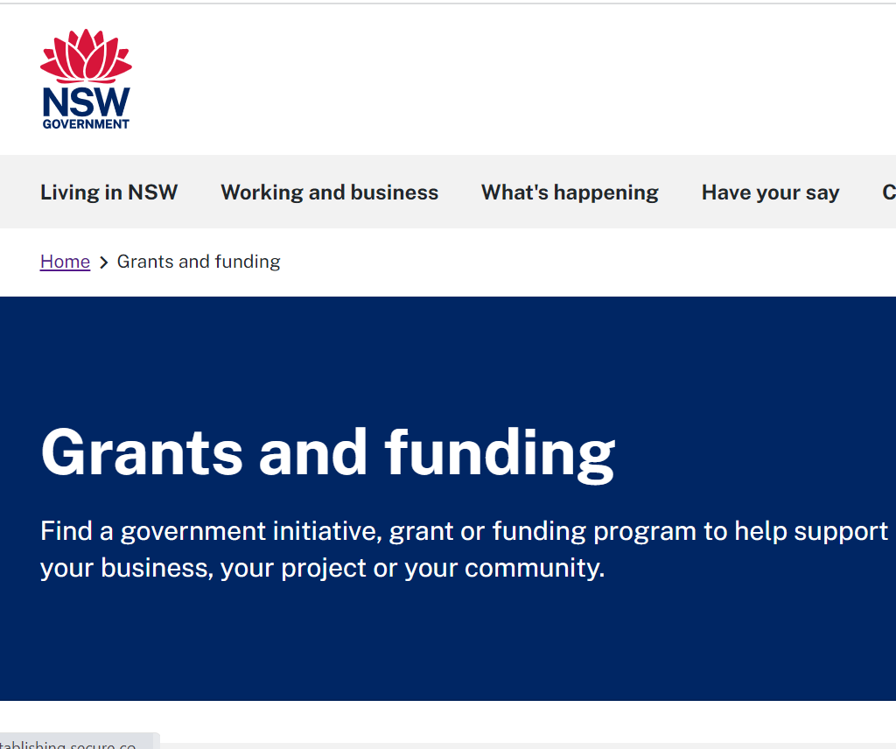
Publishing grant information
The following information about grants must be published:
upcoming grant opportunities
open grant opportunity guidelines
all grants awarded
the exercise of Ministerial discretion
program evaluations.
Specific publishing requirements are set out at Appendix A to the Guide.
Information about grants awarded must be published within 45 days.
Some legal and policy exceptions to publication may apply.
Notes:
Effective disclosure and publishing of grants information are essential for transparency and public accountability.
Officials must publish the following information about grants to best-practice customer experience standards on the NSW Government Grants and Funding Finder
upcoming grant opportunities
open grant opportunity guidelines
all grants awarded
the exercise of Ministerial discretion in making grant decisions that vary from the recommendation of officials, including the reasons for any such decision
program evaluations.
Official must publish this information in accordance with the requirements of Appendix A to the Guide.
Decisions relating to grants must be published within 45 days of the agreement – or 45 days from when the first payment is made to the grantee if there is no grant agreement.
The Guide sets out certain legal and policy exceptions to publication.

Slide 37
Provision of Emergency Relief Grant Information to the Auditor-General
Officials must provide emergency relief grants information to the Auditor-General within three months of the grant agreement taking effect, or, if there is no grant agreement, no later than three months after the first payment is paid to the grantee.
The information about emergency relief grants that must be provided to the Auditor-General includes:
the grants information required to be published on the NSW Government Grants and Funding Finder under section 6.5 of this Guide
grants information required to be reported by NSW agencies to the Commonwealth under the Disaster Recovery Funding Arrangements 2018.
Notes:
Officials must provide emergency relief grants information to the Auditor-General within three months of the grant agreement taking effect, or, if there is no grant agreement, no later than three months after the first payment is paid to the grantee.
Emergency relief grants are those grants that provide relief or recovery assistance for a ‘natural disaster’ or ‘terrorist act.’ They may include emergency grants co-funded with the Commonwealth under the Disaster Recovery Funding Arrangements (DRFA).
The information about emergency relief grants that must be provided to the Auditor-General includes:
the grants information required to be published on the NSW Government Grants and Funding Finder under section 6.5 of this Guide
grants information required to be reported by NSW agencies to the Commonwealth under the Disaster Recovery Funding Arrangements 2018.
These terms are defined in Disaster Recovery Funding Arrangements 2018 Guidelines.
The DRFA is a joint Australian Government-State cost sharing arrangement to alleviate the financial burden on the states and facilitate the early provision of assistance to disaster affected communities.

Slide 38
Monitoring and acquitting grants
Officials should monitor both individual grants and the overall grant opportunity:
track the progress of grant activities
establish if funds were dispersed correctly and used as intended
assess outcomes, benefits and value for money.
An acquittals process is also a key element of continuous financial monitoring. Officials should conduct an acquittal for individual grants to account for how funds have been spent and compliance with the grant terms and conditions.
Notes:
Grant agreements should be supported by ongoing communication, active grants management and performance monitoring, which are proportional to the risks involved.
It is important that officials support grantees with appropriate guidance, templates and a contact to obtain additional advice if they need it.
Officials should also ensure that reliable and timely evidence demonstrates that the grant is used according to its terms and conditions.
Monitoring
Monitoring payments made and the progress towards intended outcomes is integral to good governance and risk management.
Agencies need to ensure they are resourced to for ongoing grants monitoring and management following the signing of a grants agreement.
Officials should monitor both individual grants and the overall grant opportunity:
track the progress of grant activities
establish if funds were dispersed correctly and used as intended
assess outcomes, benefits and value for money.
Acquittal
An acquittals process is a key part of continuous financial monitoring that accounts for how funds have been spent.
An acquittal should be conducted for individual grants – assessing grantees’ compliance with the terms and conditions set out in the funding agreement.
Funding agreements should include adequate safeguards to prevent misuse of grant funds and stipulate what should happen to funds that are not fully expended.
Where conducting an acquittal for each grant is not practicable, such as in high-volume grant opportunities for emergency relief, agencies should apply appropriate alternative methods for verifying how grant money has been spent.

Slide 39
Grants evaluation
Grants evaluation is important to determine whether a grant has met its intended outcomes and to help inform the design of future grant opportunities.
There are three main types of evaluation:
Process evaluation
Outcome evaluation
Economic evaluation
The NSW Government publication ‘TPG22-22 Treasury Policy and Guidelines: Evaluation’ sets out mandatory requirements, recommendations and guidance for agencies to conduct evaluation.
Notes:
Evaluating grants is important to:
determine whether a grant is on track to meet objectives and government priorities, and any performance improvement needed
identify outcomes and benefits, including assessing how the grant has improved the welfare of the NSW community
contribute to a broader knowledge base to help inform the design and appraisal of future grant opportunities.
There are 3 main types of evaluation:
process evaluation – consider how an initiative was delivered, including whether it was implemented as intended, and any issues that arose
outcome evaluation – examine if and how an initiative has lead to intended changes
economic evaluation – identify and measure the impacts of an initiative relative to its costs (an assessment of value for money or net social benefit).
The NSW Government publication Treasury Policy and Guidelines: Evaluation sets out mandatory requirements, recommendations and guidance for agencies to plan for and conduct evaluation.
Ex-post CBA's are recommended for investments valued over $50 million, or for smaller investments where evidence will inform future decision making (e.g. pilots)
If, however, an ex-ante business case and/or CBA was required but did not take place due to an emergency or other exigency, an evaluation including an ex-post CBA must be conducted. Agencies must clearly identify who will be held responsible for completing the evaluation and that sufficient resources are set aside.

Slide 40
Contacts and additional resources
6

Slide 41
Resources
Premier’s Memorandum M2024-03 Grants Administration Guide
Grants Administration Guide, including fact sheets and templates: https://www.nsw.gov.au/grants-and-funding/grants-administration-guide
NSW Government Grants and Funding Finder: https://www.nsw.gov.au/grants-and-funding
TPP 18-03: NSW Government Guide to Cost-Benefit Analysis
TPG 23-08: NSW Government Business Case Guidelines
TPP 20-08: Internal Audit and Risk Management Policy for the General Government Sector
TPP 22-22: Treasury Policy and Guidelines: Evaluation

