Slide 1
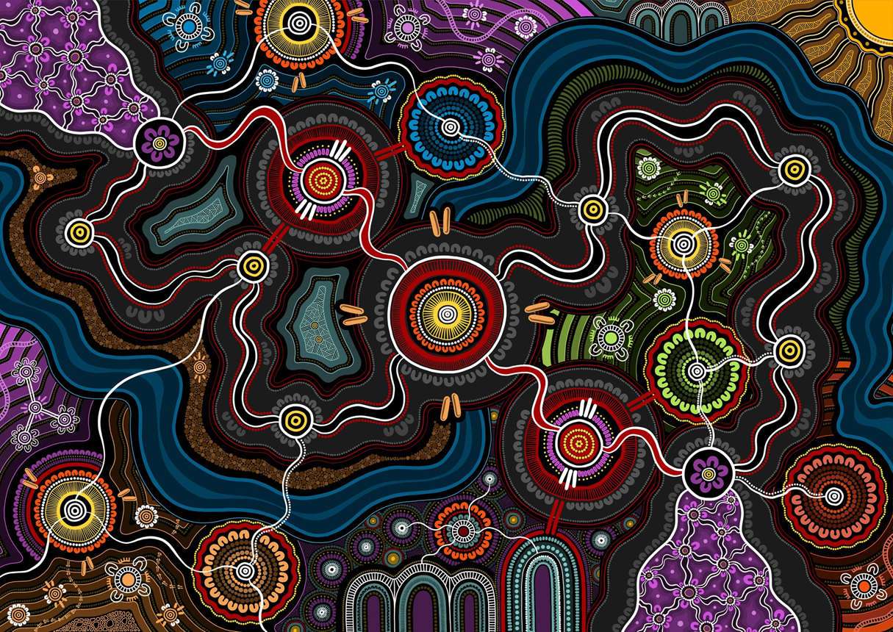
Closing the Gap Grants
Monitoring, Evaluation and Learning (MEL) Toolkit
Introductory PowerPoint Presentation

Slide 2
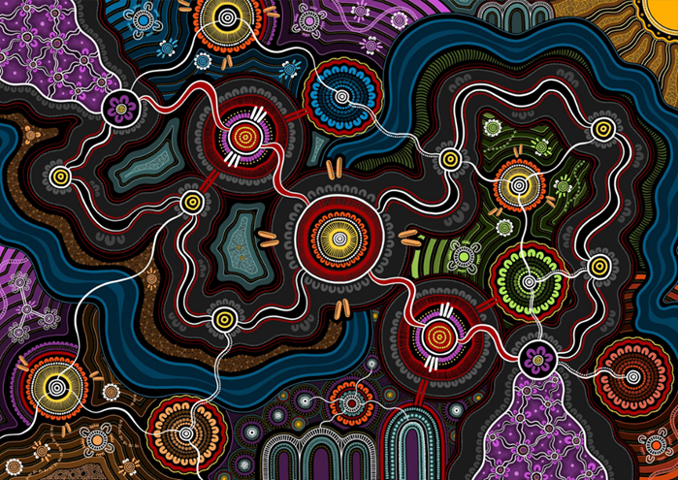
We acknowledge the diverse Countries, languages, and cultures of Aboriginal and Torres Strait Islander Peoples as the First Peoples and Custodians of our lands and waters. We recognise their shared experiences and celebrate the diversity and uniqueness of each Aboriginal and Torres Strait Islander community, emphasising the importance of listening to local needs and priorities.
'In the Footsteps of Our Ancestors' Amy Allerton

Slide 3
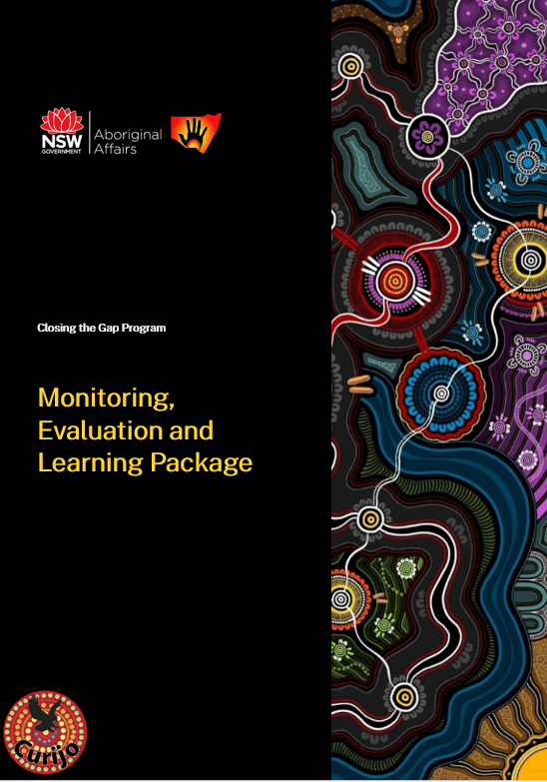
The purpose of this PowerPoint is to introduce the new MEL Toolkit and factsheets for Aboriginal businesses and ACCOs.
These have been developed by Curijo with NSW Aboriginal Affairs .
The Toolkit aligns with the MEL Framework, incorporating a cultural lens.
The aim of the toolkit is to introduce basic MEL knowledge for grant-funded programs.
There is the Toolkit and 8 factsheets.

Slide 4
MEL Toolkit Overview
This entry-level toolkit helps ACCOs, and Aboriginal businesses monitor, evaluate, and learn (MEL) from their grant initiatives. It supports the CTG Grants Program with community-led, culturally adapted approaches.
Toolkit Highlights
Basics of MEL
Planning to reporting
Dos and Don’ts of MEL
Cultural safety and privacy considerations
Communicating findings effectively

Slide 5
History of Aboriginal Evaluation
Evaluation of programs designed for Aboriginal peoples and their communities is shifting from external, non-Indigenous assessments to community-led, strengths-based, and culturally respectful practices.
Recent Shift: Emphasising self-determination and cultural safety.
Examples: SNAICC, Lowitja Institute, and CREATE promote Aboriginal-led, culturally safe evaluation.
Toolkit Info: Includes Aboriginal and culturally responsive evaluation resources and links for further reading.

Slide 6
Theory of Change
Program evaluation supports long-term success by ensuring programs effectively meet community needs and goals. MEL processes help Aboriginal organisations stay accountable and empower communities in shaping their futures.
Self-Determination and Cultural Integrity: ACCOs and businesses base their evaluations on these principles, respecting Aboriginal ways of knowing, being, and doing.
Purpose: Integrating these approaches ensures the work aligns with community needs and achieves its intended impact.

Slide 7
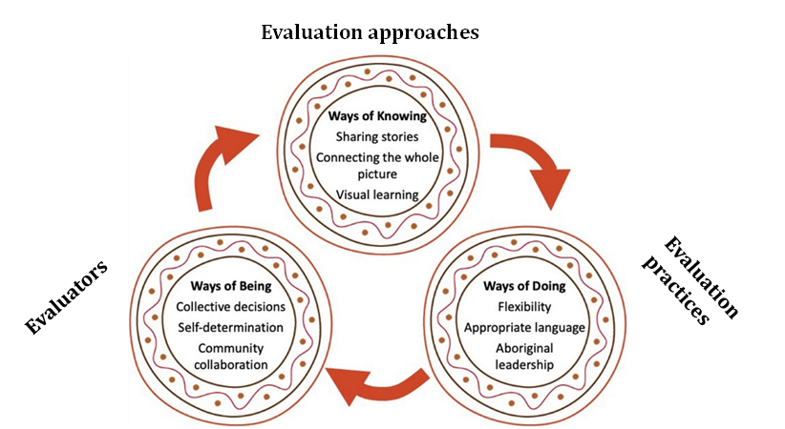
CCC
https://www.sciencedirect.com/science/article/pii/S235282732100149X
This is the model of systems of thinking of knowing, doing and being.
The three elements form a feedback loop, where Ways of Knowing inform Ways of Being which underpin Ways of Doing, which in turn prompts learning and, therefore, shapes Ways of Knowing.
Artwork: Casey Atkinson, Bangerang.
https://www.sciencedirect.com/science/article/pii/S235282732100149X

Slide 8
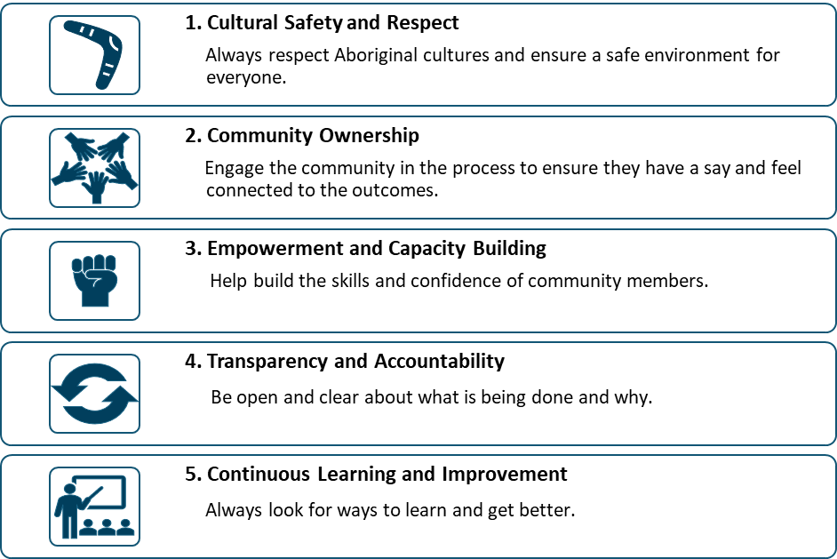
These are the principles we have used from the Evaluation Recommendations
All of this sets the scene for MEL

Slide 9
What is MEL?
Monitoring: Collect information regularly to check progress and goals.
Evaluation: Makes an assessment of programs to determine what has worked well, what hasn’t worked, and why, to improve programs.
Learning: Use insights from monitoring and evaluation to enhance decision-making and growth.
Why MEL Matters
Ownership: Empowers communities to define success and own their data.
Improvement: Continuously refine programs to meet needs and goals.
Empowerment: Ensures cultural relevance by involving communities.
Accountability: Shows impact and spending to funders and communities.

Slide 10
CCC
Basic Dos and Don’ts of MEL

Slide 11
Overview of the steps
Step 1: Planning Your MEL Approach
Step 2: Collecting Data
Step 3: Analysing and Evaluating Data
Step 4: Reporting and Sharing Insights
Step 5: Learning and Changing

Slide 12
Step 1: Planning Your MEL Approach
Allocate time and budget for MEL activities
Define success using a Logic Model (inputs, activities, outputs, outcomes)
Identify indicators to track progress
Choose stakeholders to involve in the evaluation process
Develop evaluation questions to guide your analysis
Ensure the MEL approach is culturally safe and inclusive

Slide 13
Step 2: Data Collection
Organise consultation
Get consent
Do the consultation and collect the data

Slide 14
Step 3: Analysing and Evaluating Data
Identify trends and areas to improve
Interpret findings with community

Slide 15
Step 4: Reporting and Sharing Data
Make the reports and visuals
Sharing the findings

Slide 16
Step 5: Learning and Changing
Translate findings into action

Slide 17
MEL (Monitoring, Evaluation, and Learning)
Helps ACCOs and Aboriginal businesses identify what works and what needs improvement.
An ongoing process that collects, analyses, and shares data for continuous program and service improvement.
Builds trust with communities by meeting their needs and expectations.
Involves community members to ensure cultural appropriateness and respect.
Provides feedback from participants, clients, and staff to create reports and make necessary changes.
Sharing findings shows commitment and fosters community growth.
MEL toolkit supports ACCOs, Aboriginal businesses, and communities in achieving goals, making smarter decisions, and creating lasting, positive impact.
Summary Overview for MEL Toolkit

Slide 18
Introduction to MEL Factsheets
These factsheets are designed to guide ACCOs and Aboriginal businesses through the MEL process. There are 8 factsheets:
Introduction to MEL
Dos and Don’ts of MEL
Planning and Budgeting for MEL
Engaging with Stakeholders
Data Collection Methods
Evaluating Outcomes
Cultural Safety in Evaluation
Economic Assessments in MEL

Slide 19
Overview:
Defines Monitoring, Evaluation, and Learning.
Highlights importance for program success and community impact.
Key Points:
Monitoring: Track progress and goals.
Evaluation: Assess program effectiveness.
Learning: Improve programs based on findings.
Factsheet 1 - Introduction to MEL

Slide 20
Dos:
Keep it simple.
Focus on main goals.
Use both quantitative and qualitative data.
Ensure cultural appropriateness in methods.
Don’ts:
Don’t leave MEL until the end of the program.
Avoid measuring too many indicators.
Involve the community throughout the MEL process.
Factsheet 2 - Dos and Don’ts of MEL

Slide 21
Planning Steps:
Define clear objectives and outcomes.
Identify and allocate resources early.
Budgeting Tips:
Allocate around 10% of program budget to MEL.
Include staff time, data collection tools, and participant incentives.
Factsheet 3 - Planning and Budgeting for MEL

Slide 22
Stakeholder Involvement:
Engage clients, staff, and community leaders.
Ensure diverse perspectives for holistic evaluation.
Approaches:
Use culturally safe and respectful methods.
Include regular feedback loops to maintain transparency.
Factsheet 4 - Engaging with Stakeholders

Slide 23
Quantitative Methods:
Surveys, statistics, program data.
Qualitative Methods:
Yarning Circles, interviews, storytelling.
Best Practices:
Combine both methods for a comprehensive evaluation.
Ensure cultural relevance in tools used.
Factsheet 5 - Data Collection Methods

Slide 24
Steps for Analysis:
Analyse data to identify trends and areas for improvement.
Use thematic analysis for qualitative data.
Outcome Assessment:
Determine program impact and areas for growth.
Involve community members in interpreting findings.
Factsheet 6 - Evaluating Outcomes

Slide 25
Key Principles:
Respect, community ownership, and empowerment.
Ensure transparency and continuous improvement.
Best Practices:
Use culturally appropriate methods and involve Aboriginal leadership.
Regularly review and refine evaluation processes for cultural safety.
Factsheet 7 - Cultural Safety in Evaluation

Slide 26
Overview:
Assess value and impact of programs economically.
Guidance:
Analyse costs and benefits.
Ensure that economic assessments align with community values and priorities.
Factsheet 8 - Economic Assessments in MEL

Slide 27
We hope this toolkit and the accompanying factsheets provide valuable guidance for your MEL processes.
Next Steps:
Apply the tools and strategies outlined to your projects.
Engage with community members and stakeholders for meaningful evaluation.
Continue to adapt and learn, ensuring your programs achieve lasting impact.
Thank You for Engaging with the MEL Toolkit and Factsheets

