Slide 1
WriteOn 2025 Teaching and learning support

Slide 2
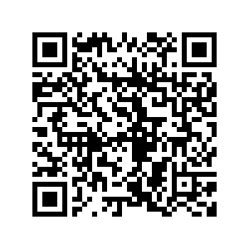
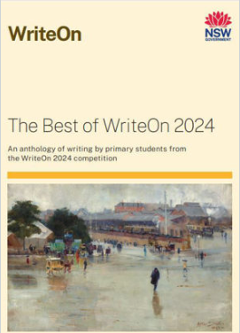
What is WriteOn?
Overview
NESA’s annual WriteOn competition is an exciting opportunity for schools to focus on writing while developing students’ skills as young writers to express their ideas. The competition is for primary students in Years 1 to 6 accessing NSW syllabuses. Students create an imaginative text of up to 500 words, inspired by the provided stimulus.
Teaching and learning advice aligned to the NSW English K–10 Syllabus (2022) is provided to assist teachers to use the competition as part of teaching and learning.
NESA selects winning entries to become published authors in The Best of WriteOn anthology as well as being celebrated in a prestigious WriteOn Awards Ceremony event this year at the State Library of NSW.
The 2024 anthology is available for purchase from the NESA Shop.
This year we are providing resources for schools to host their own WriteOn festival to focus on and celebrate writing across the school.
Meet some of the winners from WriteOn 2024.
Figure 1: The Best of WriteOn 2024 Anthology

Slide 3
How to start
Stimulus for WriteOn 2025
For WriteOn 2025, students use this stimulus quote: ‘Could they be changing?’ to explore their voices as authors when creating an imaginative text. Responses should be guided by English syllabus content for the appropriate stage of learning.
Writing an imaginative text for WriteOn 2025
Suggestions for imaginative texts for WriteOn 2025 may include:
diary or journal entries from an imaginary character
short prose fictional narratives (e.g., a short fantasy or adventure story)
character explorations
poetry.
The imaginative text chosen should relate to the stimulus and include intentional choices with appropriate text structures, features and language to engage the audience. Stage-based criteria is included to support teachers and students.
NESA’s judging
A panel comprised of experienced NSW primary teachers, from NESA and educational sectors, judge the final entries submitted to NESA.
The decision of the judging panel is final.
Figure 2: WriteOn 2025 stimulus
WriteOn 2025 poster
Download the competition poster from the NESA website.

Slide 4
Entry information
Entry information
Applications must be submitted by Friday 20 June 2025.
Each school can submit a maximum of 3 entries: one entry per stage from Stage 1, Stage 2, and/or Stage 3 using the online entry form.
Each submitted work should be typed and a maximum of 500 words.
Student and school details including Aboriginal Country name, contact teacher and/or principal email address are required.
Parent/guardian permission to publish information must be completed for each entry via the consent form included in the entry form.
School entries must:
only be submitted by a teacher in a school
be approved by the school principal.
Home school entries must:
only be submitted by a registered home schooling parent/legal guardian
include a valid NESA registration number.
Additional entry information
Only individual student entries can be submitted (no joint constructions).
Entries must be the student’s own work. AI generated entries are not permitted
Texts should be created in the student’s class environment.
Guidance for schools in selecting their finalists for submission using an in-school writing festival is included.
Optional inclusion
Entries may include a scanned or photographed version of the student’s first draft. These drafts can be uploaded to the online entry form. Drafts may be used by NESA for future teaching and learning resources.

Slide 5
WriteOn 2025 timeline
24 March
24 March to 13 June
13 June
20 June
July to September
22 September
Suggested date to finalise and commence uploading max 3 entries
WriteOn 2025 Awards ceremony at State Library of NSW
WriteOn 2025 opens
In school WriteOn activities
WriteOn 2025 closes
NESA’s judging

Slide 6
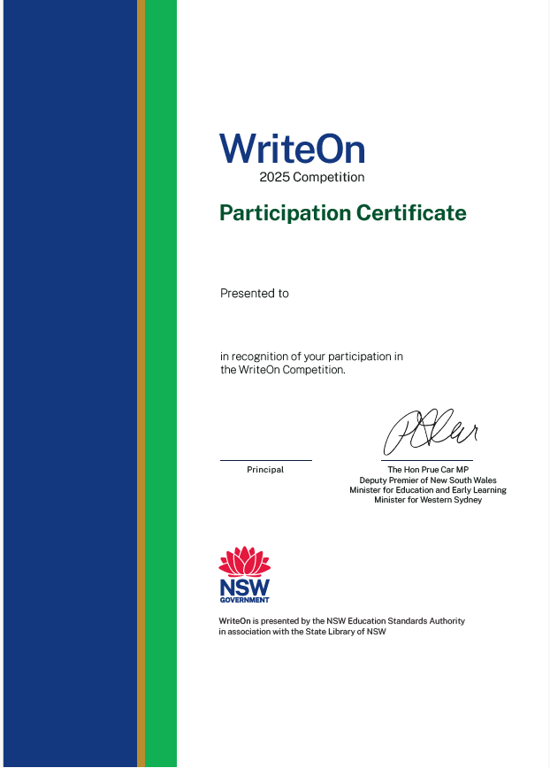
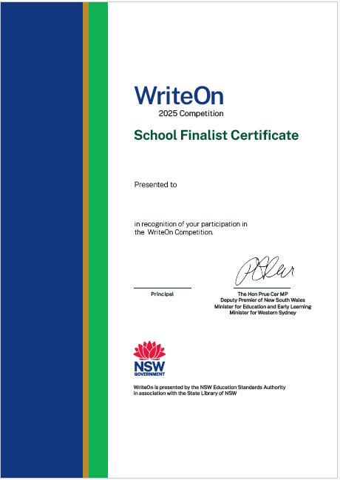
Promoting writing in your school
Regularly publish written texts selected by teachers or students in the school newsletter.
Students who participated in the optional school WriteOn festival may be presented with a participation or school finalist certificate.
Share sections of the writing with peers, other classes or stages.
Students share written texts or read them aloud to peers in other stages.
Figure 3: WriteOn participation certificate
Figure 4: WriteOn school finalist certificate
Schools create their own The Best of WriteOn anthology.
Participation certificate – participation certificate templates will be made available on the NESA website
School finalist certificate – finalist certificate templates will be made available on the NESA website
Notes:
Schools may wish to include some of these optional activities to promote writing in their schools through the WriteOn competition. Some schools may also wish to download and print WriteOn certificates for student participation and for the students selected as finalists for entry into the competition.

Slide 7
WriteOn 2025: Support materials

Slide 8
Suggested English K–10 Syllabus outcomes
Stage 1 outcomes | Syllabus focus area
EN1-CWT-01 EN1-VOCAB-01 EN1-UARL-01 | Creating written texts Vocabulary Understanding and responding to literature
Stage 2 outcomes | Syllabus focus area
EN2-CWT-01 EN2-UARL-01 EN2-VOCAB-01 | Creating written texts Understanding and responding to literature Vocabulary
Stage 3 outcomes | Syllabus focus area
EN3-CWT-01 EN3-UARL-01 EN3-VOCAB-01 | Creating written texts Understanding and responding to literature Vocabulary

Slide 9
Supporting students with disability
Some students with disability may need adjustments to create imaginative written texts such as access to alternative transcription formats and assistive technologies.
Students with disability can be supported with writing adjustments when creating their written text. Strategies could include:
use a word bank or list
scaffold writing using graphic organisers.
To support students who are unable to handwrite or type, alternative communication formats and assistive technologies may be used, for example, speech-to-text devices or communication boards (see also teaching advice for Creating written texts). The transcription from these devices of students’ texts can be submitted for entry to the competition.

Slide 10
Supporting students who have English as an additional language or dialect (EAL/D)
When engaging in WriteOn 2025, strategies to support EAL/D students when creating written texts include:
providing opportunities for students to plan writing in their home language
scaffolding the editing process to transfer text into Standard Australian English
using the stimulus to support oral and written language and vocabulary
building background and cultural knowledge connected to the stimulus
explicitly teaching language structures in context such as modelling and deconstructing sentences and text features
using a small range of familiar words, drawings and/or symbols that may then be transcribed. In these instances, the transcriptions can be submitted for entry to the competition.
Refer to the NESA website for additional support.

Slide 11
Supporting Aboriginal students
Teachers can support Aboriginal students to create their entry for WriteOn 2025 in a range of ways.
Aboriginal English refers to Indigenised varieties of English used by Aboriginal people around Australia. There are enough similarities between these varieties to refer to them collectively as 'Aboriginal English'. Aboriginal English has its own structure, rules, and the same potential as any other linguistic variety. Due to a range of historical and contemporary experiences, Aboriginal Languages and English are incorporated into Aboriginal English in different ways and to varying degrees.
When planning and drafting, and in their completed texts, Aboriginal students may:
include Aboriginal English, e.g. "You mob wanna hab a feed now, owot? It getting proper late."
incorporate Aboriginal Language words or phrases, e.g. as a feature of their authorial voice, making purposeful language choices
use culturally-specific terms and concepts, e.g., Country, Uncle, sista. For students whose first language is an Aboriginal Language, Torres Strait Islander Language, or Aboriginal English, teachers can also refer to advice on supporting students learning English as an additional language/dialect (EAL/D).
Refer to the NESA website for further information about Aboriginal students and Aboriginal and Torres Strait Islander principles and protocols.

Slide 12
WriteOn 2025: Teacher resources
Suggested in-school judging criteria for teachers

Slide 13
Stage 1: suggested in-school WriteOn judging criteria
Stage 1: suggested in-school judging criteria for WriteOn 2025 | Observed | Not observed
Makes connections to the stimulus in imaginative ways.
Engages and sustains reader interest.
Selects, maintains and/or makes deliberate choices about the selected text features.
Uses appropriate tense across the text.
Ideas or events develop in a logical order across the text.
Uses conjunctions to create cohesion across the text.
Groups sentences into paragraphs.
Uses different kinds of sentence structures such as simple and compound, and experiments with some complex sentences.
Uses punctuation accurately and for effect.
Builds descriptions of the setting, action and characters to add meaning or precision.
Makes interesting word choices or wordplay.
Uses Tier 2 and Tier 3 vocabulary to elaborate and extend on ideas
Is within the 500-word limit.
Notes:
This suggested WriteOn judging criteria may be used by schools to assist them in selecting their class, stage or school finalists for entry into NESA’s WriteOn 2025 competition.

Slide 14
Stage 2: suggested in-school WriteOn judging criteria
Stage 2: suggested in-school judging criteria for WriteOn 2025 | Observed | Not observed
Makes connections to the stimulus in imaginative ways.
Selects, maintains and/or makes deliberate choices about the selected text features.
Engages and sustains reader interest by elaborating on details such as time or place or characters.
Maintains appropriate, consistent past, present or future tense across a text.
Ideas and events develop in a logical and coherent order using paragraphs or stanzas.
Has consistent control of sentence types and language.
Uses different kinds of sentence types for effect.
Uses punctuation conventions accurately.
Selects and uses adjectives to develop descriptive features.
Includes language to create imagery or humour.
Makes interesting word choices and includes Tier 2 and Tier 3 vocabulary.
Is within the 500-word limit.
Notes:
This suggested WriteOn judging criteria may be used by schools to assist them in selecting their class, stage or school finalists for entry into NESA’s WriteOn 2025 competition.

Slide 15
Stage 3: suggested in-school WriteOn judging criteria
Stage 3: suggested in-school judging criteria for WriteOn 2025 | Observed | Not observed
Makes connections to the stimulus in imaginative ways.
Selects, maintains and/or makes deliberate choices about the selected text structure, features and language to engage the audience.
Engages and sustains reader interest by elaborating on details such as setting or character profiles.
Maintains and/or makes deliberate choices about the selected text structure and features, developing thematic elements.
Controls tense across a text according to the purpose.
Ideas or events develop in a clear, coherent way e.g., through multiple paragraphs or stanzas.
Makes creative choices about temporal and spatial settings, or character/s to enhance reader engagement.
Makes choices about the use of verbs, nouns and adjectives to modify, or to add detail, meaning or variety.
Uses different kinds of sentences such as imperative, interrogative and/or exclamatory, and may include questioning for meaning or effect.
Varies sentence lengths for clarity and effect.
Uses accurate punctuation conventions and may experiment for effect.
Experiments with word choices to add interest.
Uses Tier 2 and Tier 3 vocabulary.
Is within the 500-word limit.
Notes:
This suggested WriteOn judging criteria may be used by schools to assist them in selecting their class, stage or school finalists for entry into NESA’s WriteOn 2025 competition.

Slide 16
WriteOn 2025: Classroom resources
Optional additional English K–10 Syllabus (2022) aligned teaching and learning support

Slide 17
Stage 1: WriteOn student self-assessment criteria
Stage 1: Criteria for creating an imaginative text for WriteOn 2025 (student)
My text has an interesting title and connects to the stimulus.
The ideas or events are easy to follow.
My text describes the time, place or characters in an interesting way.
My ideas make sense.
I have created paragraphs by grouping sentences together.
I have used simple and compound sentences are used to engage the reader.
I have used the correct punctuation.
Words or wordplay are chosen to add detail and interest to the writing.
I have used Tier 2 and Tier 3 vocabulary.
My writing is less than 500-words.
Name: ___________________________
Notes:
This suggested WriteOn student self-assessment criteria may be used by schools to assist students with the WriteOn 2025 competition.

Slide 18
Stage 2: WriteOn student self-assessment criteria
Stage 2: Criteria for creating an imaginative text for WriteOn 2025 (student)
My writing connects to the stimulus in an interesting way.
My writing has an interesting title that will appeal to my audience.
The ideas or events are easy to follow and in a clear order.
My writing describes the time, place or characters in an interesting way.
The sentences and ideas make sense and have used the same tense across my writing.
My text uses different types of sentences and has some ideas connected into paragraphs or stanzas.
I have used punctuation correctly.
I have used Tier 2 and 3 vocabulary.
I experimented with words to engage the reader.
Words such as adjectives and verb groups are used to describe and add more detail to the writing.
My text is less than 500-words.
Name: ___________________________
Notes:
This suggested WriteOn student self-assessment criteria may be used by schools to assist students with the WriteOn 2025 competition.

Slide 19
Stage 3: WriteOn student self-assessment criteria
Stage 3: Criteria for creating an imaginative text for WriteOn 2025 (student)
My writing connects to the stimulus in an interesting way.
My writing has an interesting title that will appeal to my audience.
My ideas or events are easy to follow and develop in a clear order.
The time, place or characters and their actions or motives are described in an interesting way.
I have controlled the tense across the text using past present and future tense if required.
I have varied sentence structure and length.
I have used punctuation appropriately.
I have used Tier 2 and Tier 3 vocabulary.
I have made choices about using different sentences to suit text purpose, and for meaning and effect
I have selected words to add interest, including some word play or imagery.
My writing is less than 500-words.
Name: ___________________________
Notes:
This suggested WriteOn student self-assessment criteria may be used by schools to assist students with the WriteOn 2025 competition.

Slide 20
WriteOn – ideas for planning your imaginative text
Plan your writing
Getting started:
How can I connect to the stimulus in an interesting way?
Who will be the audience that will read my text?
What type of text do I want to write?
Can any texts I have read give me some ideas or vocabulary?
What happens in the beginning, middle and end of my text?
Characters:
If I have characters, who will they be?
What language features can I use to explain what these characters look like and what do they do?
What will these characters want and what is standing in their way?
Place:
Where will my text take place and how can I describe it?
What language features can I use to help the reader picture my text?
Time:
When will my text take place?
What tense will I need to use for this time?
Notes:
Teachers may use these additional slides to support students in creating their imaginative texts. These may be varied to suit student or class contexts.

Slide 21
WriteOn – ideas for creating your imaginative text
Create your text
Structure:
How can I start and finish to make my text interesting for the reader?
Are my ideas, events and actions in a clear sequence?
Sentences:
Can I vary the length and type of my sentences e.g. exclamations, questions, simple or complex?
Have I grouped or sequenced my sentences into paragraphs?
Language:
Can I use noun groups, verbs, adjectives, adverbs to add details?
Where can I use Tier 2 and Tier 3 vocabulary?
Where can I use some creative word play for effect?
Punctuation:
Am I correctly using:
exclamation, question or quotation marks
commas, capital letters and full stops
apostrophes?
Notes:
Teachers may use these additional slides to support students in creating their imaginative texts. These may be varied to suit student or class contexts.

Slide 22
WriteOn – revise your imaginative text
Revise your text
Questions for me:
Have I connected to the stimulus
Do I have an interesting title?
Are my ideas in order and do they make sense?
Have I used Tier 2 and Tier 3 words to add power?
Have I checked my spelling?
Do I use the right tense at the right time?
Have I checked my punctuation and grammar?
Has my teacher provided feedback to me?
Has someone else read my text and given feedback?
Have I edited and incorporated any feedback?
Questions for a peer:
Can you follow my ideas or what happens in my writing?
How could I make my text better?
Can you suggest some other interesting vocabulary I could use?
What did you find interesting about my text?
Notes:
Teachers may use these additional slides to support students in creating their imaginative texts. These may be varied to suit student or class contexts.

Slide 23
State Library of NSW stimulus materials
The State Library of NSW website contains collections of materials that schools may choose to explore. Schools have the option to use these materials to inspire students in developing ideas or themes for WriteOn 2025. An example is included below.
Insects watercolours, ca. 1790s
From the collections of the State Library of NSW.
Reference code 993151

Slide 24
Judges’ notes from WriteOn 2024
Judges from WriteOn 2024 noted that winning entries showed strength appropriate for their stage in:
using their selected text structure and remaining within the 500-word limit
making connection to the stimulus and with an interesting perspective
engaging the audience in imaginative, interpretive, emotive or creative ways
communicating and developing a clear theme
sustaining reader interest by drawing on background knowledge or unique ideas
making deliberate choices about the text features e.g. a plot twist or circular plot
organising the text into paragraphs with easy to follow and coherent ideas
demonstrating appropriate tense across a text
developing detailed descriptions of the setting, actions and character profiles
using word play or figurative language, creatively and purposefully
building tension or atmosphere by experimenting with word choices
using stage-appropriate vocabulary, grammar, punctuation and language.

Slide 25
WriteOn: Teaching considerations
Why focus on writing?
WriteOn is an opportunity for schools to embed writing across the school. A whole school focus on writing can foster a collaborative and consistent approach to the teaching of writing. This is important because:
the ability to write clearly and purposefully is a way students both learn and demonstrate what they have learned (NESA, 2018)
writing involves a range of skills from spelling and handwriting (or typing) to the organisation of ideas (Hochman and Wexler, 2017)
writing is a powerful tool for consolidating information in long-term memory and contributes to students’ learning in various subjects (Graham, 2019)
connecting writing with other English content, particularly reading, grammar and punctuation, supports clear expression of ideas (Cottingham, 2024).
For further information about creating written texts, refer to the teaching advice on the NSW Curriculum website.
General information about supporting student writing
WriteOn is an opportunity for schools to develop student writing through:
collaboratively generating ideas and modelling strategies for creating written texts
scaffolding writing and explicitly teaching targeted skills such as sequencing ideas in a logical order with consistent tense
leveraging mentor texts to highlight structural features and vocabulary
modelling and experimenting with sentence level grammar and punctuation (refer to NESA’s Teaching Grammar professional learning course for additional support in unpacking new grammar content in the NSW English K–10 Syllabus (2022)).
engaging students in peer conferencing and providing feedback
modelling self-reflection and self-monitoring while providing clear expectations through student self-judging rubrics
conferencing with students, giving explicit and detailed feedback to improve writing.

Slide 26
References
Cottingham S (2024) ‘Integrating Grammar and Creative Writing Lessons’, Edutopia, accessed January 20, 2025 https://www.edutopia.org/article/integrating-grammar-creative-writing/
Graham S (2019) 'Changing How Writing Is Taught', Review of Research in Education, 43(1):277–303, doi:10.3102/0091732X18821125.
Hochman JC and Wexler N (2017) The writing revolution: A guide to advancing thinking through writing in all subjects and grades, Jossey-Bass, San Francisco, CA
NSW Education Standards Authority (NESA) (2018) Teaching Writing, NESA website, accessed 11 May 2021 https://educationstandards.nsw.edu.au/wps/portal/nesa/about/who-we-are/research/research-reports/teaching-writing

