Slide 1
Keeping your identity safe program
Department of Customer Service
Stages 5 - 6
ID Support NSW nsw.gov.au/id-support-nsw
2024
Notes:
Teachers notes
Stages 5 – 6 (Years 9 – 12) have been identified for the Keeping your identity safe lesson.
Students in this age group are more likely to have:
begun working
obtained a tax file number
opened personal bank accounts
a learners or provisional driver licence
a passport.
Teachers may also decide that the content of this lesson, or some of the activities are appropriate for younger stage groups.
It is important to note that there are no right or wrong answers as students progress through the program. The intent is to get students thinking about when they may have shared their personal information and the reasons behind feeling safe to do so.
Students are not required to share their answers with the class if they do not feel comfortable.
If they want to talk to someone further about their situation, teachers can assist them in finding an appropriate person.
All time frames are suggested estimates.

Slide 3
Topic 1: Why identity matters
Department of Customer Service
1
10 minutes

Slide 4
Introduction 1
In Australia, people are often required to prove their identity, before accessing a variety of services and benefits.
These can include:
banking and loans, including buy now pay later services
phone and internet
cinemas
employment
travel
health services
Image: Sydney Harbour with boats in water
Notes:
Introduction
In Australia, people are often required to prove their identity, before accessing a variety of services and benefits.
These can include:
banking and loans, including buy now pay later services
phone and internet
cinemas
employment
travel
health services
CLICK TO NEXT SLIDE

Slide 5
Introduction 2
Criminals are aware of this too.
Australians lost nearly $3 billion* to scams and identity theft in 2023.
Scammers are always finding new ways to trick people into handing over their personal information like bank account details or proof of identity credentials.
They might try to trick you into thinking they are from the police, the government, banks, or well-known companies.
They might even act like a friend or family member.
Image: Two teenagers looking at their mobile phones
* Australian Competition and Consumer Commission. (2023). Targeting Scams, Report of the ACCC on scams activity 2022. Canberra.
Notes:
Criminals are aware of this too.
Australians lost nearly $3 billion to scams and identity theft in 2023.
Scammers are always finding new ways to trick people into handing over their personal information like bank account details or proof of identity credentials.
They might try to trick you into thinking they are from the police, the government, banks, or well-known companies.
They might even act like a friend or family member.
CLICK TO NEXT SLIDE

Slide 6
Introduction 3
Scammers often target students because they think young people don't know how to keep their personal information safe.
This short program will give you tips on how to keep your identity credentials secure, and to pause and consider the risks before sharing personal information.
Your identity is important, let’s protect it.
Image: A map of Australia on a black background
Notes:
Scammers often target students because they think young people don't know how to keep their personal information safe.
This short program will give you tips on how to keep your identity credentials secure, and to pause and consider the risks before sharing personal information.
Your identity is important, let’s protect it.
CLICK TO NEXT SLIDE

Slide 7
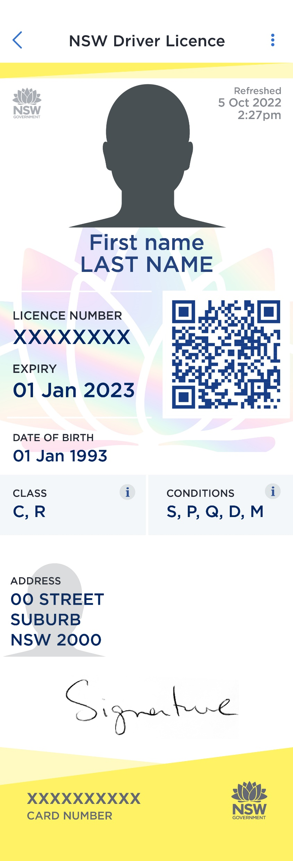
Activity Class discussion
What do you think personal information is, and how does it link to your identity?
Any information that can be used to establish someone's identity is considered personal information.
Driver licences, photo cards and passports are examples of identity documents that contain personal information.
Image: An example of a digital NSW Driver Licence
Notes:
ACTIVITY: CLASS DISCUSSION
Ask students what they think personal information is and how it links to their identity.
Any information that can be used to establish someone's identity is considered personal information. Driver licences and passports are both examples of documents that contain personal information.
CLICK TO NEXT SLIDE

Slide 8
Activity Identity bingo
Make a list of everything can you think of that might be considered 'personal identity information’.
Receive 1 x point for every correct answer on your list.
Birth certificate
Citizenship certificate
Signature
Visa / immigration card
Criminal record
Date of birth
Location
Passwords
Driver licence number
Bank or credit card
Place of birth
First name
Gender
Height and weight
Passport number
Bank account details
Smartphone log in
Student ID
Address
Blood type
Last name
Tax file number
Medicare card
Health records
Employee files
Marriage certificate
Sexual orientation
Biometric information
(e.g. electronic copy of your face, voice,
fingerprints or iris scan).
Collect 2 x bonus points if you guess this one!
Notes:
ACTIVITY: IDENTITY BINGO
Students have three or four minutes to write a list of as many things as they can that they consider to be ‘personal information’.
Encourage students to take turns sharing one of their responses OR you can reveal the answers in the slide deck one by one.
The class can tick their responses off as they go.
If you have time, as a class discuss the importance or uniqueness of each response as they move through the list.
To turn the activity into a game, students can earn 1 point for each correct answer on their list.
Students who have the final answer - Biometric information - on their list receive two (2) bonus points.
This list is not exhaustive, there are hundreds of things that could be considered personal information. This list just highlights a range of things that could be considered highly sensitive, or that criminals can use in combination to either access accounts or build a profile of someone.
CLICK TO NEXT SLIDE

Slide 9
Activity Class or small group discussion
Consider a time when you had to decide whether to share personal information.
In small groups, discuss your responses and nominate a speaker to provide one example to the class.
What was the personal information you were asked to share?
What were the pros and cons of sharing this information
How did you know it was the right thing to share the information or to keep it private?
Did anything happen after posting or sending your personal information?
Would you do it again?
Notes:
ACTIVITY: SMALL GROUP DISCUSSION
Divide the class into small groups and ask students to consider a time when they had to decide whether to share personal information or not.
Ask the following questions:
What was the personal information you were asked to share?
What were the pros and cons of sharing this information?
How did you know it was the right thing to share the information or to keep it private?
Did anything happen after posting or sending your personal information?
Would you do it again?
Students can then discuss their responses in small groups and nominate a speaker to share one example with the class.
Teachers notes
There are no right or wrong answers, the intent is to get students thinking about when they may have shared their personal information and the reasons behind feeling safe to do so.
Students are not required to share their answers with the class if they do not feel comfortable.
If they want to talk to someone further about their situation, teachers can assist them in finding an appropriate person or direct them to ID Support NSW resources.
CLICK TO NEXT SLIDE

Slide 10
Topic 2: Stop! Check! Reject! Recognising different types of scams
Department of Customer Service
2
20 minutes

Slide 11
Activity Video (4 min 30 sec) Spotting dangers online
Notes:
ACTIVITY: SPOTTING DANGERS ONLINE VIDEO (4 min 30 sec)
As a class, watch the video – Identity Management Day, Spotting Dangers Online.
Link: https://vimeo.com/818221672/8617187a6e .
This video will require internet access and audio.
Closed captions can also be turned on. The transcript is available in the Appendix.
Teachers notes
The purpose of this video is to provide a brief overview of some of the tactics scammers will use to get their hands on personal information. More information about 7 different types of scams is shared in the following slides.
CLICK TO NEXT SLIDE
.

Slide 12
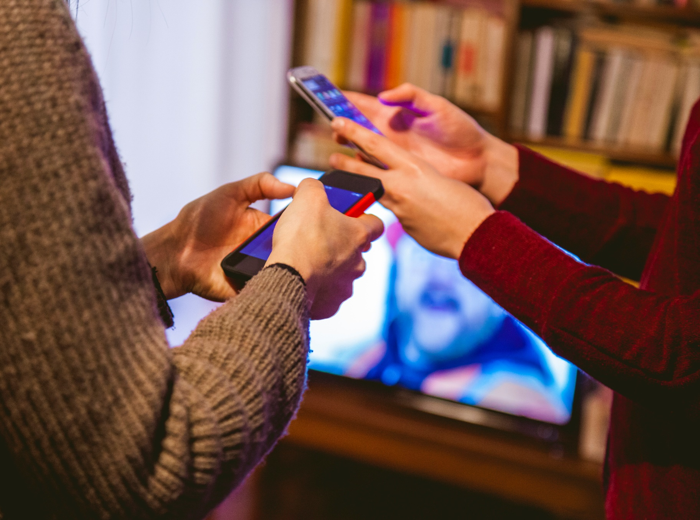
Recognising different types of scams
Scammers are always finding new ways to trick people in to handing over their personal information.
It's important to stay informed and aware of how they might approach you next.
Here are 7 scams you may have heard of or even experienced.
Image: A group of people holding phones
Notes:
Scammers are always finding new ways to trick people in to handing over their personal information.
It's important to stay informed and aware of how they might approach you next.
Here are 7 scams you may have heard of or even experienced.
Teachers notes
If you want more information on scams you can visit https://www.scamwatch.gov.au/types-of-scams for more information on different types of scams.
CLICK TO NEXT SLIDE

Slide 13
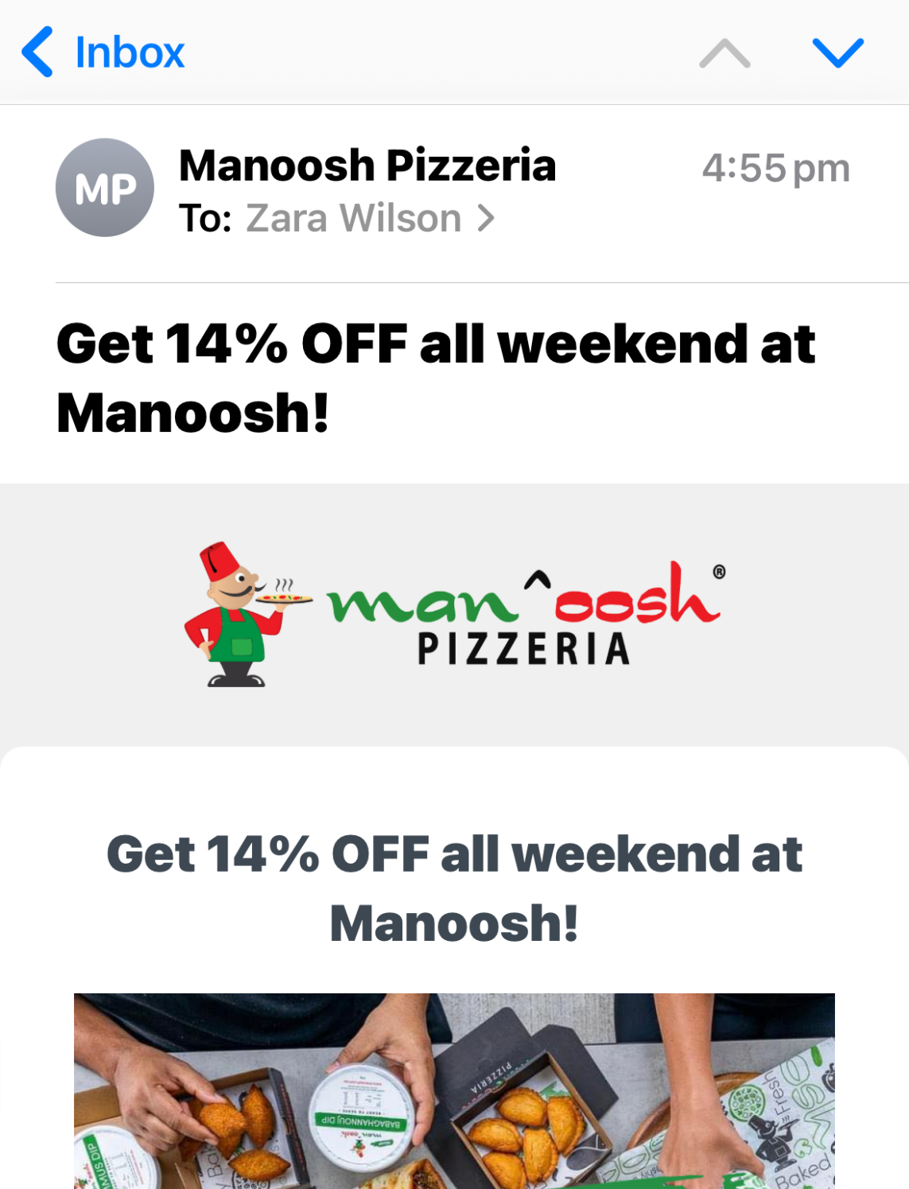
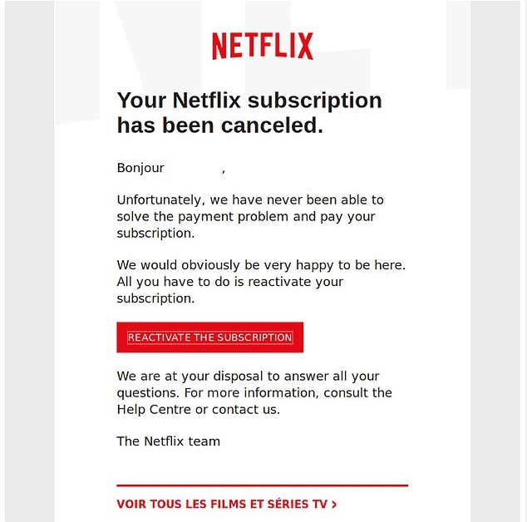
Phishing scams
Phishing is a type of online scam where people are sent an email from what appears to be a well-known brand, such as a bank or phone company.
The scammer will request your personal information to verify your identity or as you to complete a survey.
It can be difficult to tell the difference between a real and a fake email.
Image: Example of a phishing email from a scammer impersonating Netflix, requesting person to update billing information.
Notes:
Phishing Scams
Phishing is a type of online scam where people are sent an email from what appears to be a well-known brand, such as a bank or phone company.
The scammer will request your personal information to verify your identity or as you to complete a survey.
It can be difficult to tell the difference between a real and a fake email.
CLICK TO NEXT SLIDE

Slide 14
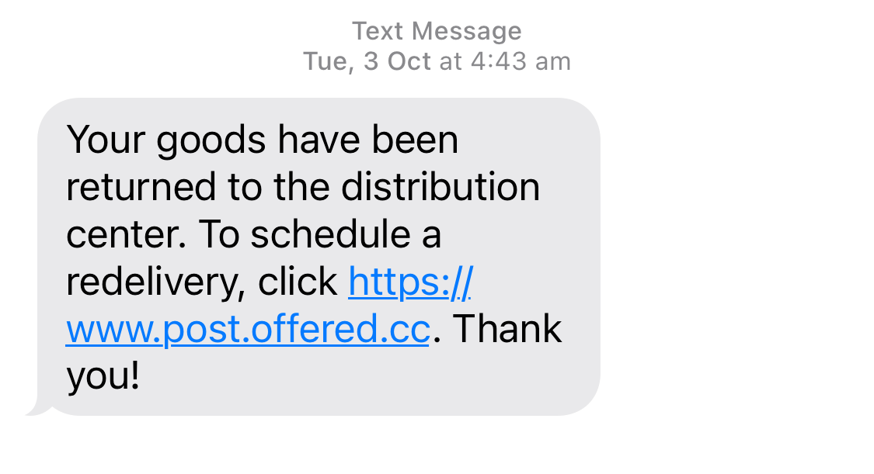
Smishing scams
Smishing, short for "SMS phishing," is a text-messaging scam trying to convince you to hand over your personal or financial information.
The messages will look like they are from trusted organisations like your bank or a government agency.
The messages might say there is a problem with your account or offer an unbelievable deal.
They'll usually include a link or phone number.
Image: Example of a smishing text impersonating Australia Post
Notes:
Smishing Scams
Smishing, short for "SMS phishing," is a text-messaging scam trying to convince you to hand over your personal or financial information.
The messages will look like they are from trusted organisations like your bank or a government agency.
The messages might say there is a problem with your account or offer an unbelievable deal.
They'll usually include a link or phone number.
CLICK TO NEXT SLIDE

Slide 15
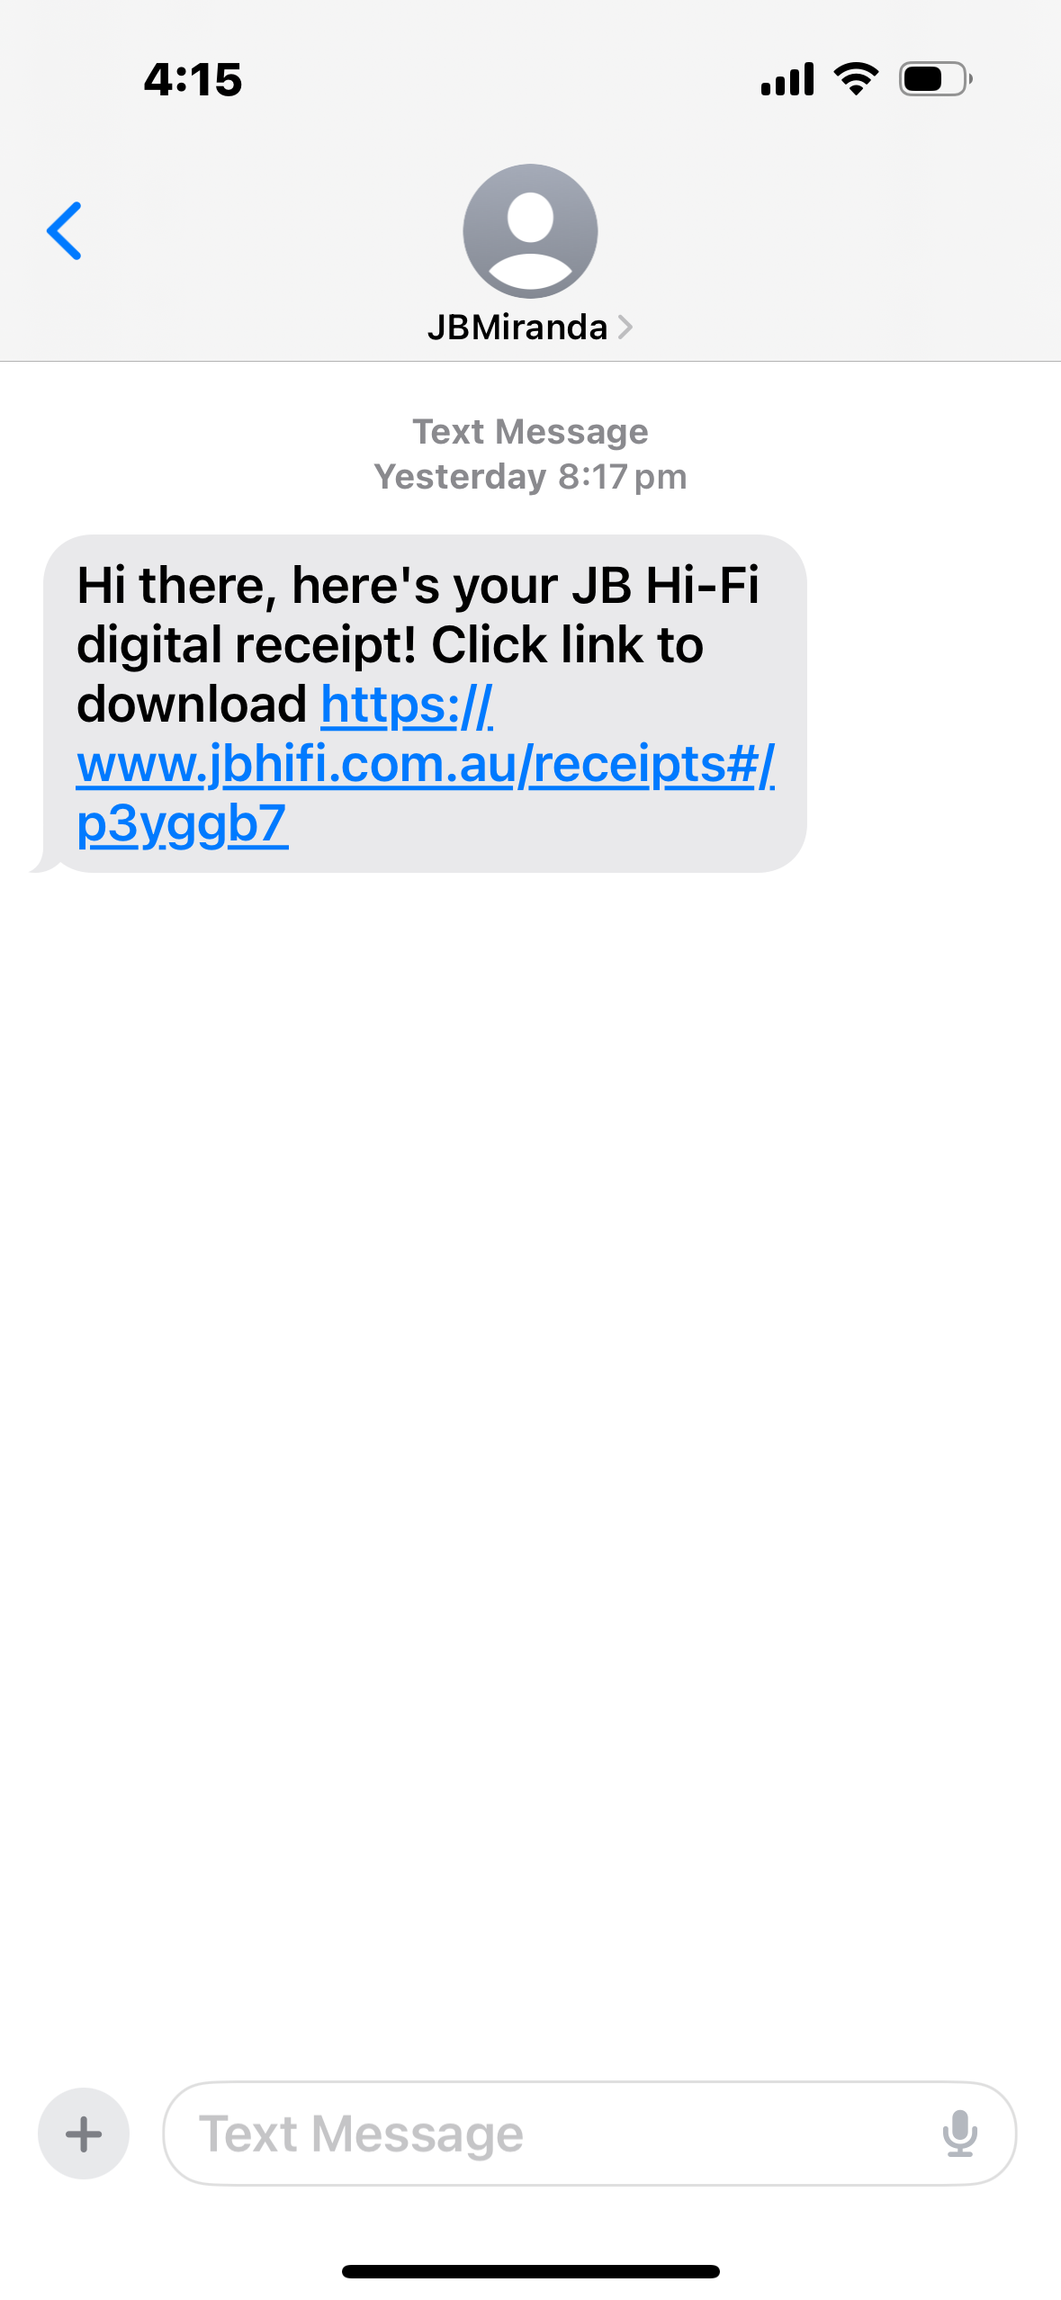
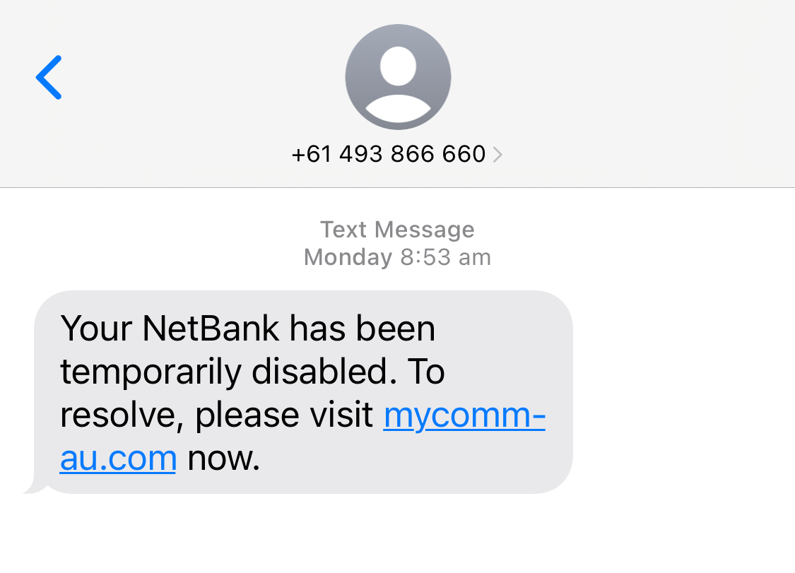
Activity Class or small group discussion
Have you received a scam email or text message that tricked or almost tricked you?
Did you know what to do with the message?
Who would like to share their experience?
Image: Example of smishing text impersonating Commonwealth Bank
Notes:
ACTIVITY: CLASS OR GROUP DISCUSSION
Ask the class or groups the following questions:
Have you received a scam email or text message that tricked or almost tricked you?
Did you know what to do with the message?
Who would like to share their experience?
Teachers notes
Students are not required to share their answers with the class if they do not feel comfortable.
If they want to talk to someone further about their situation, teachers can assist them in finding an appropriate person or direct them to ID Support NSW
resources.
CLICK TO NEXT SLIDE

Slide 16
Activity Class or small group discussion
What are some things to look for when receiving an email or text message to see if it’s a scam?
Sense of urgency
A legitimate organisation will never pressure you to hand over personal information immediately.
Contact the organisation directly to confirm if a message is a scam.
Unusual domain name
Hover your mouse over the sender's link to check the domain name matches their official website.
Unusual email format, spelling errors or a generic greeting
Does the email or message address you by name and does it have spelling or formatting errors?
Misleading hyperlinks and unsolicited attachments
Never open attachments or click on links in messages you are not certain are legitimate.
Notes:
ACTIVITY: CLASS OR GROUP DISCUSSION
Ask the class the following question: What are some things to look for when receiving an email or text message to see if it’s a scam?
Potential answers
A sense of urgency. A legitimate organisation will never pressure you to hand over personal information immediately. Contact the organisation directly to confirm if a message is a scam.
An unusual domain name. Hover your mouse over the sender's link to check the domain name matches their official website.
An unusual email format, spelling errors or a generic greeting. Does the email or message address you by name and does it have spelling or formatting errors?
Misleading hyperlinks and unsolicited attachments . Never open attachments or click on links in messages you are not certain are legitimate.
CLICK TO NEXT SLIDE

Slide 17
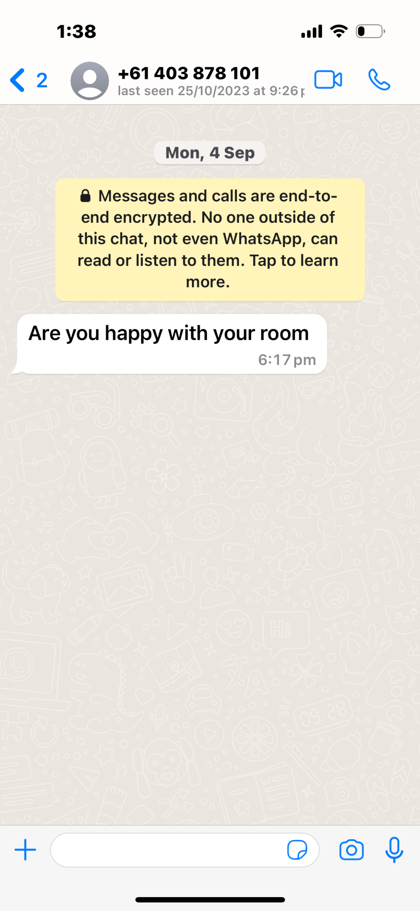
Hi Mum! scam
Scammers target Australian parents by pretending to be their upset children, playing on their feelings, and asking for money.
Usually, the message starts with a short reason for using a different way to communicate, like saying that their phone was lost or broken.
They will ask for money to fix or replace the phone and new banking information since they say they can't get into their accounts.
Image: Example of ‘Hi Mum’ scam via text on WhatsApp
Notes:
Hi Mum! Scam
Scammers target Australian parents by pretending to be their upset children, playing on their feelings, and asking for money.
Usually, the message starts with a short reason for using a different way to communicate, like saying that their phone was lost or broken.
They will ask for money to fix or replace the phone and new banking information since they say they can't get into their accounts.
Teachers notes
First seen on WhatsApp, but deepfake technology has seen it progress to voice calls and messages.
Usually, a sense of urgency and a 'supposed' lost or broken phone is involved.
This is followed by a 'desperate' plea for a money transfer to a 'friend's' bank account.
Ask students to make sure their family is aware of this scam and have a conversation about the language they would use in an emergency situation.
In an emergency always try and call your emergency contact rather than sending messages.
CLICK TO NEXT SLIDE

Slide 18
Activity Class or small group discussion
Try and make your family aware of this scam and have a conversation about the language you would use in an emergency.
In emergencies, always try and call your family or emergency contacts rather than sending messages, so they are certain it is you.
It’s important that you and your family communicate online in a safe manner.
Who has heard of the ‘Hi Mum’ scam?
How do you think your parents or carers would respond to this scam message?
Do you think they would ask questions to ensure it was you sending the message?
What questions do you think they should ask?
Notes:
ACTIVITY: CLASS OR GROUP DISCUSSION
Ask the class the following questions:
Who has heard of the ‘Hi Mum’ scam?
How do you think your parents or carers would respond to this scam message?
Do you think they would ask questions to ensure it was you sending the message?
What questions do you think they should ask?
Teachers notes
Scammers target parents, pretending to be their child and playing on their feelings.
Th Hi Mum scam was first seen on WhatsApp, but deepfake technology has seen it progress to voice calls and messages.
Usually, a sense of urgency and a 'supposed' lost or broken phone is involved.
This is followed by a 'desperate' plea for a money transfer to a 'friend's' bank account.
Steps students can take to protect themselves:
It’s important that you and your parents communicate in a safe manner.
Make sure your family is aware of this scam and have a conversation about the language you would use in an emergency situation.
You should always call and speak to your parents rather than sending messages, so they are certain it is you.
CLICK TO NEXT SLIDE

Slide 19
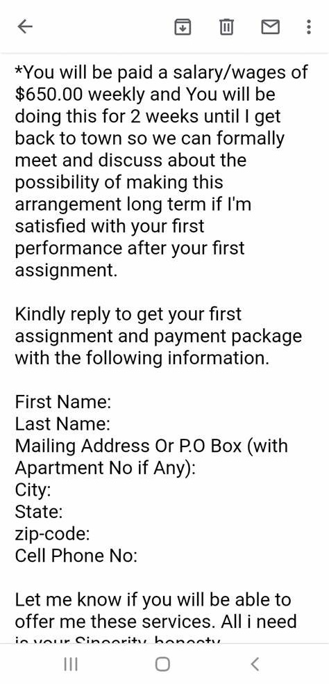
Employment scams
The goal of a job scam is to get your money and personal information, not give you a job.
A "recruitment fee" is sometimes asked for up front so that you can start the job and start making money.
A lot of the time, there are no jobs and only the scammer is making money.
Has anyone seen or received a job ad or job offer out-of-the blue promising huge rewards for very little effort?
Image: Example of phishing email requesting personal information.
Notes:
QUICK DISCUSSION
Ask the class the following questions:
Has anyone seen or received a job ad or offer out-of-the blue promising huge rewards for very little effort?
Would anyone like to share their experience or what they noticed about the job ad?
Steps students can take to protect themselves:
Legitimate companies and hiring agencies will never ask for deposits for potential employment.
Never click on a link that you are not certain is legitimate
Never give your personal information to someone you are not certain is legitimate
Never transfer money to anyone in this situation. Especially someone you haven’t met.
CLICK TO NEXT SLIDE

Slide 20
Romance scams
Romance scams work by convincing the victim that they are in a romantic relationship with the scammer.
Scammers create a phony dating profile and use it to make the victim feel special and emotionally connected. After establishing trust online, the scammer manipulates the victim into sending money or engaging in fraudulent activities.
These scams can happen quickly or over a long time, taking advantage of people who are emotionally vulnerable while looking for love online.
Image: Example of potential romance scams sent by SMS.
Notes:
Teachers notes
Steps students can take to protect themselves:
Adjust privacy settings – minimise how much personal information you share on your profile
Never transfer money to anyone. Especially someone you haven’t met.
Do your research – check how many posts they have, how many friends they have, how long have they been on this site etc.
Remember it’s always ok to say no
CLICK TO NEXT SLIDE

Slide 21
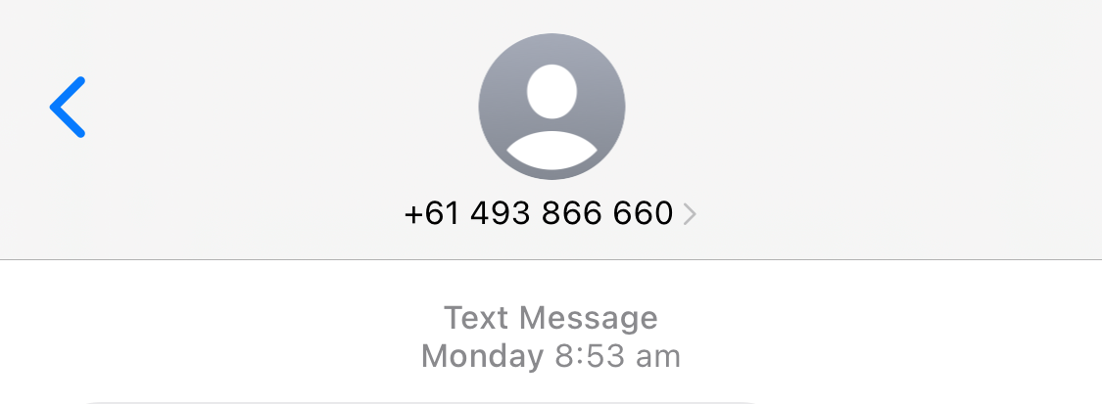
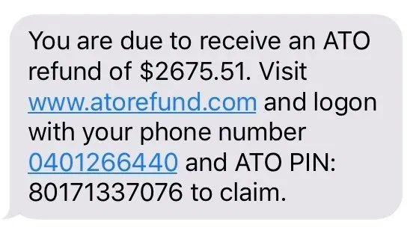
Australian Tax Office (ATO) scams
The number of scams involving the Australian Taxation Office (ATO) goes up every year at the end of the financial year in June.
Often, these scams come in the form of pre-recorded messages or text messages that say you either owe the Tax Office money or have a refund due.
Does anyone know why there may be an increase in scams claiming to be from the ATO around June and July every year?
Image: Example of ATO scam sent by SMS.
Notes:
QUICK DISCUSSION
Ask the class the following question:
Does anyone know why there may be an increase in scams claiming to be from the Australian Tax Office around June and July every year?
Answer: There is often an increase in scam activity from June to August, around the end of financial year when tax returns are due. This is often in the form of text messages claiming to be from the ATO or myGov or from agencies claiming to help people gain early access to their superannuation.
Teachers notes
Steps to take to protect yourself:
Be wary of emails, phone calls and text messages claiming to be from the Australian Tax Office (ATO).
If you think a phone call, SMS, voicemail, email or interaction on social media claiming to be from the ATO is not genuine, do not engage with it.
The ATO will sometimes contact people by phone, email, SMS and post. If you're not sure whether it's really the ATO, do not reply. You should phone the ATO on 1800 008 540 to check.
This scam is the same as phishing and smishing scams where they are trying to gain your banking details or personal information.
Never click on a link that you are not certain is legitimate
Never give your personal information to someone you are not certain is legitimate
CLICK TO NEXT SLIDE

Slide 22
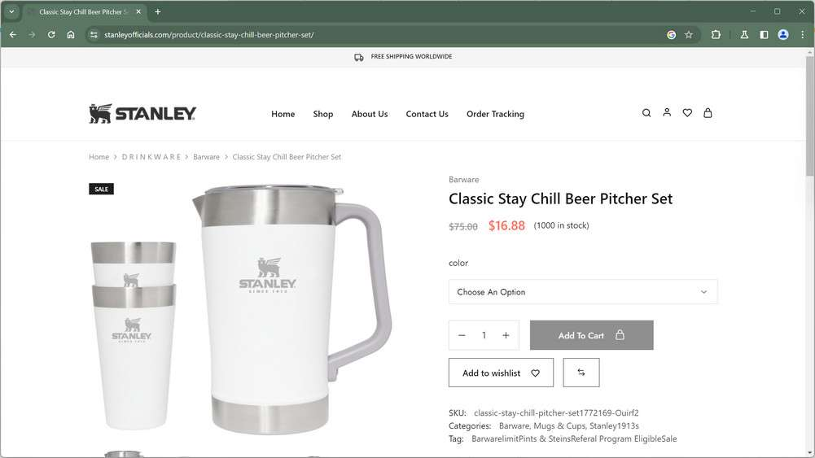
Fake websites 1
A common type of scam is fake shopping websites, which are made to look like the websites of well-known stores.
The goal is to either:
steal your money or
get your personal information when you enter your payment details.
You might even be sent fake links to track your package, showing it flying around the world.
But what if your order never arrives?
Notes:
Fake Websites
A common type of scam is fake shopping websites, which are made to look like the websites of well-known stores.
The goal is to either:
steal your money or
get your personal information when you enter your payment details.
You might even be sent fake links to track your package, showing it flying around the world.
But what if your order never arrives?
CLICK TO NEXT SLIDE

Slide 23
Fake websites 2
Fake websites often appear very similar to those of real stores, but there are ways of spotting them.
Red flags include:
unusual URLs
very large discounts
missing information and
poor spelling and formatting.
Image: Example of spoofed website selling cheap Stanley products.
Notes:
Fake Websites continued
Fake websites often appear very similar to those of real stores, but there are ways of spotting them.
Red flags include:
unusual URLs
very large discounts
missing information and
poor spelling and formatting.
Teachers notes
Steps students can take to protect themselves
Don't click on any links.
Look for all the red flags such as unusual URLS, large discounts and missing policy or contact information.
Don’t enter banking or credit card details.
If you’ve been scammed, report to your financial institution immediately.
CLICK TO NEXT SLIDE

Slide 24
Stop, check, reject!
If you ever receive a text message, phone call or email that you are unsure about, the best thing to do is:
STOP
Take a moment to pause and assess the situation.
CHECK
Look into the request and check it is legitimate.
REJECT
If you are unsure, hang up the phone, delete the email or SMS, or block the number.
Notes:
Stop, check, reject!
If you ever receive a text message, phone call or email that you are unsure about, the best thing to do is:
STOP - Take a moment to pause and assess the situation.
CHECK - Look into the request and check if it is legitimate.
REJECT – If you are unsure, hang up the phone, delete the email or SMS, or block the number.
Teachers notes
Other steps students can take to protect themselves:
Never click on a link that you are not certain is legitimate.
Never give your personal information to someone you are not certain is legitimate.
CLICK TO NEXT SLIDE

Slide 25
Activity Spotting scams online video Fatima’s case study (1 min)
Notes:
CLASS ACTIVITY: FATIMA'S CASE STUDY VIDEO
As a class watch the video – Fatima’s case study
Link: https://vimeo.com/906237906/72074a2cc3?share=copy.
This video will require internet access and audio.
Closed captions can be turned on. The transcript is available in the Appendix.
CLICK TO NEXT SLIDE

Slide 26
Activity Class or group discussion
Has anyone in the class bought concert tickets online?
How many people have seen advertisements for concert tickets on social media?
What are some of the signs that might indicate a ticket website is fake?
How could Fatima have avoided this situation?
After watching Fatima’s video, consider the following questions and share your answers with the group or class.
Notes:
ACTIVITY: CLASS OR GROUP DISCUSSION
After watching Fatima’s video, consider the following questions and share your answers with the group or class.
Has anyone in the class bought concert tickets online?
How many people have seen advertisements for concert tickets on social media?
What are some of the signs that might indicate a ticket website is fake?
How could Fatima have avoided this situation?
Teachers notes
Students are not required to share their answers with the class if they do not feel comfortable.
If they want to talk to someone further about their situation, teachers can assist them in finding an appropriate person.
CLICK TO NEXT SLIDE

Slide 27
Topic 3: Social media: beware the overshare
Department of Customer Service
3
15 minutes

Slide 28
Activity 5 Video (2 minutes) How private is your personal information?
28
Notes:
ACTIVITY: HOW PRIVATE IS YOUR PERSONAL INFORMATION VIDEO
As a class watch the video - How private is your personal information?
Link: https://www.youtube.com/watch?v=yrjT8m0hcKU
This video will require internet access and audio.
Closed captions can be turned on.
Key message is for students to make sure their social media accounts are set to private.
CLICK TO NEXT SLIDE

Slide 29
Social media: beware the overshare
Sharing content online can be a lot of fun, but just because it’s easy to share 'anything and everything’, doesn't mean we should.
You may be sharing more private information in your social media accounts than you think: photos, places visited, and contact details can be found on millions of social media profiles.
This information can tell criminals a lot about a person and can be used to steal someone's identity.
Image: Three young girls posing for a selfie
Notes:
Sharing content online can be a lot of fun, but just because it’s easy to share 'anything and everything’, doesn't mean we should.
You may be sharing more private information in your social media accounts than you think: photos, places visited, and contact details can be found on millions of social media profiles.
This information can tell criminals a lot about a person and can be used to steal someone's identity.
CLICK TO NEXT SLIDE

Slide 30
Activity Social media video (2 mins) Jacob’s case study
Notes:
ACTIVITY: JACOB'S CASE STUDY VIDEO
As a class watch the video – Jacob’s case study
Link: https://vimeo.com/906237393/c2c2ca49a9?share=copy
This video will require internet access and audio.
Closed captions can be turned on. The transcript is available in the Appendix.
CLICK TO NEXT SLIDE

Slide 31
Activity Class or group discussion Jacob’s case study
After watching Jacob’s case study, consider the following questions and share your answers with the group or class.
Who has a public or private social media profile in the class, and why?
Who only accepts friend requests from people they already know?
Who verifies a new account before accepting a friend request, even if it's from someone you already know?
Who can share some examples of how you can do this?
Who has had an experience with fake social media profiles or scams?
Notes:
ACTIVITY: CLASS OR GROUP DISCUSSION
After watching Jacob’s case study, ask the class to consider the following questions and share their answers with the group or class:
Who has a public or private social media profile in the class, and why?
Who only accepts friend requests from people they already know?
Who verifies a new account before accepting a friend request, even if it's from someone you already know?
Who can share some examples of how you can do this?
Who has had an experience with fake social media profiles or scams?
Teachers notes
Students are not required to share their answers with the class if they do not feel comfortable.
If they want to talk to someone further about their situation, teachers can assist them in finding an appropriate person.
CLICK TO NEXT SLIDE

Slide 32
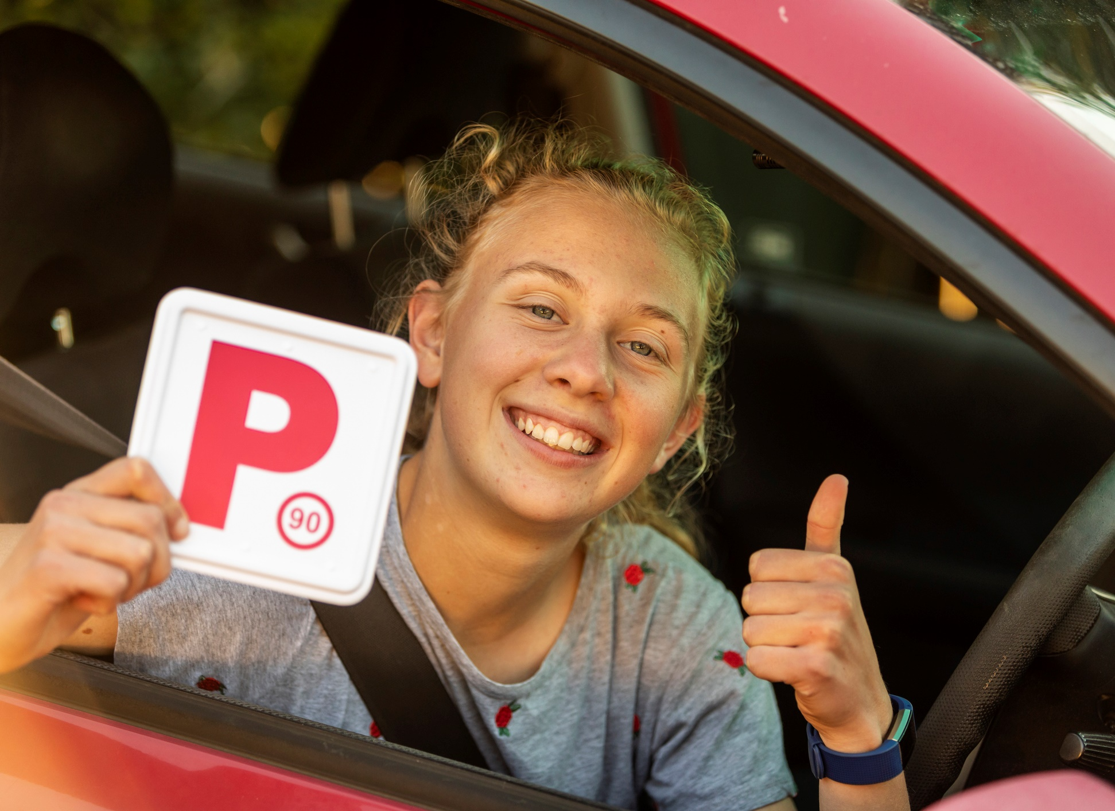
Activity Class or small group discussion Tegan’s case study 1
Tegan is excited because she recently passed her driver's test and now has her P plates.
She can't wait to share the good news with her friends!
Tegan thought what better way to tell everyone than to post a picture of her new driver licence on her public Instagram page.
Her post receives more than 200 likes from her followers within the first 24 hours.
Image: Young woman smiling holding P plate
Notes:
ACTIVITY: CLASS OR SMALL GROUP DISCUSSION
Share the following case study with the class:
Tegan is excited because she recently passed her driver's test and now has her P plates.
She can't wait to share the good news with her friends!
Tegan thought what better way to tell everyone than to post a picture of her new driver licence on her public Instagram page.
Her post receives more than 200 likes from her followers within the first 24 hours.
CLICK TO NEXT SLIDE

Slide 33
Activity Class or small group discussion Tegan’s case study 2
A few weeks later, Tegan gets a letter in the mail which includes a receipt for a brand-new iPhone.
Tegan thought this was strange because she hadn't purchased a new phone.
The receipt includes her correct full name and address.
Tegan discovers she is being charged for a $1500 phone and $80 a month for two years; that’s nearly $3,500 in total costs.
Image: Person checking phone at desk
Notes:
Case study continued
A few weeks later, Tegan gets a letter in the mail which includes a receipt for a brand-new iPhone.
Tegan thought this was strange because she hadn't purchased a new phone.
The receipt includes her correct full name and address.
Tegan discovers she is being charged for a $1500 phone and $80 a month for two years; that’s nearly $3,500 in total costs.
CLICK TO NEXT SLIDE

Slide 34
Activity Class or small group discussion Tegan’s case study 3
After reading Tegan’s story, consider how this could have happened and what she could have done differently to prevent this happening.
Share your answers with the group or class.
Make sure your social media accounts are set to private. Tegan's account was not private, so the picture was visible to everyone, including criminals looking for identity information.
Never share any part of official proof of identity documents such as driver licences on social media, including on private accounts.
Criminals can assume your identity by using your NSW Driver Licence to apply for goods and services or gain access to your accounts without your knowledge or consent.
A NSW Driver Licence is considered a primary proof of identity document. It's often used to prove your identity either by physically presenting it or entering its details online.
Notes:
ACTIVITY: CLASS OR GROUP DISCUSSION
After reading Tegan’s story, consider how this could have happened and what she could have done differently to prevent this happening.
Teachers notes
Students are not required to share their answers with the class if they do not feel comfortable.
If they want to talk to someone further about their situation, teachers can assist them in finding an appropriate person.
Additional information about NSW Driver Licences
A NSW Driver Licence is considered a primary proof of identity document. It's often used to prove your identity either by physically presenting it or entering its details online.
A NSW Driver Licence contains personal, sensitive, health and biometric information such as your:
- Given name(s)
- Family name
- Date of birth
- Residential address
- Signature
- Conditions (e.g. driver restrictions)
- Health information (e.g. wearer of glasses or contact lenses)
- Photo
- Class of licence (e.g. learner, multi combination)
- Expiry date
Additionally, it contains other important, identifiable information, such as:
- Driver licence number
- Card number
- State of issue
Criminals can assume your identity by using a compromised NSW Driver Licence to apply for goods and services or gain access to your accounts without your knowledge or consent.
Examples of some important accounts and services include:
- Banking
- Phone and internet
- Utilities: water, gas and electric
- Rental properties
- Government services and entitlements
- Lines of credit including credit cards, loans and buy now pay later services
- Health and medical
Make sure your social media accounts are set to private. Tegan's account was not private, so the picture was visible to everyone, including criminals looking for identity information.
Never share any part of official proof of identity documents such as driver licences on social media, including on private accounts.
CLICK TO NEXT SLIDE

Slide 35
topic 4: Creating strong passwords
Department of Customer Service
4
10 minutes

Slide 36
Passwords are like toothbrushes!
A simple password that is easy to figure out is like leaving your house key under the mat for any thief to find.
If someone knows your password or where to find it, they could access your email, social media, or even your bank accounts.
It might be even easier to remember it this way; passwords are like toothbrushes:
Never share them with anyone!
Change them often!
Don’t leave them lying around!
Image: Toothbrushes in container
Notes:
Passwords are like toothbrushes!
A simple password that is easy to figure out is like leaving your house key under the mat for any thief to find.
If someone knows your password or where to find it, they could access your email, social media, or even your bank accounts.
It might be even easier to remember it this way; passwords are like toothbrushes:
Never share them with anyone!
Change them often!
Don’t leave them lying around!
CLICK TO NEXT SLIDE

Slide 37
Activity World’s worst passwords
Most of the world's most common passwords can be cracked in seconds.
We've made a list of some of the worst passwords to use. How many will you guess?
**********
user
password
guest
admin
123456
your street name
abc123
your sports teams name
iloveyou
superman
your pets name
qwerty
asdfghjkl;
000000
Notes:
ACTIVITY: WORLD'S WORST PASSWORDS
Ask the class to spend 2 – 3 minutes writing down what they think might be the easiest passwords to crack.
To test them, we’ve made a list of fourteen of the worst passwords to use. How many will they guess?
password
000000
guest
user
admin
qwerty
123456
**********
iloveyou
Abc123
superman
Your pets name
Your favourite sports team’s name
Your street name
Additional question:
Why would the following be considered bad password options:
Your pets name
Your favourite sports team’s name
Your street name
Answer: Because these answers can often be guessed if someone knows you, by looking at your social media posts or by asking these questions. These are also often answers to questions to help you recover access to your accounts. Do not share this information with people you don’t know.
CLICK TO NEXT SLIDE

Slide 38
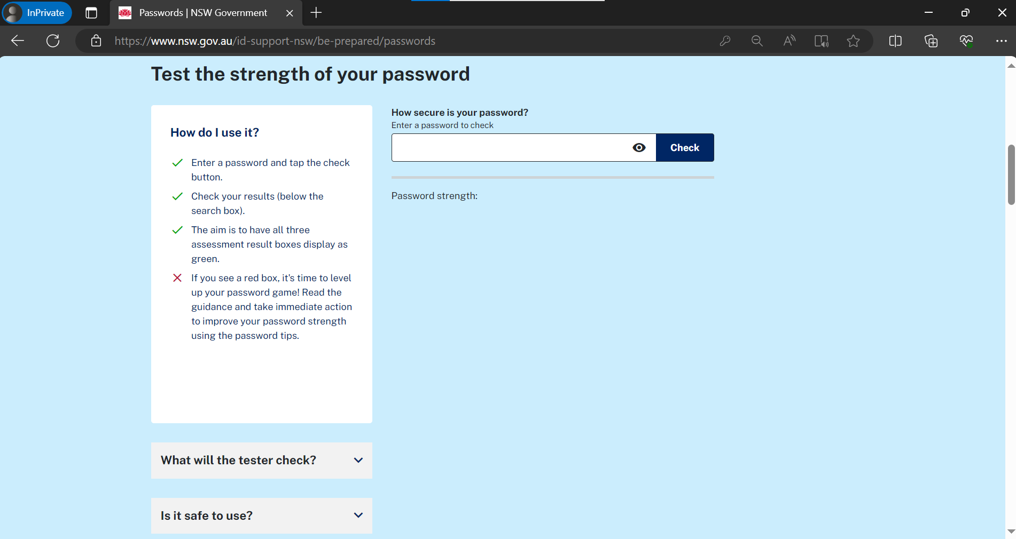
Activity Create a strong password
Develop a pretend password by creating a sentence and then change letters to numbers or symbols.
For example, Change A to 4, Change T to 7 and change E to 3.
The best kind of password is one that looks like it’s just a jumble of numbers, letters and symbols. It uses both capitals and lowercase letters.
Enter your pretend passwords into the Password Strength Tester and see if all boxes are green.
Image: The Passwords Strength Tester landing page
Notes:
ACTIVITY: CREATE A STRONG PASSWORD
Ask the class to develop a pretend password by creating a sentence and then changing letters to numbers or symbols. The best kind of password is one that looks like it’s just a jumble of numbers, letters and symbols. It uses both capitals and lowercase letters.
For example,
Change A to 4
Change T to 7
Change E to 3.
Then ask students to enter their pretend passwords into the ID Support NSW Password Strength Tester at the following link Passwords | NSW Government or https://www.nsw.gov.au/id-support-nsw/be-prepared/passwords
The aim is to have all three assessment result boxes display as green.
If you see a red box, it's time to level up your password game!
Teachers notes
When you enter a password, the strength tester uses complicated algorithms to figure out how hard it is to guess. It then gives you tips on how to make stronger passwords.
It also lets you know if your password has been hacked or exposed in a data breach. It helps you understand the impact and what you can do to make your passwords safer.
The tester will assess your password based on:
Time to crack. How long it would take for a hacker to crack the password using a computer bot.
Password strength. Assessing the strength of the password based on complexity and guessability.
Exposure online. Compares the password to a database of exposed passwords. If it has been posted online or involved in a data breach it is at increased risk of being used to take over your accounts.
The Password Strength Tester is anonymous. We never collect, track, or store your passwords, so no one can link them to your usernames, accounts, or websites.
Your password is assessed directly from this page, not on our servers. If you close the window or switch pages, the page will refresh.
Continue to be alert and cautious, paying special attention to websites that request personal information and passwords.
CLICK TO NEXT SLIDE

Slide 39
Lesson 5: Meet the Authenticators
Department of Customer Service
5
10 minutes

Slide 40
What is Multi Factor Authentication?
Multi-factor authentication, or MFA, sometimes called two-factor authentication, is one of the best ways to keep other people from getting into your accounts and accessing your valuable information.
Most password-related cyberattacks can't get past multi-factor authentication.
Who in the class has used multifactor authentication on their accounts?
Image: Person holding phone with a verification code notification
Notes:
What is multi-factor authentication?
Multi-factor authentication, or MFA, sometimes called two-factor authentication, is one of the best ways to keep other people from getting into your accounts and accessing your valuable information.
Most password-related cyberattacks can't get past multi-factor authentication.
Ask the class the following question:
Who in the class has used multifactor authentication on their accounts?
How does it work?
CLICK TO NEXT SLIDE

Slide 41
Meet the Authenticators
Password or phrase PIN
Something you KNOW
Code from app or SMS, push notification, USB token
Something you HAVE
Finger or thumb print, face scan, iris scan
Something you ARE
Before granting access to an online account, multi-factor authentication (MFA) requires two or more forms of personal identification, greatly increasing protection and making it much more difficult for someone to gain access to your accounts.
Examples of multi-factor authentication are:
Notes:
Before granting access to an online account, multi-factor authentication requires two or more forms of personal identification, greatly increasing protection and making it much more difficult for someone to gain access to your accounts.
For example
Something you KNOW – password or pin phrase
Something you HAVE – Code from app or SMS push notification or USB token
Something you ARE - Finger or thumb print, face scan or iris scan.
CLICK TO NEXT SLIDE

Slide 42
Activity Sasha’s case study
Sasha is a student in Year 12 and would often share her passwords to her school accounts with her friends.
Sasha has a simple password with no symbols or capitals letters and reuses it for many of her accounts.
It is so hard for her to remember all her passwords so it’s easier for her to have the same one.
One day, Sasha receives an email with an attachment for the purchase of a very expensive pair of shoes.
Sasha did not make this purchase, but the receipt included all her contact details and bank details used for payment.
Sasha logged into her banking app and noticed there were a few more purchases she did not recognise.
She tried changing her passwords for her important accounts, but it was too late as the hacker had already logged her out.
Notes:
ACTIVITY: CLASS OR GROUP DISCUSSION
Share the following case study with the class:
Sasha is a student in Year 12 and would often share her passwords to her school accounts with her friends.
Sasha has a simple password with no symbols or capitals letters and reuses it for many of her accounts.
It is so hard for her to remember all her passwords so it’s easier for her to have the same one.
One day, Sasha receives an email with an attachment for the purchase of a very expensive pair of shoes.
Sasha did not make this purchase, but the receipt included all her contact details and bank details used for payment.
Sasha logged into her banking app and noticed there were a few more purchases she did not recognise.
She tried changing her passwords for her important accounts, but it was too late as the hacker had already logged her out.
CLICK TO NEXT SLIDE

Slide 43
Activity Group discussion Sasha’s case study
Created unique passwords for each account so that if one was cracked, the other accounts would still be safe.
Set up multi-factor authentication (MFA) so she would be notified when someone else tried to log into her account.
Kept her passwords secret.
Sasha should report the incident to her bank, change her passwords and add MFA to accounts she can still access.
How was someone able to access Sasha's accounts?
What could Sasha have done to prevent this happening?
What should she do next?
Notes:
After reading Sasha’s story, ask students to consider the following questions and share their answers with the group or class:
How was someone able to access Sasha's accounts?
What could Sasha have done to prevent this happening?
What should she do next?
Potential answers
Created unique passwords for each account so that if one was cracked, the other accounts would still be safe.
Set up multi-factor authentication (MFA) so she would be notified when someone else tried to log into her account.
Kept her passwords secret.
Sasha should immediately report the incident to her bank, change all her passwords and add multifactor authentication to the accounts she can still access.
CLICK TO NEXT SLIDE

Slide 44
Lesson 6: Top things to remember to keep your identity safe
Department of Customer Service
6
5 minutes

Slide 45
When sharing your personal information
Only share your personal information with organisations you trust, especially your name, date of birth and contact information.
If you don't know the sender of an email or text message and it looks suspicious, don't open it. These messages could put your device's safety at risk if you open them.
Watch out for links in emails or text messages that have spelling or grammar mistakes, unknown logos, ask for ‘urgent attention’, or for personal information.
When making an online purchase or signing up for services, only enter the information required in mandatory fields. If too much personal information is requested, reconsider your purchase.
Image: A person reading a book with a computer in background
Notes:
When sharing your personal information
Only share your personal information with organisations you trust, especially your name, date of birth and contact information.
If you don't know the sender of an email or text message and it looks suspicious, don't open it. These messages could put your device's safety at risk if you open them.
Watch out for links in emails or text messages that have spelling or grammar mistakes, unknown logos, ask for ‘urgent attention’, or for personal information.
When making an online purchase or signing up for services, only enter the information required in mandatory fields. If too much personal information is requested, reconsider your purchase.
CLICK TO NEXT SLIDE

Slide 46
When sharing financial information
Don't give your credit card number, online account information, or copies of personal documents to people or groups you don't know or trust.
Never give someone who calls you access to your phone or computer, no matter where they say they are calling from.
Image: Young woman with credit card using laptop
Notes:
When sharing financial information
Don't give your credit card number, online account information, or copies of personal documents to people or groups you don't know or trust.
Never give someone who calls you access to your phone or computer, no matter where they say they are calling from.
CLICK TO NEXT SLIDE

Slide 47
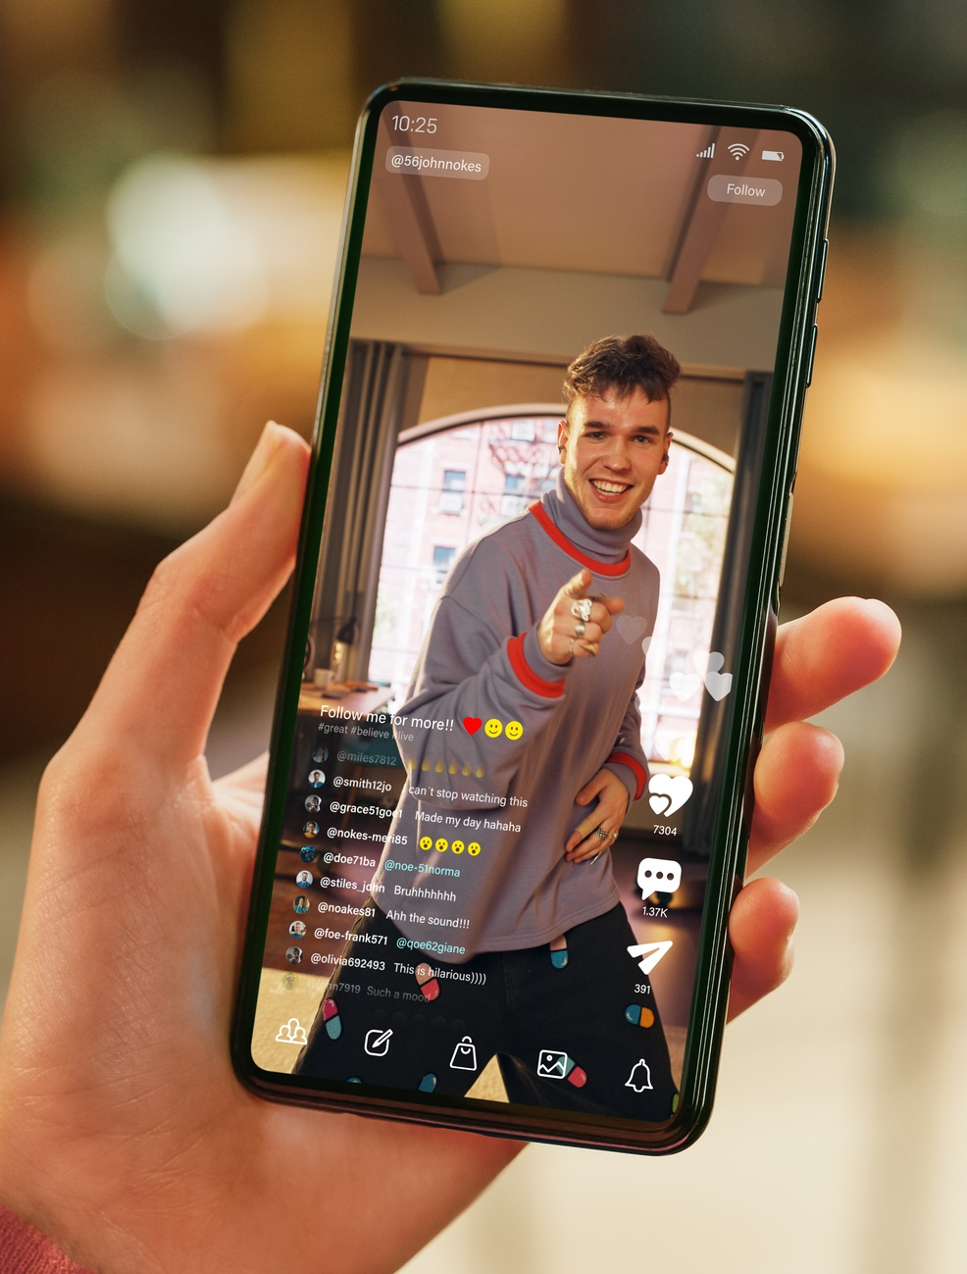
On social media
Social media accounts should be private.
Personal information should not be posted or shared with anyone—even to friends and family.
Do not accept friend requests from people you do not know.
Image: Woman holding phone watching young man on a live stream
Notes:
On social media
Social media accounts should be private.
Personal information should not be posted or shared with anyone—even to friends and family.
Do not accept friend requests from people you do not know.
CLICK TO NEXT SLIDE

Slide 48
When reading and opening communications
Always check the links in all your emails by moving your mouse over them. The link should be the same as or very similar to the organisations website where the message is coming from. If you're not sure, don't click.
Most organisations, like banks, government agencies, and big businesses, will not ask for personal information by text or email.
If someone asks for your identity credentials or personal information, you should call the company via the number on their website to make sure they are real.
Image: An example of a scam email, pretending to be from the NSW Government.
Notes:
When reading and opening communications
Always check the links in all your emails by moving your mouse over them. The link should be the same as or very similar to the organisations website where the message is coming from. If you're not sure, don't click.
Most organisations, like banks, government agencies, and big businesses, will not ask for personal information by text or email.
If someone asks for your identity credentials or personal information, you should call the company via the number on their website to make sure they are real.
CLICK TO NEXT SLIDE

Slide 49
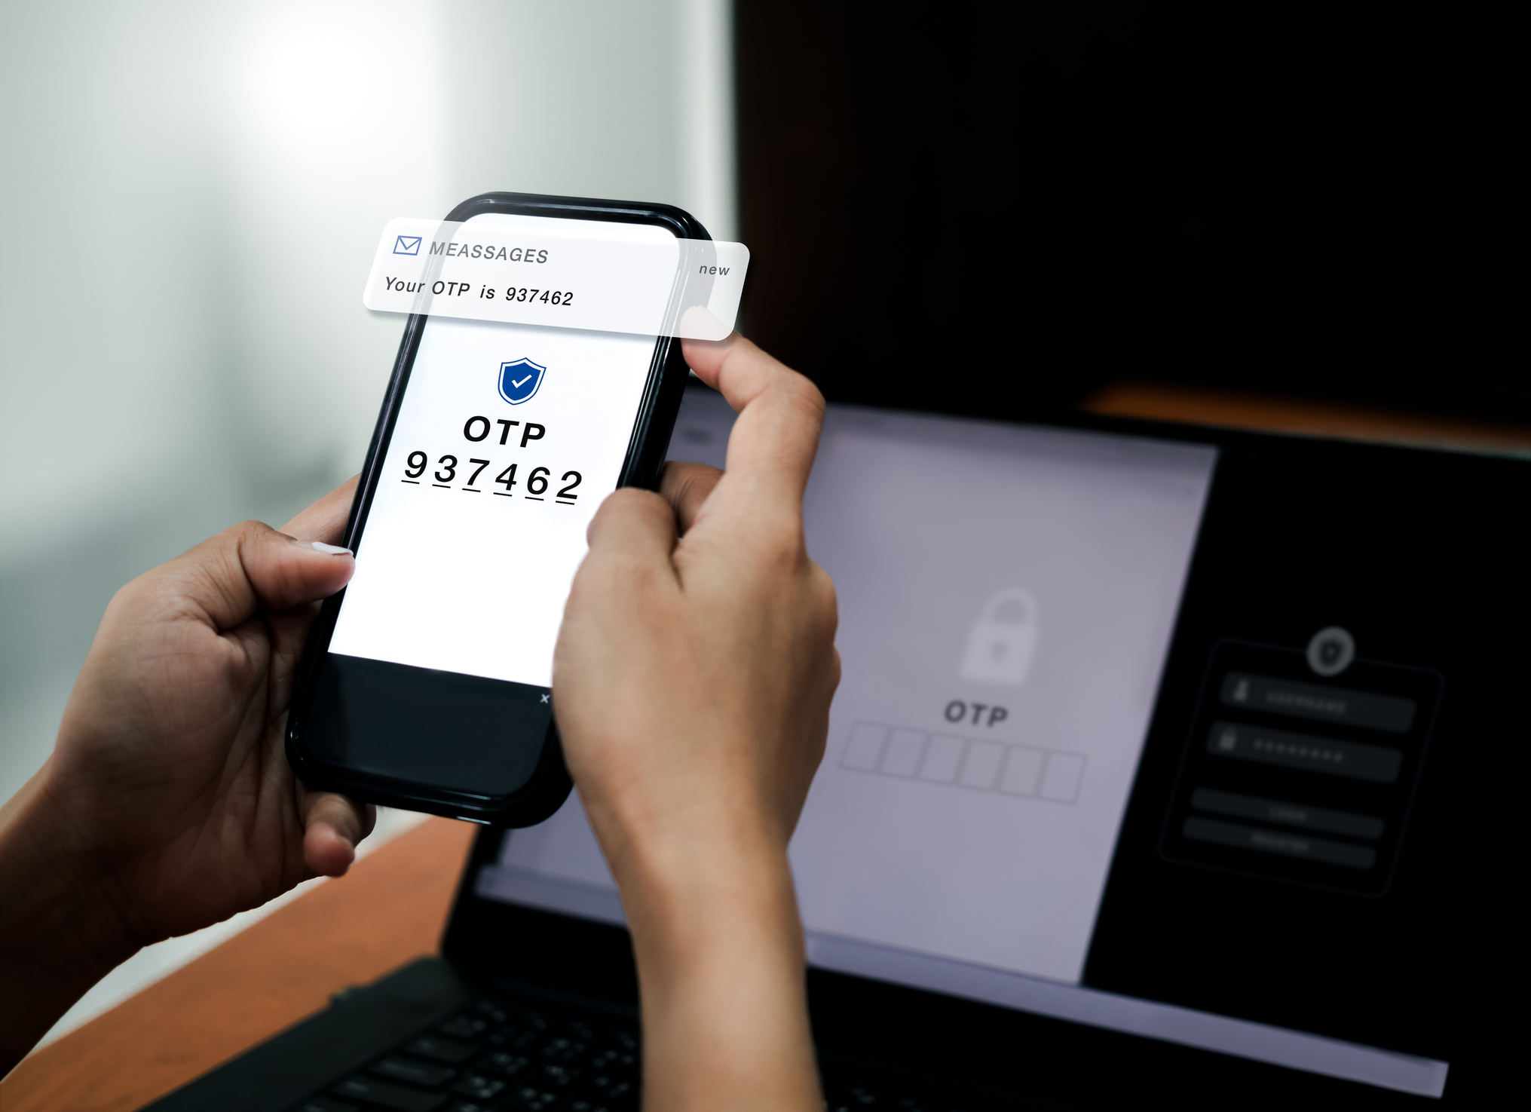
Passwords and two-step verification, also known as multi-factor authentication
Passwords are like toothbrushes! Change them regularly, don’t share them with anyone and don’t leave them lying around!
Don’t use the same password for more than one account.
Create long complex passwords using upper- and lower-case letters, numbers, and symbols.
Use multi-factor authentication for all systems and accounts where possible.
Image: A person holding a phone with one time passcode alert
Notes:
Passwords and two-step verification, also known as multi-factor authentication
Passwords are like toothbrushes! Change them regularly, don’t share them with anyone and don’t leave them lying around!
Don’t use the same password for more than one account.
Create long complex passwords using upper- and lower-case letters, numbers, and symbols.
Use multi-factor authentication for all systems and accounts where possible.
CLICK TO NEXT SLIDE

Slide 50
Activity Quick quiz
Which of the following would be the strongest password?
Asdfg
Longdancesummerfrance
B1g5mile123
Using two or more authentication factors boosts your cyber security and makes it much more difficult for someone to gain access to your account. True or false?
True
False
What are some of the technique's scammers use to trick people into handing over their personal information?
Fake websites
Impersonating banks, family or friends
Urgent emails or text messages
All of the above
What three words can help you pause and think before you share personal information with someone you aren’t sure you can trust or online?
Just do it!
I’m lovin’ it!
Stop, check, reject!
Notes:
ACTIVITY: QUICK FINAL QUIZ!
To complete the lesson, ask students to complete a quick quiz together.
Q1. Which of the following would be the strongest password?
Asdfg
Longdancesummerfrance
B1g5mile123
Answer is C B1g5mile123
Q2. What are some of the technique’s scammers use to trick people into handing over their personal information?
Fake websites
Impersonating banks, family or friends
Urgent emails or text messages
All of the above
Answer is D All of the above
Q3. Using two or more authentication factors boosts your cyber security and makes it much more difficult for someone to gain access to your account.
True or false?
Answer is True
Q4. What three words can help you pause and think before you share personal information with someone you aren’t sure you can trust or online?
Just do it!
I’m lovin’ it!
Stop, check, reject!
Answer is C Stop, check, reject
CLICK TO NEXT SLIDE

Slide 51
Additional resources
Learn
Everything you need to know about data breaches, scams and identity theft.
Be prepared
In depth guidelines on protecting yourself and your family from identity theft, including how to maintain your online privacy, passwords and devices
Get support
Easy-to-follow steps, actions and support for when you’re the victim of a data breach or identity theft.
For more information visit nsw.gov.au/id-support-nsw
Notes:
Congratulations! You have completed the Keeping your Identity Safe program!
If teachers or students want more information or support below are some links to additional resources.
Learn: Everything you need to know about data breaches, scams and identity theft.
Be prepared: In depth guidelines on protecting yourself and your family from identity theft, including how to maintain your online privacy, passwords and devices.
Get support: Easy-to-follow steps, actions and support for when you’re the victim of a data breach or identity theft.
Feedback on this lesson can be provided to engagement@idsupport.nsw.gov.au.
If you believe your NSW Government identity documents have been stolen or used and accessed without your knowledge or consent, help is available.
Website nsw.gov.au/id-support-nsw
Call 1800 001 040
Advisors are available between 9am and 5pm, Monday through Friday.
CLICK TO NEXT SLIDE

